Slide 1
TOD Pilot Customer Survey Update-Energy Usage Reports
Denine Rothman
Time-of-day Program Manager

Slide 2


Survey overview and objectives
The Time-of-Day (TOD) Pilot Customer Survey was distributed to 1,390 enrolled customers to better understand how they are engaging with the rate plan monthly Energy Usage Reports
A total of 425 responses were received, resulting in a strong 32% response rate for an optional feedback-based survey. us

Slide 3
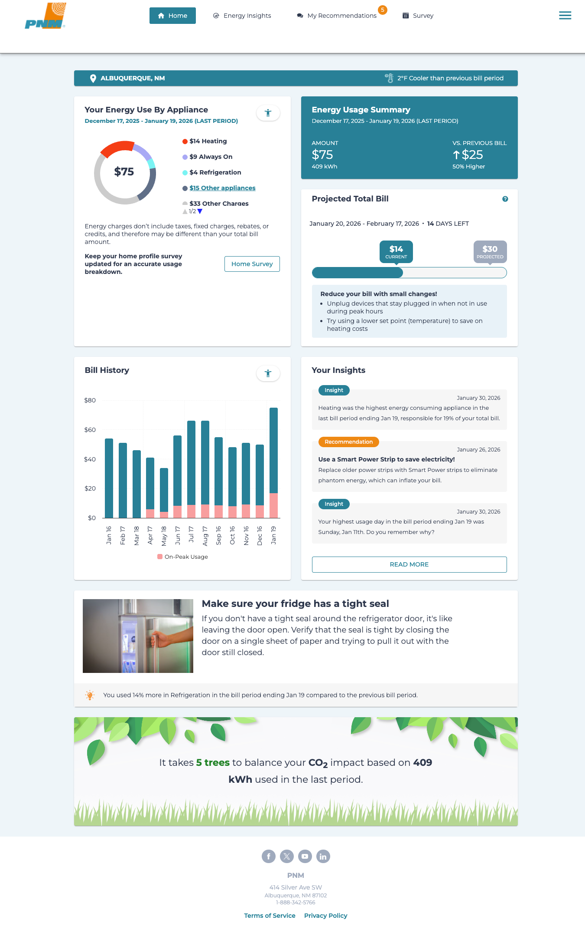
Key findings-Customer awareness
Customer Awareness
86% of customers are aware of the monthly Energy Usage Report, showing strong visibility and reach
Report Perceived Value
95% of customers find the report helpful or very help for understanding energy usage and costs

Slide 4
Key findings-Customer awareness
Bill Project Report
79% of customers reviewed their bill projection alert that is sent once a month at the mid point of their billing cycle
87% of customers find the report helpful in managing their energy usage and costs

Slide 5
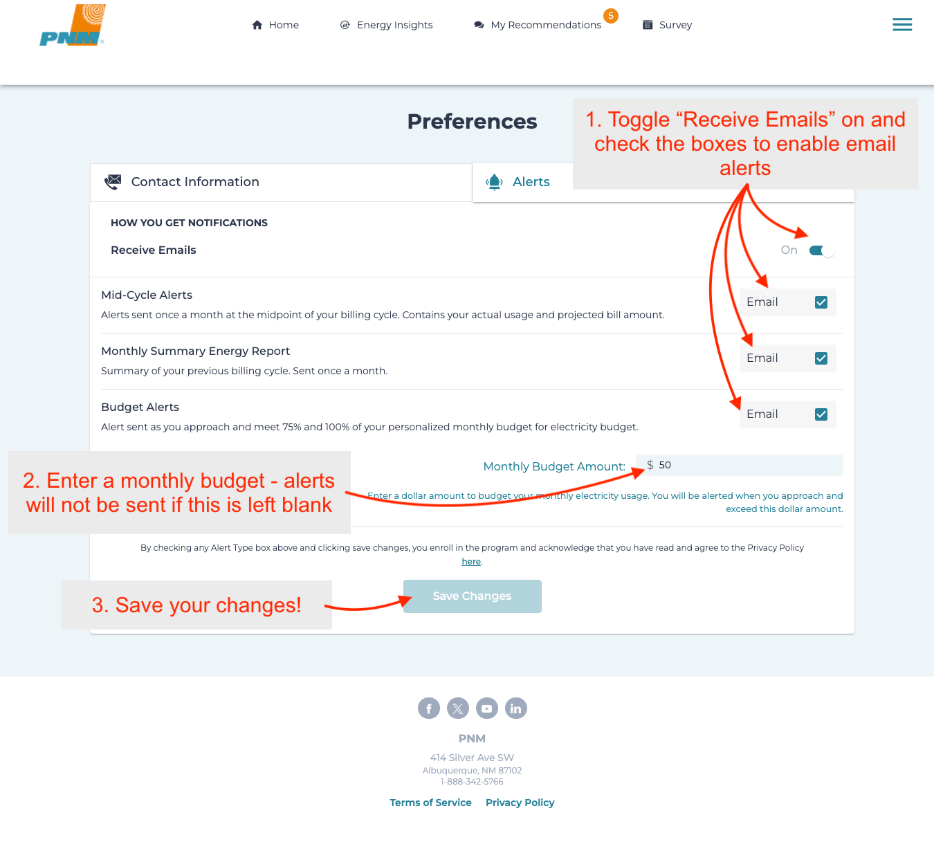
Key findings-Customer Awareness
Budget Alerts
42% of respondents indicated they would like to set up a budget alert, however, don’t know how to set this up.

Slide 6
Insights/Learning opportunities
Learning Opportunities & Feedback
Customers want more convenience and clearer guidance
Aligns with 2026 TOD Strategy and digital enhancement
Common Feedback
Interest in PNM mobile app
More access points to home energy dashboard
  PNM.com account homepage
  On customer’s bill
Customer Insights
Customers value monthly energy usage reports
Top features used
Appliance level usage
Historical usage trends
Hourly usage, especially
on-peak

Slide 7
Summary/next steps
Summary
Confusion is driven by navigation and feature awareness, not the report content.
Next Steps
Create PDF’s and 20-30 second audio guides, on navigating reports and understanding on/off-peak hours and seasonal shifts
Add materials in customer emails, the TOD website, and energy usage reports
Send a mid-March nurture email with budget alert instructions and a reminder of on/off-peak hours
Provide rotating educations PDFs and audio guides every other month
New Enhancement- Work in Progress-to provide text message reminders for seasonal changes
Conduct a follow-up survey six months (July) after enhancements to measure improvements

