Slide 1
Pricing Advisory Committee (PRAC)
september 9, 2025

Slide 2
SEPTEMBER 9 prac Agenda
I. Low-income rates/riders from other IOUs
Categories of low-income rates/riders
Eligibility
Qualifying / application process
Rate types / amounts
Monthly bill discounts
Who pays? A focus on residential surcharges.
Program evaluation
II. Low-income assistance applied in New Mexico
Federal programs participation
Back-of-the-envelope calculation of common low-income rate designs in other IOUs
Pros & cons of common methods discussion
III. PNM Rate Design Principles
Working group – not for reproduction

Slide 3
i. Low-income rates and programs
Working group – not for reproduction

Slide 4
Low-income rates and programs
Utilities with Percentage of Income Payment Plan (PIPP)
California | Colorado | Illinois | Ohio | Pennsylvania | Virginia
Pacific Gas & Electric | Black Hills Energy | Ameren Illinois | AEP Ohio | Duquesne Light Company | Appalachian Power Company
San Diego Gas & Electric | PSCo - Xcel | ComEd | AES Ohio | Metropolitan Edison | Dominion Energy
Southern California Edison |  |  | Duke Energy | PECO
 |  |  | The Illuminating Company | Pennelec
 |  |  | Ohio Edison | Pennsylvania Power
 |  |  | Toledo Edison | UGI Utilities
 |  |  |  | West Penn Power
Working group – not for reproduction

Slide 5
Low-income rates and programs
Utilities offering Discount Rate
Arizona Public Service | ComEd, Exelon (IL) | Montana-Dakota Utilities Co. (MT) | Rhode Island Energy | Potomac Edison Corp (WV)
Liberty, Algonquin Power & Utilities Corp | Cleco Corporate Holdings (LA) | NorthWestern Energy (MT) | Green Mountain Power (VT) | Pacific Power (OR)
Pacific Gas & Electric | Eversource Energy (MA) | Eversource Energy (NH) | Avista Utilities (WA) | Portland General Electric (OR)
San Diego Gas & Electric | National Grid (MA) | Liberty, Algonquin Power & Utilities Corp (NH) | PacifiCorp (WA) | Minnesota Power
Southern California Edison | Until Corporation (MA) | Until Corporation (NH) | Puget Sound Energy (WA) | DTE Energy (MI)
Eversource Energy (CT) | The United Illuminating Company, Avangrid (CT) |  | Appalachian Power Co. (WV) | Mon Power (WV)
Working group – not for reproduction

Slide 6
Low-income rates and programs
Utilities offering Flat Discount
Alabama Power | Georgia Power | Indiana Michigan Power (MI) | Evergy (MO) | Orange and Rockland Utilities, ConEd (NY)
Tucson Electric Power | Kentucky Power | Xcel Energy (MI) | Liberty, Algonquin Power & Utilities Corp (MO) | PSEG Long Island (NY)
Unisource Energy (AZ) | Central Maine Power | Minnesota Power (MN) | Central Hudson Gas & Electric (NY) | Rochester Gas and Electric
Oklahoma Gas & Electric (AR) and (OK) | Versant Power (ME) | Otter Tail Power Company (MN) | Consolidated Edison Company of New York | Duke Energy Progress (NC)
Public Service Company of Colorado | Consumers Energy (MI) | Mississippi Power | National Grid (NY) | PPL Electric Utilities (PA)
Pepco, Exelon Corp (Washington DC) | DTE Energy (MI) | Ameren Missouri | New York State Electric & Gas | Rocky Mountain Power (UT)
Working group – not for reproduction

Slide 7
Low-income rates and programs
Characteristics applicable to all the different rates
Eligibility
Qualifying / application process
Rate types / amounts
Monthly bill discounts
Who pays?
Program evaluation
Working group – not for reproduction

Slide 8
Low-income rates and programs
Characteristics applicable to all the different rates
Eligibility
Working group – not for reproduction

Slide 9
Low-income rates and programs
eligibility
Income*
200% FPL
250% FPL (HH 3+)
Vulnerable populations
Elderly (60 or 65+)
Assistance program qualified
LIHEAP*
SNAP
130% FPL (NY) & vulnerable person
Medicaid
150% FPL (MI, PA, UT)
Disabled
160% FPL (CT)
<60% median state income (CT. NH, OR), <80% (CO, WA)
Chronic medical condition
Child under age 5 or 6
TANF
*Either related to a percentage of the Federal Poverty Level or the median income of the state.
*Seems to be the most common.
Working group – not for reproduction

Slide 10
Low-income rates and programs
Eligibility, continued…
Additional State or Federal assistance programs used to determine eligibility
Lifeline Telephone Service Program
Veterans Disability or Survivors Pension
Bureau of Indian Affairs General Assistance
Food Distribution Program on Indian reservations
Tribal Lands Head Start
Federal Public Housing assistance
Supplemental Security Income (SSI)
Working group – not for reproduction

Slide 11
Low-income rates and programs
Characteristics applicable to all the different rates
Qualifying / Application Process
Working group – not for reproduction

Slide 12
Low-income rates and programs
Application
In some states, customers apply through Community Action Agencies,
  Rocky Mountain Power (UT) uses UT Dept of Workforce Services
  EPE (TX) uses TX HHS SNAP client database or Company-recognized public assistance agencies in counties in service territory
Application on-line or mailed into the utility
Some utilities require customers to requalify every 2-4 years.
Working group – not for reproduction

Slide 13
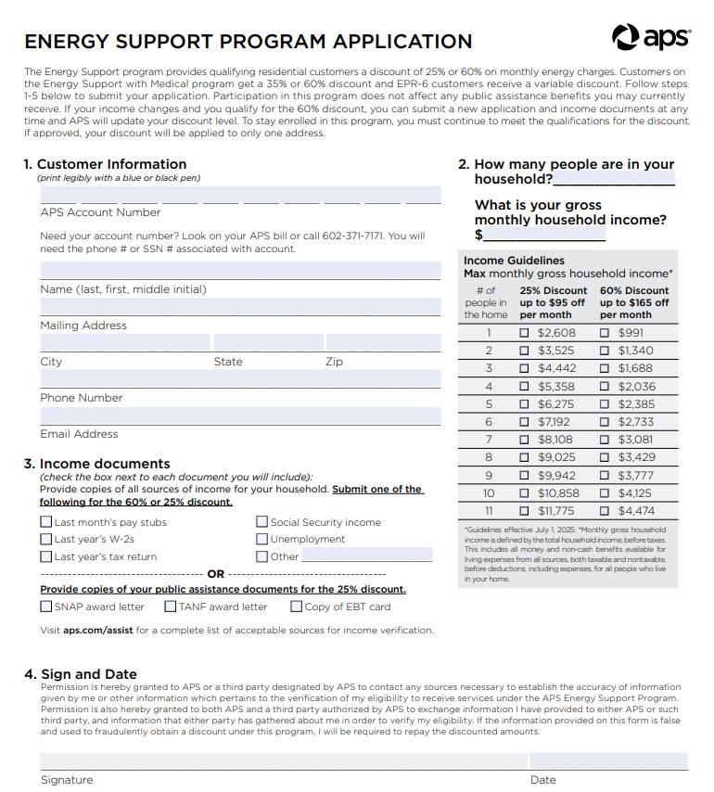
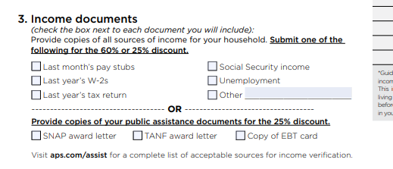
Low-income rates and programs
On-line or mail in application
Working group – not for reproduction

Slide 14
Low-income rates and programs
One advantage of using liheap-qualifications
LIHEAP gathers the following customer data:
Household number
Applicant name
Date application approved
Heating fuel type
Household size
Applicant gender
Applicant phone number
If HH member age 60+
If applicant is disabled
Monthly HH income
HH FPL
Residence address & mailing address
Account number
LIHEAP benefit amt
Working group – not for reproduction

Slide 15
Low-income rates and programs
Characteristics applicable to all the different rates
Rate types/amounts
Working group – not for reproduction

Slide 16
Low-income rates and programs
Discounts offered
Discount characteristics | Notes
Tiered discounts | APS (AZ), Eversource Energy and United Illuminating Co (CT), ComEd (IL), National Grid (MA), Eversource Energy/Liberty/Until Corp (NH), Rhode Island Energy
Seasonal discount | NorthWestern Energy (MT), Appalachian Power (WV), Kentucky Power
Discount by heating type | Electric vs non-electric heating.
Discount period | Typically, monthly, but in Maine it appears to be annual amount.
Maximum discount period | Evergy (MO) offers a monthly discount of $65, but for a maximum 12 consecutive months.
Working group – not for reproduction

Slide 17
Low-income rates and programs
Characteristics applicable to all the different rates
Monthly Bill discounts
Working group – not for reproduction

Slide 18
Low-income rates and programs
PIPP (% of monthly HH income)
CA – 4%
IL – 6%
Flat Discount
Often the customer charge
Discount rate
WV: 20% Appalachian Power, Mon Power, Potomac Edison
Electric heat (3-6% CO, 10% OH, 10% VA)
Gas (2-3% CO, 5% OH)
Non-electric heat (2-3% CO, 6% VA)
$7.58 / $8.50 / $9 / $13 / $14.50 / $16 / $20
Seasonal discounts tend to be larger (i.e. Kentucky Power $175/month Jan-April)
Varies by heating type. Electric heating discount > Non-electric heating discount.
WA: 5-45% Puget Sound Energy, 15-72% PacifiCorp, 15-94% Avista
VT: 25% plus one-time arrearage forgiveness, Green Mountain Power
RI: 25-30% Rhode Island Energy
CA: 18% - 30%
NH: 8-76% Eversource Energy, Liberty, Until Corp
MT: 15-25% Northwestern Energy, 30% Montana-Dakota Utilities
LA: 25% on fuel portion of bill Cleco
Bill discounts
Working group – not for reproduction

Slide 19

Low-income rates and programs
Bill discounts, ctd…
Some utilities base discount amount on electricity usage:
Otter Tail Power Company
$15 (<7,500 kWh/year)
$25 (7,500 – 12,000 kWh/year)
$40 (12,000+ kWh/year)
Working group – not for reproduction

Slide 20
Low-income rates and programs
Characteristics applicable to all the different rates
Who Pays?
Working group – not for reproduction

Slide 21
Who pays?
A survey of residential charges to fund low-income riders
Kentucky Power: $0.40/bill
Minnesota Power: $1.28/bill
Rocky Mountain Power (UT): $0.16/bill
Indiana Michigan Power (MI): $1.25/retail billing meter/month
OtterTail Power (MN): $0.32/month
Duke Energy Progress, $0.00034/kWh (all other rates schedules pay $/bill)
Union Electric (MO): couldn’t find details, just a list of rates schedules that pay
Table 3-5 Residential Rate Surcharges
Colorado Utility | Fuel Type | Residential Monthly Fee Nov 2023
Atmos Energy | Gas | $1.00
Black Hills | Gas | $0.04
 | Electric | $0.51
CNG | Gas | $1.00
Public Service | Gas | $1.00
 | Electric | $1.00

Slide 22
Low-income rates and programs
Characteristics applicable to all the different rates
Program Evaluation
Working group – not for reproduction

Slide 23
Low-income rates and programs
Colorado’s evaluation of PIPP (March 2024)
Enrollment
Multiple methods
Automatic
Coordinate other low-income, EE, Financial Assistance programs
Quick application process
$ Benefit$
Tiered benefit amounts
Frequent distribution
Arrearages forgiveness
Energy burden <= 6%
Best Practices
Awareness
Market to low-income customers
Standard name within state
Spanish-speaking customer service reps
Who pays?
All rate classes
Working group – not for reproduction

Slide 24
Low-income rates and programs
Colorado utilities (gas & electric) pipp program evaluation
Table 3-9 Program Participants and Costs for Program Year 2021-2022
 | Atmos Energy | Black Hills – electric | Black Hills – gas | CNG | Public Service – electric | Public Service - gas
# of participants | 879 | 948 | 363 | 194 | 34,205 | 44,872
Total Admin Costs | $1,168 | $23,960 | $18,984 | $9,651 | $249,215 | $124,759
Fixed Bill Credits | $67,615 | $1,120,020 | $179,336 | $87,662 | $11,036,108 | $4,385,295
Arrearage Credits | $88,170 | $97,439 | $17,892 | $6,867 | $0 | $689,633
Other Costs | $0 | $1,564 | $3,274 | $0 | $100,000 | $100,000
Working group – not for reproduction

Slide 25
Low-income rates and programs
These programs if applied at PNM
Working group – not for reproduction

Slide 26
II. Mini analysis of these programs at pnm
what would these programs look like for pnm? A very basic analysis
  Energy burden statistics
  Federal aid in New Mexico and their income eligibility guidelines
  Standard programs examined to consider cost
    Flat Discount (discount the customer charge)
    PIPP (assume 3% of monthly income) is the acceptable energy burden for the base rate component of bills)
    Discount Rate (a summer discount only with tiers)
Working group – not for reproduction

Slide 27
Energy burden in NM recap from august 19
Low-Income Energy Affordability data (Lead) tool – us. Dept of energy
 | Energy Burden Breakdown by FPL
Fuel Type | 0-100% | 100-150% | 150-200% | 200-400% | 400%+
Electricity | 10% | 4% | 3% | 2% | 1%
Gas | 6% | 3% | 2% | 1% | 1%
Other | 1% | 1% | 0% | 0% | 0%
Total Energy Burden | 17% | 8% | 5% | 3% | 2%
Housing Count | 120,266 | 78,297 | 74,097 | 234,011 | 306,180
 |  | # HH <200% FPL | 272,660
 |  | Pct HH <200% FPL | 34%
 | Energy Cost Breakdown by FPL
Fuel Type | 0-100% | 100-150% | 150-200% | 200-400% | 400%+
Electricity | $ 1,058 | $ 1,010 | $ 1,052 | $ 1,118 | $ 1,204
Gas | $ 666 | $ 745 | $ 787 | $ 752 | $ 803
Other | $ 158 | $ 137 | $ 131 | $ 123 | $ 101
Total Energy Costs | $ 1,882 | $ 1,892 | $ 1,970 | $ 1,993 | $ 2,108
Housing Count | 120,266 | 78,297 | 74,097 | 234,011 | 306,180
 | Income Breakdown by FPL
 | 0-100% | 100-150% | 150-200% | 200-400% | 400%+
Avg Inc. NM | $ 10,650 | $ 25,125 | $ 36,314 | $ 60,632 | $ 149,492
Working group – not for reproduction
https://www.energy.gov/scep/low-income-energy-affordability-data-lead-tool

Slide 28
Low-income rates and programs
Who qualifies? Income eligibility for Federal aid programs in nm
SNAP, Commodity Supplemental Food Program (USDA), Emergency Food Assistance Program (USDA), and Medicaid in NM administered by NM Health Care Authority
YES New Mexico has application for SNAP and WIC
Medicaid
Childless Adults, 138% FPL
Seniors and People with disabilities, 74% to 222% FPL
Children, 305% FPL
Commodity Supplemental Food Program
Federal Senior Poverty Guidelines 150%
Supplemental Nutrition Assistance Program (SNAP)
Federal Poverty Guidelines
100% FPG Net Income
130% FPG Gross Income
200% FPG Gross Income for Categorical Eligibility
The Emergency Food Assistance Program
~ 175% FPL
Working group – not for reproduction

Slide 29
Low-income rates and programs
Federal aid program in NM 2022 [USDA, food and nutrition service]
SNAP (FY 2022)
  Total Participants 492,516
  258,863 households
  81% of NM households receiving SNAP in FY 2022 had income at or below poverty line
MEDICAID (July 2025 Health Care Authority Dashboard)
  809,454 New Mexicans enrolled (38.23% of NM’s population)
  37% are children, 14% have 3+ chronic conditions
WIC
  20,200 eligible women (8,200 participants)
  According to Santa Fe New Mexican, if a family applies to Medicaid, SNAP or TANF, automatically integrated into WIC system if certain criteria met
Working group – not for reproduction

Slide 30
Low-income utility research if applied to pnm
Discount the customer charge
Residential 1A Customer Charge (effective April 1, 2026) $11.93
 | # of customers, (estimated Dec 2023) | Annual Cost
100% of FPL | 49,673 | ($7,111,187)
150% of FPL | 75,689 | ($10,835,637)
200% of FPL | 123,516 | ($17,682,551)
250% of FPL | 178,557 | ($25,562,220)
Working group – not for reproduction

Slide 31
Low-income utility research if applied to pnm
A pipp thought experiment
Federal Poverty Level | # of customers, (estimated Dec 2023) | Avg July2023 kWh | Avg Dec2023 kWh | Est. inc*
100% | 49,673 | 730 | 567 | $14,488
101-150% | 26,016 | 794 | 610 | $36,246
151-200% | 47,830 | 765 | 577 | $39,666
201-250% | 55,038 | 786 | 577 | $50,832
No estimated inc | 30,450 | 733 | 580
Not low income | 277,659 | 917 | 630 | $114,591
Working group – not for reproduction

Slide 32


Low-income utility research if applied to pnm
Pipp thought experiment, continued….
July 2023
Federal Poverty Level | Avg July 2023 kWh | Avg July 2023 base rates bill | Est. Monthly Income | Energy burden, base rates
100% | 730 | $93.85 | $1,207.34 | 7.8%
101-150% | 794 | $103.45 | $3,020.48 | 3.4%
151-200% | 765 | $99.11 | $3,305.47 | 3.0%
201-250% | 786 | $102.17 | $4,236.03 | 2.4%
December 2023
Federal Poverty Level | Avg Dec 2023 kWh | Avg Dec 2023 base rates bill | Est. Monthly Income | Energy burden, base rates
100% | 567 | $69.74 | $1,207.34 | 5.8%
101-150% | 610 | $76.12 | $3,020.48 | 2.5%
151-200% | 577 | $71.19 | $3,305.47 | 2.2%
201-250% | 577 | $71.22 | $4,236.03 | 1.7%
Working group – not for reproduction

Slide 33
Low-income utility research if applied to pnm
Pipp thought experiment, conclusion
July 2023
Federal Poverty Level | Est. Monthly Income | Avg July 2023 base rates bill | PIPP base rates limit 3% | July PIPP discount
100% | $1,207.34 | $93.85 | $36.22 | ($57.63)
101-150% | $3,020.48 | $103.45 | $90.61 | ($12.83)
151-200% | $3,305.47 | $99.11 | $99.16 | $0.05
201-250% | $4,236.03 | $102.17 | $127.08 | $24.91
December 2023
Federal Poverty Level | Est. Monthly Income | Avg Dec 2023 base rates bill | PIPP base rates limit 3% | Dec PIPP discount
100% | $1,207.34 | $69.74 | $36.22 | ($33.52)
101-150% | $3,020.48 | $76.12 | $90.61 | $14.50
151-200% | $3,305.47 | $71.19 | $99.16 | $27.98
201-250% | $4,236.03 | $71.22 | $127.08 | $55.86
Working group – not for reproduction

Slide 34
Low-income utility research if applied to pnm
PIPP 3% energy burden base rates
 | # of customers, (estimated Dec 2023) | July PIPP Discount | Total Discount to maintain 3% PIPP, July | December PIPP Discount | Total Discount to maintain 3% PIPP, December | 2-month Total
100% of FPL | 49,673 | ($57.63) | ($2,862,433) | ($33.52) | ($1,664,958) | ($4,527,391)
150% of FPL | 26,016 | ($12.83) | ($333,911) |  |  | ($333,911)
200% of FPL | 47,830
250% of FPL | 55,038
Working group – not for reproduction

Slide 35
Low-income utility research if applied to pnm
Seasonal Discount rate example
 | # of customers, (estimated Dec 2023) | Avg June 2023 kWh | Avg July 2023 kWh | Avg Aug 2023 kWh | Avg customer Summer Energy charges | Summer Tiered Discount per customer | Remaining Summer energy charge | Total cost
100% of FPL | 49,673 | 518 | 730 | 815 | $227.06 | ($200) | $27.06 | ($9,934,600)
150% of FPL | 26,016 | 563 | 794 | 894 | $254.96 | ($150) | $104.96 | ($3,902,400)
200% of FPL | 47,830 | 543 | 765 | 860 | $242.69 | ($125) | $117.69 | ($5,978,750)
250% of FPL | 55,038 | 556 | 786 | 883 | $250.95 | ($50) | $200.95 | ($2,751,900)
Working group – not for reproduction

Slide 36
Low-income utility research if applied to pnm
Discuss Pros and cons of the various methodologies
This table is from Colorado’s PIPP evaluation of the electric and gas utilities’ implementation. These evaluation characteristics are a good starting point for discussion:
Should there be a customer participation cap?
Limits on total annual credit amount? Administration costs?
Is it important for discount to be easy to understand?
What should the income cutoff for the discount be?
And more…….
Table 3-9 Program Participants and Costs for Program Year 2021-2022
 | Atmos Energy | Black Hills – electric | Black Hills – gas | CNG | Public Service – electric | Public Service - gas
# of participants | 879 | 948 | 363 | 194 | 34,205 | 44,872
Total Admin Costs | $1,168 | $23,960 | $18,984 | $9,651 | $249,215 | $124,759
Fixed Bill Credits | $67,615 | $1,120,020 | $179,336 | $87,662 | $11,036,108 | $4,385,295
Arrearage Credits | $88,170 | $97,439 | $17,892 | $6,867 | $0 | $689,633
Other Costs | $0 | $1,564 | $3,274 | $0 | $100,000 | $100,000
Working group – not for reproduction

Slide 37
RATE DESIGN PRINcIPLES - What is pnm trying to achieve?
Align Cost Causation with Cost Recovery
ETA
Fairness and Affordability
Less Volatile / More Predictable
Bills and Revenue
Reasonable
Sustainable
Modern Rate Design
Equitable
Working group – not for reproduction

Slide 38
Next meeting
October 14, 2025 (registration link on PNM.com/prac)
1. Low-income rate proposals
2. Road to Default TOD rate design
Working group – not for reproduction

