Slide 1
Pricing Advisory Committee
Meeting #3 December 6, 2023

Slide 2
Disclosure regarding forward looking statements
The information provided in this presentation contains scenario planning assumptions to assist in the Pricing Advisory Committee (PRAC) public process and should not be considered statements of the company’s actual plans. Any assumptions and projections contained in the presentation are subject to a variety of risks, uncertainties and other factors, most of which are beyond the company’s control, and many of which could have a significant impact on the company’s ultimate conclusions and plans. For further discussion of these and other important factors, please refer to reports filed with the Securities and Exchange Commission. The reports are available online at www.pnmresources.com.
The information in this presentation is based on the best available information at the time of preparation. The company undertakes no obligation to update any forward-looking statement or statements to reflect events or circumstances that occur after the date on which such statement is made or to reflect the occurrence of unanticipated events, except to the extent the events or circumstances constitute material changes in the Integrated Resource Plan that are required to be reported to the New Mexico Public Regulation Commission (NMPRC) pursuant to Rule 17.7.4 New Mexico Administrative Code (NMAC).

Slide 3
Meeting Agenda
Review Mission and Goals of the PNM Pricing Advisory Committee (“PRAC”)
Background
PNM’s proposed allocation methodology
  Overview
  Benefits over current method
  Alignment to Cost Causation
  Walkthrough of Example and Results
Near Term Schedule & Next Steps

Slide 4
PNM PRICING ADVISORY COMMITTEE: WHY WE ARE HERE

Slide 5
The focus of the meeting is PNM’S CLASS COST OF SERIVCE AND RATE DESIGN POLICY
MISSION & Goals
The mission of the Pricing Advisory Committee (“PRAC”) is to collectively work with Public Service of New Mexico (“PNM”) stakeholders to explore, develop and institute rate design and pricing policy matters that serve to achieve the goal of state mandates on energy policy.
The process will be considered a success if:
PNM and stakeholders each produce proposals and alternatives to the proposals.
Consensus on the path forward for a proposal is reached prior to the filing of said proposal in a rate case.
In absence of a consensus, a good faith effort was made to reach consensus such that PNM and Stakeholders feel that all available alternatives were considered on their merits.

Slide 6
The focus of the meeting is PNM’S CLASS COST OF SERIVCE AND RATE DESIGN POLICY
MISSION & Goals
The PRAC will conduct the following key activities to accomplish its expected outcome.
Review cost of service study modifications, especially but not limited to allocation methodologies, to ensure costs are appropriately functionalized, classified, and allocated as the cost drivers of PNM change.
Review prospective rate design modifications, including but not limited to newly designed rate schedules and updates for fairness to customers while balancing the rate design principles of gradualism, cost causation and appropriate allocation methodologies.
Explore and understand solutions proposed and implemented in other jurisdictions to gather lessons learned and incorporate those into recommendations put forward by the PRAC.
Ensure a clear understanding of the specific stakeholder issues and needs regarding cost allocation and rate design that the PRAC’s proposals are expected to address.
Brainstorm and develop alternatives to the proposed changes that address the concerns and needs of the various stakeholders and customer types in PNM’s service territory.
Identify rate design strategies that send adequate price signals to customers that promote efficient usage of system resources.

Slide 7




The focus of the meeting is PNM’S CLASS COST OF SERIVCE AND RATE DESIGN POLICY
Meeting Ground Rules
Participants will speak one at a time and refrain from interrupting others.
01
Participants are encouraged to voice questions and comments at any time
02
Participants will wait to be recognized by the facilitator before speaking or will wait for an open question period.
03
Participants will ensure that all members who wish to have an opportunity to speak are afforded the chance to do so.
04

Slide 8
PNM PRODUCTION COST ALLOCATION PROPOSAL (CONCEPT?)

Slide 9
TRANSITION milestones
BACKGROUND
400 lbs/MWh CO2 2023*
200 lbs/MWh CO2 2032
Carbon-free by 2040
40% RPS 2025
50% RPS 2030
80% RPS 2040
2022
2024
2026
2028
2030
2032
2034
2036
2038
2040
2042
2023
2025
2027
2029
2031
2033
2035
2037
2039
2041
2026 RFP resources
online
Valencia PPA expires 2028
End of Reeves depreciable life
2030
FCPP exit 2026-2031
Red Mesa PPA expires 2036
*Rules not yet promulgated by NMPRC

Slide 10
REVENUE REQUIREMENT, CLASS COST OF SERVICE & RATE DESIGN
BACKGROUND
Revenue Requirement
Compares the revenues of the utility to its expenses to determine the overall level of revenue necessary to operate the utility and afford the utility an opportunity to earn a regulated rate of return on its capital investments. [The size of the pie]
Class Cost of Service
Equitably allocate the system revenue requirement among the various customer classes [The size of the pie pieces]
Rate Design (Prices)
Design rates for each rate class to recover each classes allocated cost to serve including considerations of other rate design goals and objectives. [How each piece is served]
Customer Behavior

Slide 11
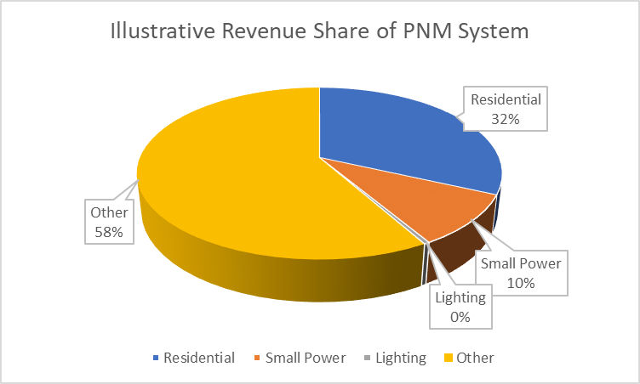
CLASS COST OF SERVICE STUDY (CCOSS): PURPOSE
BACKGROUND
To attribute the utility cost of service to different customer classes based on how those customers caused the utility to incur costs necessary to provide utility service.
Sometimes the cost a given customer or customer class imposes on the system is known.
If the specific cost to serve a customer is not known for some or all of its use of the system, a class cost of service study is performed to estimate the cost to serve imposed on the system by each class of customers.
The final result of a class cost of service study is a determination of the amount of annual revenue a utility must recover from each customer class to cover each classes cost of service.

Slide 12
BACKGROUND
Elements of Class Cost of Service
Step 1: Functionalization: “To which operating function do the costs belong?”
This step assigns the total revenue requirement to specified operating utility function categories (e.g., generation, transmission, distribution)
Step 2: Classification: “What caused the costs?”
  This step further assigns the functionalized costs into categories based on primary cost drivers for those costs, i.e., based on whether the costs are sensitive to providing capacity, energy, or adding customers
Step 3: Allocation: “How much should each rate class pay?”
  This final step allocates the functionalized and classified costs to the various customer rate classes, which is the final result of the class cost of service study
Notes:
Recall that what we are interested in with a Class Cost of Service Study is determining how to allocate the total revenue requirement across the various customer classes.
Now, we are going to discuss the various steps involved in a CCOSS. The first step is called functionalization and asks to what operating function a cost belongs (i.e. generation, transmission, or distribution). The next step is classification which further assigns the functionalized costs into categories based on the drivers of those costs, i.e. are they providing energy, capacity, or acquiring new customers? And, the third and final step in a CCOSS is allocation, which is allocating the functionalized and classified costs to the various rate classes.

Slide 13
PNM’s Proposal: Production Allocation Overview
Objective: Synchronize cost allocation with planning process which drives investments in the utility system and create internally consistent allocations across recovery mechanisms
Fundamental Concept for Allocation of Production Functional Costs:
  Two-Step process at the outset to decompose hourly class gross load data into two data sets. (i) hourly class loads served by renewable energy resources; and (ii) hourly class net loads.
  i. In the first step we identify renewable energy used to serve customer loads including the charging of storage. This will serve as the basis the for the allocation of renewable resource cost (both ppa and utility owned)
  ii. Next, we deduct the loads served by renewable resources from the gross class loads to yield customer class net loads. The energy ratio of the class net loads will serve as the basis for the allocation of fuel and non-renewable purchased power costs. Class net loads will also be used to develop a class allocator for non-renewable production-demand related costs using the class contributions to the hours with the highest loss of load risk.

Slide 14
PNM’s Proposal: Production Allocation Rationale / call to action
Relative to the current cost allocation methods being used, PNM’s proposal:
More accurately attribute costs to customer classes
More closely aligns with cost-causation
More robust / stable / predicable method to adapt to the expected changes in the system
Will incentivize conservation and efficiency in use of the system
Easy to align costs allocation with rate recovery and ensure proper price signals are sent that directly tie to the system planning and operations

Slide 15
PNM’s Proposal: Production Allocation – CAUSAL LINK ON TWO STEP “DECOMPOSITION” & NET LOAD LOLP BASED ALLOCATOR
Majority of system energy is produced by thermal resources
Production system is almost fully dispatchable
Majority of supply planning risk is generator outages at time of system gross peak and weather-related variations in the system gross peak
Significant amount of system cost is variable / fuel costs.
Majority of system energy produced by non-dispatchable renewable energy resources
Remainder of system responds / follows the renewable resources to balance and serve net load
Majority of supply planning risk will shift to weather events that cause high loads combined with low renewable output conditions – especially for sustained periods.
Weather becomes “fuel” as renewable energy resources produce energy with little or no variable cost
Thermal heavy (traditional) system characteristics
VS
Renewable heavy / deeply-decarbonized system characteristics

Slide 16
PNM’s Proposal: Production Allocation – CAUSAL LINK ON TWO STEP “DECOMPOSITION” & NET LOAD LOLP BASED ALLOCATOR
Renewable resources are energy classified, just like fuel or other energy related costs.
The decomposition will occur on an hourly energy ratio basis
Netting renewable generation from class gross loads prior to allocating production-demand related costs effectively provids an implicit capacity credit to the renewable resources
The more a class uses energy when renewable resources are producing, the more renewable costs that class will pay and reduce its allocation of non-renewable costs
Loss of load risk drives resource adequacy related investments and in turn is driven by net load patterns
Load served by Ren. / Ren. Energy Ratio
Gross Loads / Gross Energy Ratio
Net Loads / Net Energy Ratio

Slide 17
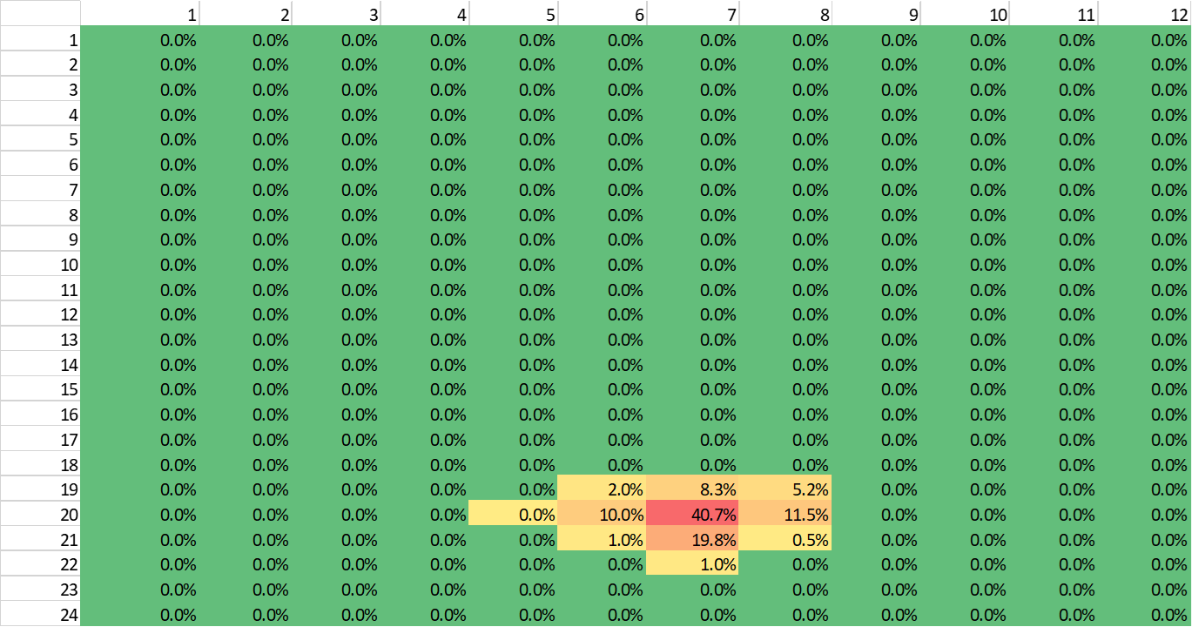
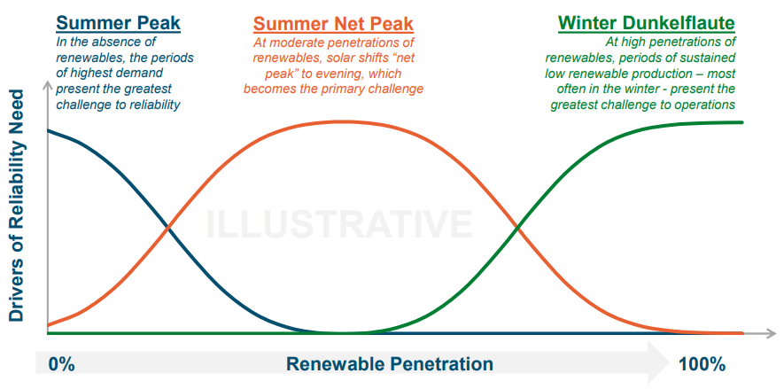
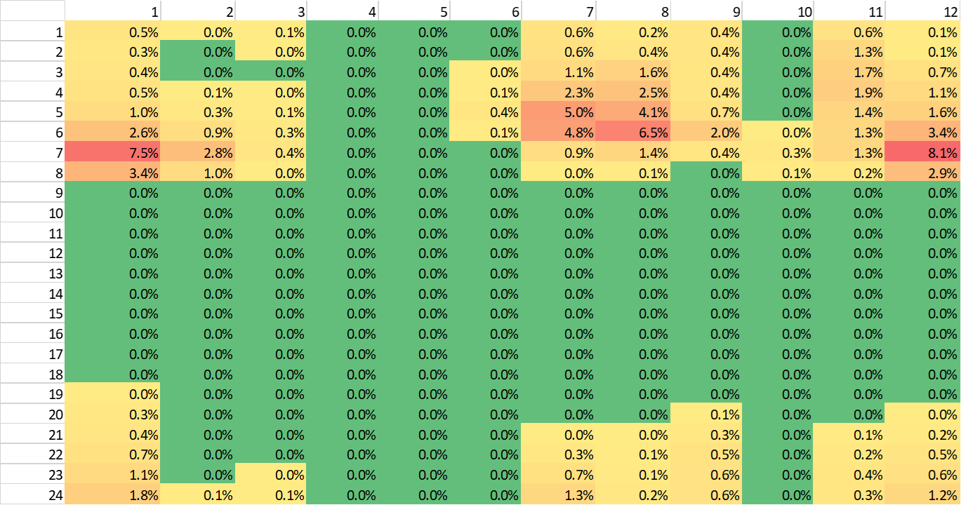
PNM’s Proposal: Production Allocation – CAUSAL LINK ON TWO STEP “DECOMPOSITION” & NET LOAD LOLP BASED ALLOCATOR
Historically, Loss of Load Risk was aligned with Gross Peak Load hours, but as systems add renewable resources and remove firm, dispatchable generation from the supply, the risk profile shifts which in turn alters the which hours are driving investments.
PNM LOLE risk by month and hour of day – 2025 above, 2040 below (prelim 2023 IRP).

Slide 18
PNM’s Proposal: Production Allocation RESULTS SUMMARY

Slide 19
PNM’s Proposal: Production Allocation RESULTS SUMMARY

Slide 20
PNM’s Proposal: Production Allocation Walk through example – decomposition of class loads
Gross Load | Gross Load
Hour | Class A | Class B | Class C | Total
1 | 50 | 30 | 20 | 100
2 | 65 | 30 | 25 | 120
3 | 100 | 30 | 20 | 150
Hourly Energy Ratio | Gross Load
Hour | Class A | Class B | Class C | Total
1 | 50% | 30% | 20% | 100%
2 | 54% | 25% | 21% | 100%
3 | 67% | 20% | 13% | 100%
Renewable
Hour | MWh
1 | 20
2 | 40
3 | 100
Step 1
Attribute hourly renewable production to hourly class load by hour energy-ratio share.
Load Served by Renewables | Gross Load
Hour | Class A | Class B | Class C
1 | 10 | 6 | 4
2 | 21.67 | 10 | 8.33
3 | 66.67 | 20 | 13.33
Class Net Load | Gross Load
Hour | Class A | Class B | Class C
1 | 40 | 24 | 16
2 | 43.33 | 20 | 16.67
3 | 33.33 | 10 | 6.67
Step 2
Subtract class load served by renewable from gross load to get class net loads

Slide 21
PNM’s Proposal: Production Allocation Walk through example
In the excel file, “Proposal Model Hourly 2025v1.5.xlsx” Start on the Class Gross Tab. This contains all the raw data necessary to perform the calculations
The EUE values were calculated using the SERVM model
The decomposition of “Class Loads Served by Renewables” and “Class Net Loads” can be found on the “Class Ren” and “Class Net” tabs respectively. Note that the Class Net Loads have been sorted from highest to lowest EUE.
The preceding example was simplified, the workbook is tracking charging energy and assumes that storage charges from renewables if renewables are available when charging prior to allocating renewable energy to the classes for hourly load service.

Slide 22
PNM’s Proposal: Production Allocation – development on non-renewable production-demand allocator
  Proposed LOLP based choice of hours is an allocation method that follows generally understood allocation principles for allocation of production-demand related costs and ties directly to PNM resource planning process.*
  Non-renewable resources will be used to balance the system and reliably operate the grid.
  Regardless of cost structure (utility owned or contracted) this would be the allocator used to attribute non-renewable production-demand related costs to classes regardless of recovery mechanism (Base Rates vs Rider)
  Depending on level of detail and data available, energy used to charge energy storage (including losses) could be reasonably allocated using this measure as well
Class Net Loads | Gross Load
Hour | Class A | Class B | Class C | Total
1 | 40 | 24 | 16 | 80
2 | 43.33 | 20 | 16.67 | 80
3 | 33.33 | 10 | 6.67 | 50
Total | 116.67 | 54 | 39.33 | 210
Allocate Non-Renewable Production Demand Related Costs by Calculating a Production Demand Allocator using Class Net Loads
* 1992 NARUC Electric Utility Cost Allocation Manual, Page 46, Multiple Coincident Peak Method

Slide 23
PNM’s Proposal: Production Allocation - development on non-renewable production-demand allocator
In the excel file, move to “Class Net” Tab. Near the top you will see the resulting Allocator:
PNM used the hours containing Top 75% of cumulative EUE. Which corresponds to 116 hours (~1.3%) in the year which are concentrated in the summer net peak
The Generation Production Allocator (called PNN Prod Prop above) is the average of the class contributions to the top 116 EUE hours.
3S1W does not align with LOLP risk hours
MST
3S Hours
1W

Slide 24
PNM’s Proposal: Production Allocation – Comparison to existing method
 | Residential | Small Power | Lighting | Other
3S1W (Gross) | 42.93% | 11.35% | 0.16% | 45.57%
PNM Proposal | 43.64% | 8.54% | 0.14% | 47.67%
Difference | 0.71% | -2.80% | -0.01% | 2.10%
3S1W (Net) | 43.44% | 8.82% | 0.02% | 47.73%
Difference to 3S1W Gross | 0.51% | -2.53% | -0.14% | 2.16%
Main cause for shifting of interclass allocations is due to the hours used the calculation and to a lessor extent, the correlation of class load shape to renewable shape.
Questions

Slide 25
PNM’s Proposal: Production Allocation – development of non-renewable production energy allocator
Class Net Loads | Gross Load
Hour | Class A | Class B | Class C | Total
1 | 40 | 24 | 16 | 80
2 | 43.33 | 20 | 16.67 | 80
3 | 33.33 | 10 | 6.67 | 50
Total | 116.67 | 54 | 39.33 | 210
 | 55.56% | 25.71% | 18.73% | 100%
  Traditional thermal assets will be dispatched and wholesale market activities will be undertaken to balance the system around the renewable generation.
  Regardless of cost structure (utility owned or contracted) this would be the allocator used to attribute non-renewable energy costs to classes.
  Benefits from Off-System Sales (bilateral and EIM) would also be appropriate to allocate using this allocator
Allocate Fuel and Non-Renewable Power Purchases Proportional to Class Net Energy Ratio

Slide 26
PNM’s Proposal: Production Allocation – development of renewable allocator
  Renewable energy resources will become the primary energy source of the system.
  Renewable energy resources are non-dispatchable and intermittent resources.
  Operators will attempt to maximize delivery of renewable energy to the extent possible, storing energy as necessary and balancing the system to serve all customers.
  Regardless of cost structure (utility owned or contracted) this would be the allocator used to attribute renewable energy costs to classes and regardless of recovery mechanism (FPPCAC vs RPS Rider).
  Be mindful of how to consider charging of energy storage
Class Loads Served by Renewables | Gross Load
Hour | Class A | Class B | Class C | Total
1 | 10 | 6 | 4 | 20
2 | 21.67 | 10 | 8.33 | 40
3 | 66.67 | 20 | 13.33 | 100
Total | 98.33 | 36 | 25.67 | 160
 | 61.46% | 22.50% | 16.04% | 100%
Allocate ALL Renewable Energy Costs Proportional to Class Loads served by Renewables

Slide 27
PNM’s Proposal: Production Allocation - development on non-renewable production-demand allocator
In the excel file, move to “Class Net” Tab. Near the top you will see the resulting Allocator:
The “Non Ren Energy Allocator” (called Non-Ren Fuel & PP above) is the energy ratio of non-negative net load hours across the entire year.
In the excel file, move to “Class Ren” Tab. Near the top you will see the resulting Allocator:
The “Renewable Allocator” (called Renewable above) is the energy ratio of load served by renewables across the entire year net of energy diverted to storage.

Slide 28
PNM’s Proposal: Production Allocation COMPARISON OF RENEWBALE AND NON-RENEWABLE ENERGY ALLOCATORS
 | Residential | Small Power | Lighting | Other
Energy (Gross) | 31.83% | 9.62% | 0.41% | 58.14%
Renewable | 28.61% | 10.93% | 0.24% | 60.21%
Diff to Gross Energy | -3.22% | 1.31% | -0.17% | 2.07%
Energy (Net) | 33.64% | 8.78% | 0.52% | 57.05%
Diff to Gross Energy | 1.81% | -0.83% | 0.11% | -1.08%
Note that the Renewable and Non-Renewable Energy allocators straddle the Gross Energy Allocator.

Slide 29
PNM’s Proposal: Production Allocation – SNAPSHOT OF OTHER ALLOCATORS

Slide 30
Near term schedule
FUTURE MEETING TIME & LOCATION
When:
Topic:
Start Time: 9:00 AM
Location: Virtual
When:
Topic:
Start Time: 9:00 AM
Location: Virtual

