Slide 1
PowerClerk User Guide
Public service company of new Mexico
FERC Generator interconnections

Slide 2
Powerclerk overview and benefits
PowerClerk is the online interconnection management system for pnm and will be used to:
Create and submit new FERC Generator Interconnection Requests
Monitor the progress of FERC Generator Interconnection Requests
Send and receive notifications about project status and updates
Submit all FERC Generator Interconnection related forms

Slide 3
ACCOUNT REGISTRATION
How to create a new powerclerk account
Register an existing powerclerk account

Slide 4
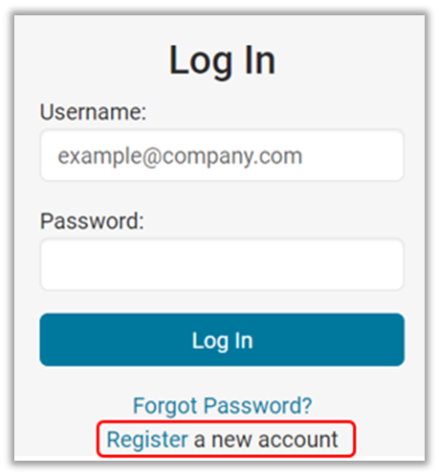
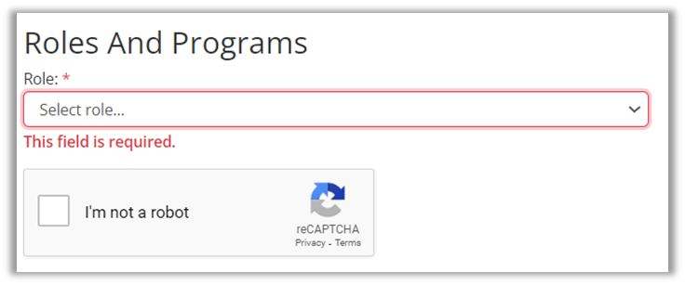
New account registration
For users logging into powerclerk for the first time
Step One
Click ‘Register’ a New Account, enter your email address, create a password in accordance with the requirements, and complete the rest of the required fields
Step Two:
Under Role, select “FERC_Interconnections_Applicant”
Step Three:
Click the reCAPTCHA button to verify you are not a robot and select “Register”
Step Four:
Click the one-time use link in the email sent to the previously entered email address to complete registration

Slide 5
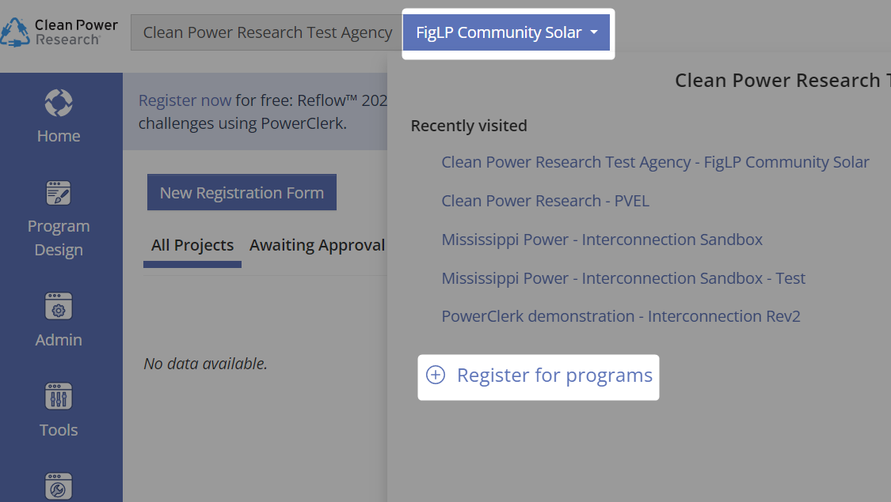
Already have a powerclerk account?
For users with an existing powerclerk account
Step One
Log Into your PowerClerk account. Any PowerClerk account will do
Step Two:
Select the current program at the top left then select “Register For Programs”
Step Three:
Under “Program to Add” select Public Service Company of New Mexico – FERC Interconnections

Slide 6
Navigating PowerClerk Programs
Select the current program dropdown at the top left of the screen to switch between all programs added to your account.
Other Programs
will appear here

Slide 7
Application Process
Submitting new interconnection request applications

Slide 8
New applications
Upon Logging into PowerClerk you will see blue buttons at the top of the screen.
Depending on your project type, select one pf the new application options at the top of the PowerClerk screen to begin your new application request.
New Large Generator Interconnection Requests will only be available for submission during the Cluster Request Window once a year. When the Cluster Request Window is open the “New Large Generator Interconnection Request” button will be available to select.

Slide 9
Application navigation
After selecting your request type, the Application Page Numbers will appear at the top of the form.
To quickly move to a specific part of the form, select one of these numbered page boxes.
To navigate from page to page, select the “Back” or “Next” buttons at the bottom of the page.

Slide 10
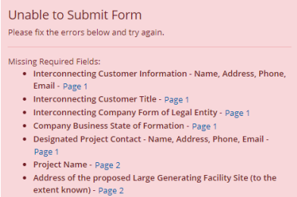
Application submission
To submit the application, click the blue “Submit” button at the bottom of the very last page.
If any required information has not been entered, a red section will appear at the bottom of the page when you select “Submit”.
Select the blue page link to navigate to the portion of the application you need to fill out and re-submit.

Slide 11
PowerClerk Home / Project Page
Navigating through projects

Slide 12
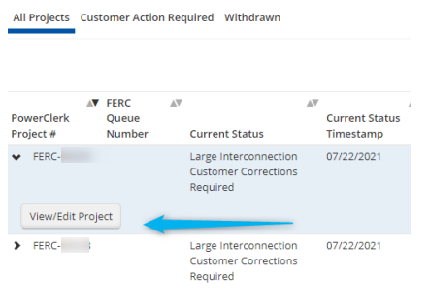
PowerClerk home screen
Your PowerClerk home Page will show you every project that you have started a request for, have submitted, or have been granted access to
To view an individual project landing page, select the project followed by “View/Edit Project”

Slide 13
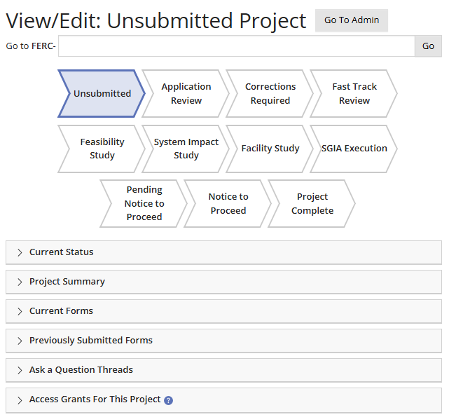
Powerclerk project landing page (view/edit)
The PowerClerk project landing page houses all the information, attachments, communications, and additional forms for your project.
Milestones: Blue highlighted chevrons below your project number will indicate what milestone your project is currently in.
Select the carrot (>) next to each menu to expand the section and reveal important information

Slide 14
Available Forms
How to submit additional project forms in powerclerk

Slide 15
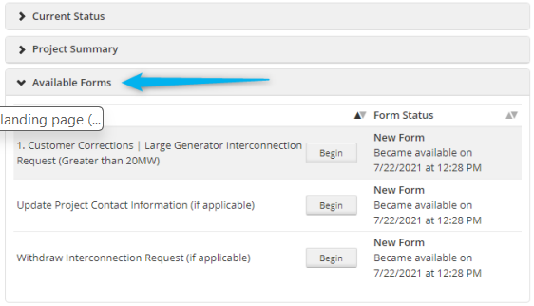
Powerclerk project landing page (view/edit)
Depending on the status of your application certain forms will become available for the applicant to fill out and submit.
Forms not designated with an (if applicable) title are mandatory forms that must be completed and submitted to move your project along its workflow. Select “Begin” next to the form you wish to fill out and submit.
Forms designated with (if applicable) are optional forms to be filled out at different stages of the project lifecycle.

Slide 16
PowerClerk Notification Emails

Slide 17
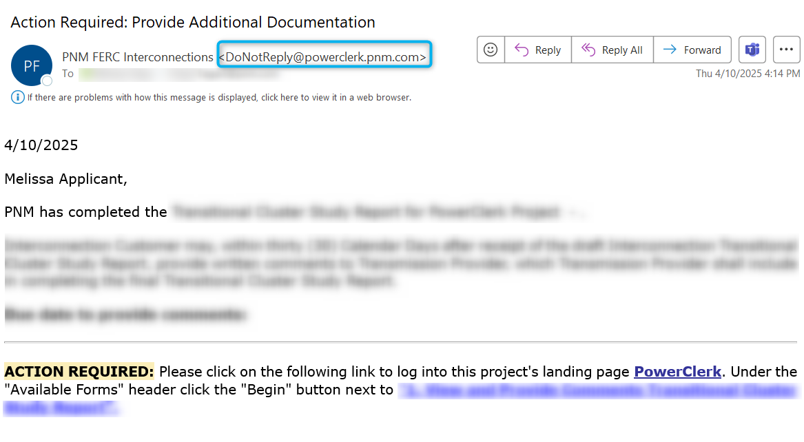
Powerclerk notification emails
From time to time, PowerClerk will send emails with action items.
These emails will come from DoNotReply@powerclerk.pnm.com
Within the email will be a description of the action required and a link to direct you to PowerClerk.
Please monitor your email inbox for communications sent from PowerClerk.

Slide 18
Need Help? “Ask a Question”
How to submit questions to pnm

Slide 19
Powerclerk notification emails
Select the “Ask a Question” button located on the top right of the PowerClerk screen to fill out and submit a project related question to PNM.
Once PNM has responded to your question you will receive an email from PowerClerk directing you to navigate to the “View/Edit” page of your project.

Slide 20
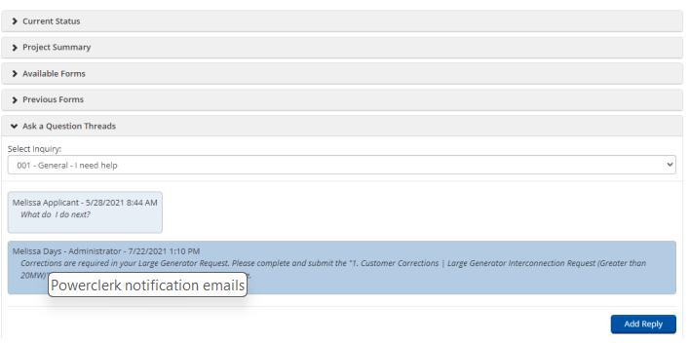
How to view and respond to ask a question
You will be able to review and respond to the “Ask a Question” thread within your project’s “View/Edit” page.
You may respond to PNM directly from PowerClerk by selecting the “Ask a Questions Thread” and selecting “Add Reply”.

