Slide 1
Time Of Day Pilot Updates
Pricing Advisory Committee
May 9, 2023

Slide 2
Time-of-day contacts
Mario Cervantes
Director of Customer Experience, mario.cervantes@pnm.com
Adria Padilla
Financial Analyst and TOD Program Manager, adria.padilla@pnm.com
Alex Reedin
Load Researcher & TOD Evaluation Lead, alex.reedin@pnmresources.com
Heidi Pitts
Lead Pricing Analyst, heidi.pitts@pnmresources.com

Slide 3
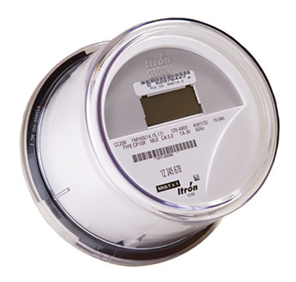
What has Pricing been doing since December 2022?
Logistics (Heidi)
Meters (Adria)
Waitlist (Adria)
Measurement/Evaluation metrics and the Rate/Control groups (Alex)
Marketing (Mario/Adria)
Education(Adria)
Website(Adria)
Customer Tools (Adria)
Next steps (Adria)

Slide 4

TIME-OF-DAY LOGISTICS
Bill guarantee
Customer Billing System issues
Billing issues
Reports to be created

Slide 5
Meters/Waitlist
We will have 10,000 meters. 7,500 for residential customers and 2,500 for commercial customers.
First order of 990 meters placed
Residential Customers can sign-up and get on the waitlist at PNM.com/timeofday. August/September
Commercial Customers can sign-up and get on the waitlist at PNM.com/timeofdaybusiness. August/September

Slide 6
What is evaluation?
Measurement of program success
Provides input for decision making
Typically done by a third party
  We hired DNV to plan the evaluation and provide program-design-for-evaluation support

Slide 7
DNV
Highly qualified team
Dozens of evaluations under their belts
Behavioral randomized control trial evaluations including:
  National Grid NY
  BC Hydro
  Puget Sound Energy
  SDG&E

Slide 8
Evaluation steps
Design for Evaluation – in process, DNV hired
Evaluation Plan – have draft from DNV
Final Evaluation Plan
Contract for Evaluation
Perform Evaluation
So – we are taking input!

Slide 9
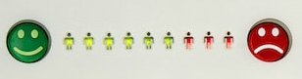

Components of evaluation
Process Evaluation
How was your experience with the PNM Time of Day program?
Note: not an actual survey question or response graphic.
Impact Evaluation
Photos by Celpax and Chris Liverani on Unsplash

Slide 10
Evaluation within TOD pilot objectives
Pilot Objective | EM&V Component | EM&V Role
Customer Satisfaction | Process Evaluation | Measure Customer Experience
Percentage Load Shift / Bill Savings | Impact Evaluation | Measure Demand and Bill Impacts
Recruitment Efficiency | Process Evaluation | Ask customers how they heard about the program

Slide 11
Process Evaluation
Surveys
  Opt-out surveys – of customers who leave
  Acceptance surveys – of customers who stay
Online metrics – engagement with emails and website

Slide 12
Impact Evaluation – Part 1
Assessing impact on when energy is used
Pilot participants are “early adopters”
Different from typical customers
How do we account for this?

Slide 13
Control Group
We are proposing a “control group” for the residential class.
This group will get a meter and enhanced energy information at the same time as the “rate group.”
But the “control group” will get the TOD rate 12 months after their meter is installed.

Slide 14
Impact Evaluation – Cont.
“Difference-only” analysis using statistical methods.

Slide 15
Impact Evaluation – Cont.
We will also assess the impact on customer bills.

Slide 16
Impact Evaluation – Cont.
Cost-effectiveness
  Will quantify costs and benefits of program
  Carbon planned to be included

Slide 17
Evaluation Questions
Do you have any input?

Slide 18
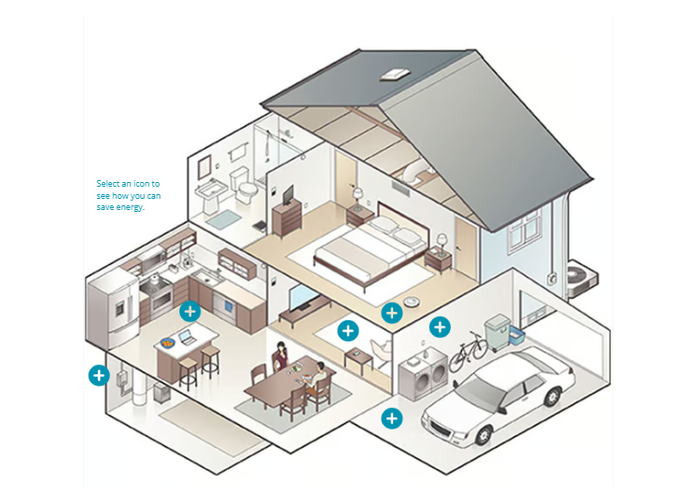
Residential Website - https://employeestaging.pnm.com/timeofday
PNM.com/timeofday

Slide 19
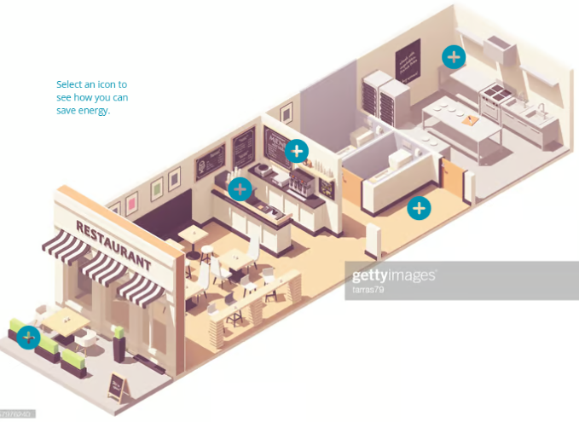
Commercial Website
PNM.com/timeofdaybusiness

Slide 20
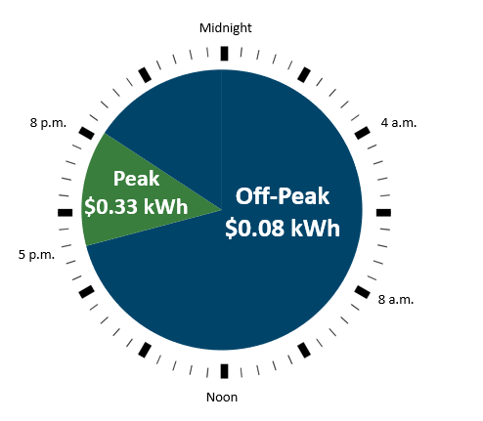
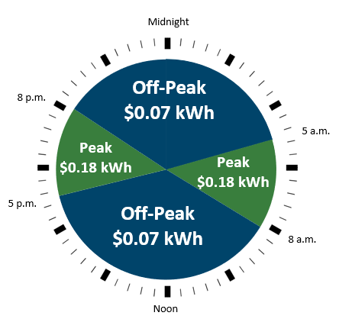
Residential Service Peak and Off-Peak Times
Residential – Time-Of-Day Pilot Rate
Summer (June, July, August)
(15 hours per week on-peak)
Non-Summer (May to September)
(30 hours per week on-peak)

Slide 21
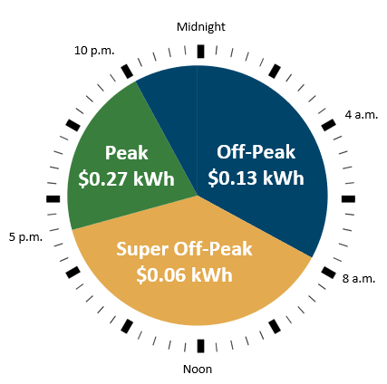
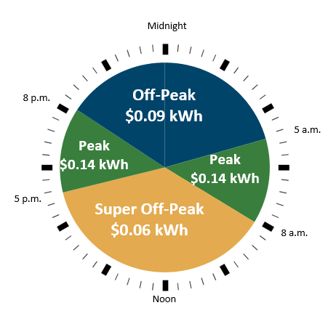
Small Power Service Peak and Off-Peak Times
Small Power Service – Time-Of-Day pilot rate
Summer (June, July, August)
(25 hours per week on-peak)
Non-Summer (May – September)
(30 hours per week on-peak)

Slide 22
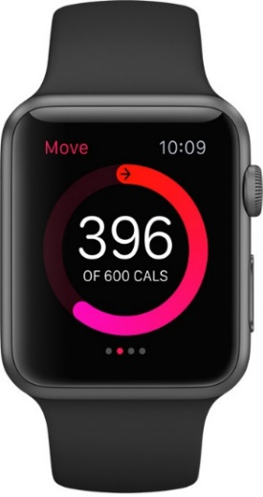
Marketing - Target Audience
Tech-savvy, data-oriented, metric tracking-driven customers (business, residential)
EV customers, adopters of smart home tech (e.g smart thermostats), high-energy users, all-electric households
Low-income customers who may be attracted to the potential savings
Tribal customers

Slide 23

Marketing
Video Ads
Audio
Digital Banner Ads
Bill Inserts
Pamphlets
Hold message on the IVR
Low-Income events

Slide 24
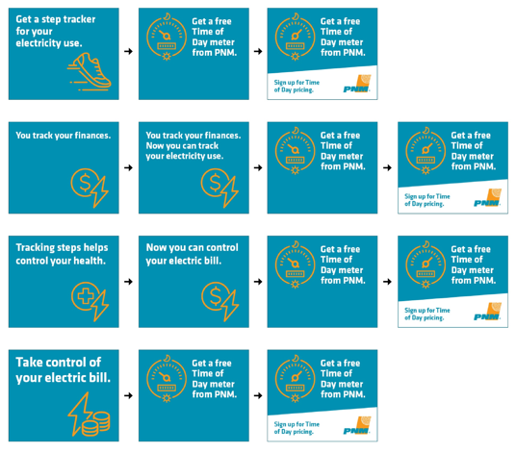
Marketing
Digital Banner Ads

Slide 25

Marketing
Bill Inserts

Slide 26
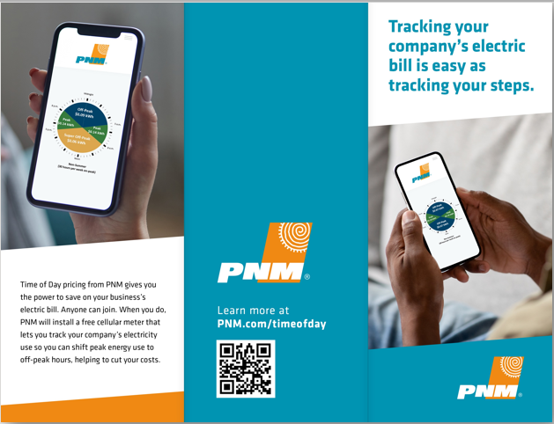
Marketing
Pamphlets

Slide 27
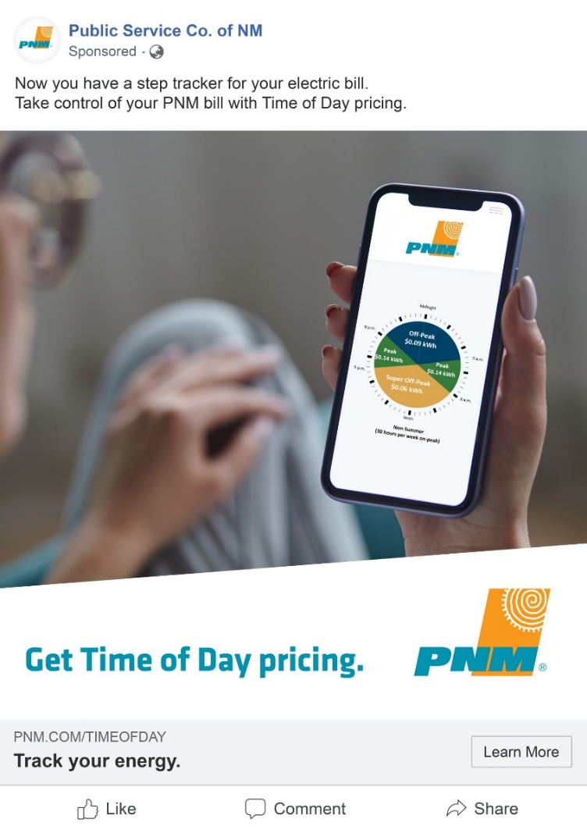
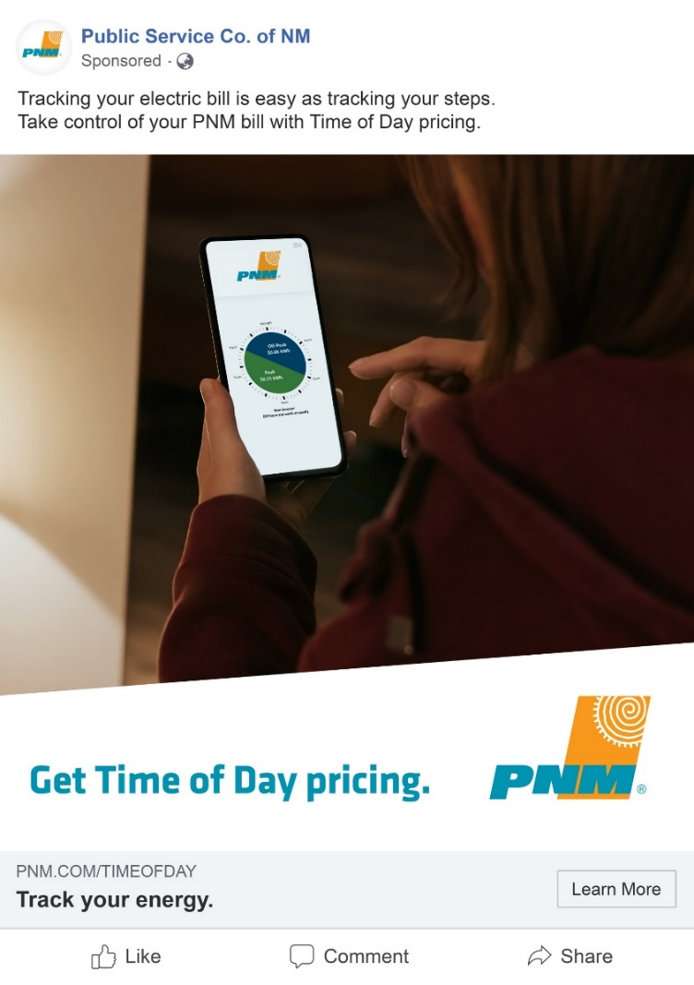
Social Media – Facebook

Slide 28
Education Plan
Customer Awareness & Education Plan
Build awareness of these new meters and their benefits
Motivate sign-ups for the meters
Aim to have a waitlist by year-end
PNM Communication & Training
CEA and Account Manager training
Focus groups

Slide 29
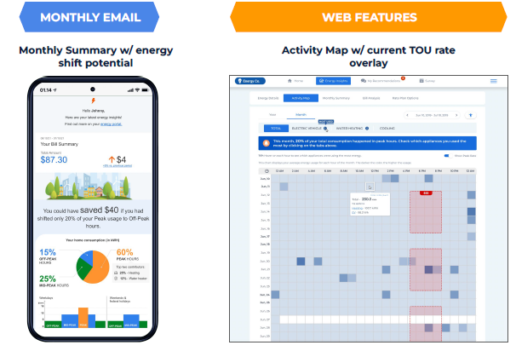
Customer Energy Management Tools and Features

Slide 30
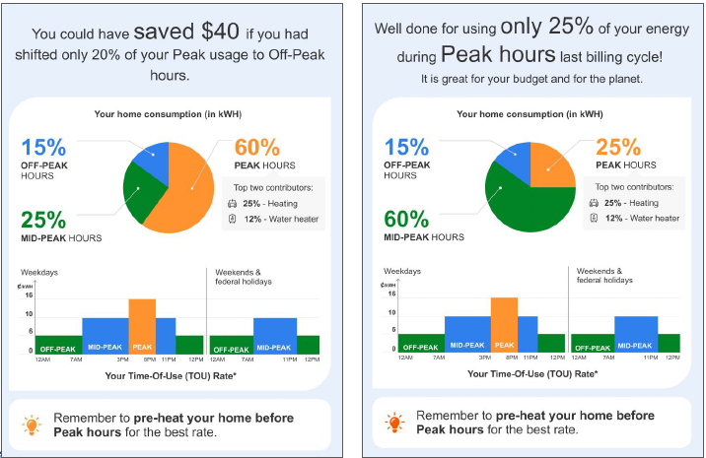
Customer Energy Management Tools and Features

Slide 31
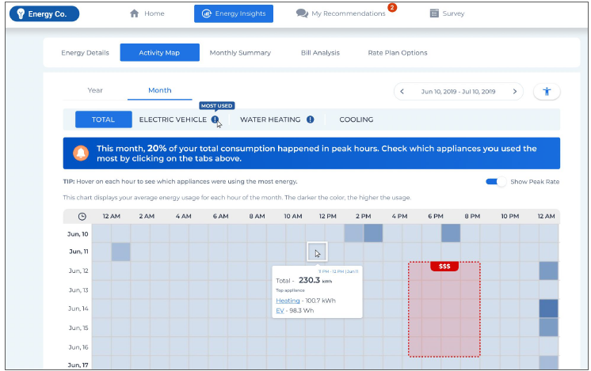
Customer Energy Management Tools and Features

Slide 32
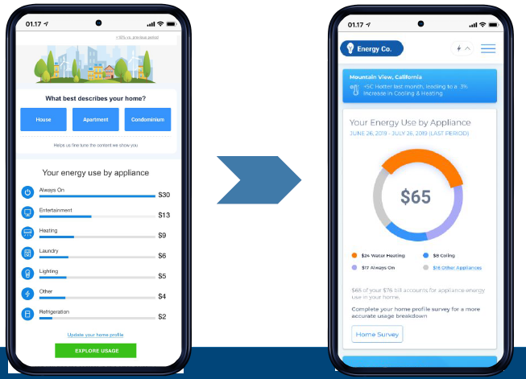
Customer Energy Management Tools and Features

Slide 33
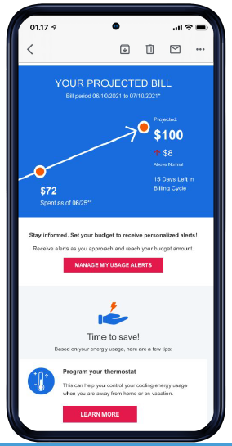
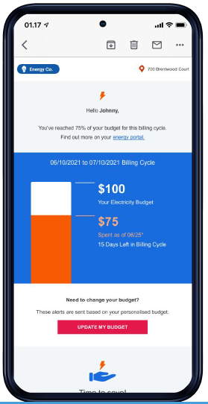
Customer Energy Management Tools and Features

Slide 34
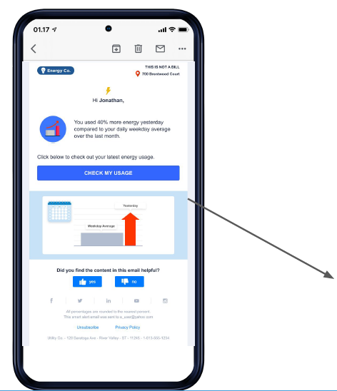
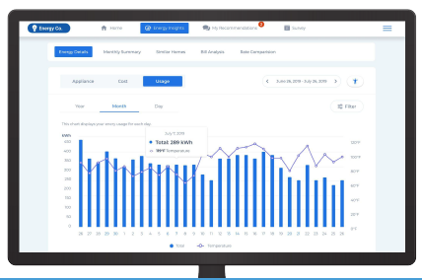
Customer Energy Management Tools and Features

Slide 35
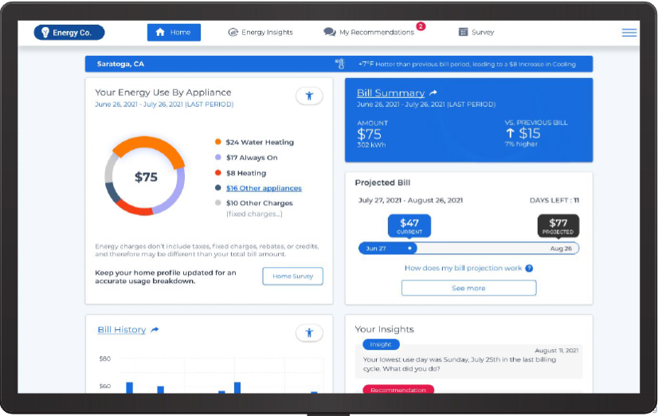
Customer Energy Management Tools and Features

Slide 36
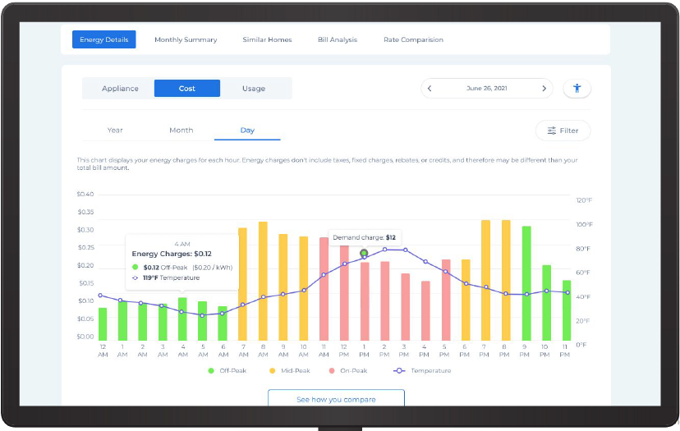
Customer Energy Management Tools and Features

Slide 37
Customer Education
Apogee – Rate Calculator
  Allows residential and small business customers to calculate and compare their current rate and the Time-Of-Day.
  Rate calculator can be used with or without an account number.

Slide 38
Steps for Pilot Rate
Sign-up for the pilot rate at PNM.com/timeofday for residential customers and PNM.com/timeofdaybusiness for commercial customers. Sign-up/waitlist will begin in August/September
Final Order from PRC
PNM confirms with the customer
Meter exchange

Slide 39
Email for Inquiries
PNM will set up a dedicated email for customers to submit questions or concerns.
timeofday@pnm.com

