Slide 1
Pricing Advisory Committee
May 9, 2023
Allocation Discussion

Slide 2
Allocation in a carbon free Future
What Drives Resource Planning
Nick Phillips
Director, Integrated Resource Planning & Forecasting
Nicholas.Phillips@pnm.com
(505) 241-2676
Sample Potential Generation Production Allocation
Mike Settlage
Principal, Pricing
Michael.Settlage@pnmresources.com
(505) 241-0634

Slide 3
Allocation in a carbon free Future
Please Note:
There is more than one generation production allocation method that could be used.
All data is for discussion purposes and is subject to change.
Allocators are based on forecast load and resource portfolios that will change.
We want and appreciate your input.
The methods shown are for illustrative purposes.

Slide 4
Allocation in a carbon free Future
The move away from fossil generation has changed how we plan and operate the power system
Gross load (traditional)
Load net of must take renewables (moving forward)
Modern rate design can enable customers to respond to price signals so the system operates more efficiently.

Slide 5
Allocation in a carbon free Future
The pattern of daily production costs has already shifted

Slide 6
Allocation in a carbon free Future
The pattern of daily production costs has already shifted

Slide 7
What DRIVES RESOURCE PLANNING?
Renewable Energy Requirements (Energy Basis by Statute)
  Renewable Energy is Intermittent
  Renewable Energy PPAs are take or pay on a $/MWh basis
Carbon emission requirements (A Function of Energy Production)
Balancing intermittent resources with energy storage and firm dispatchable resources (Reliability)
  Hours of risk drive planning
  Gross CP hours no longer are risky
  Risk hours will continue to change as the system decarbonizes
  The system will at some point be more energy constrained than capacity constrained.

Slide 8
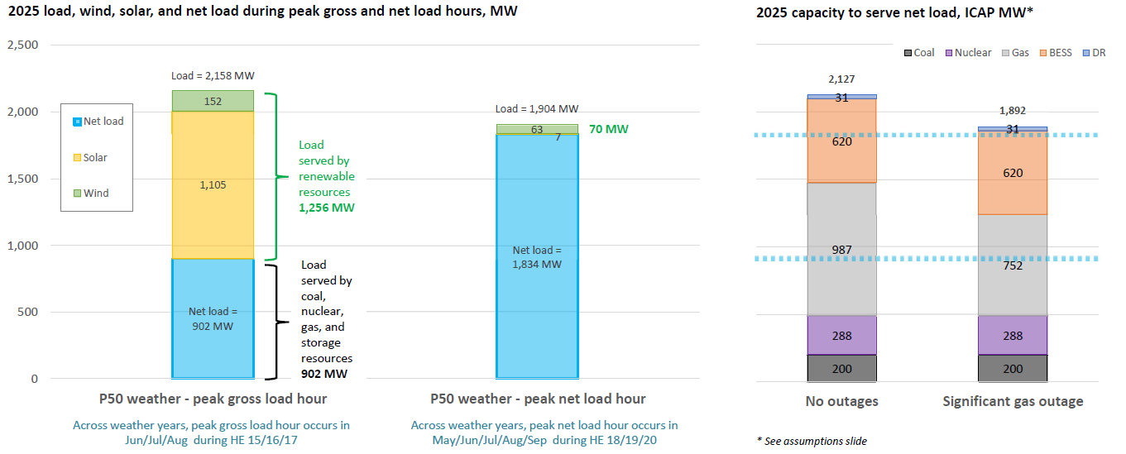
What DRIVES RESOURCE PLANNING?

Slide 9
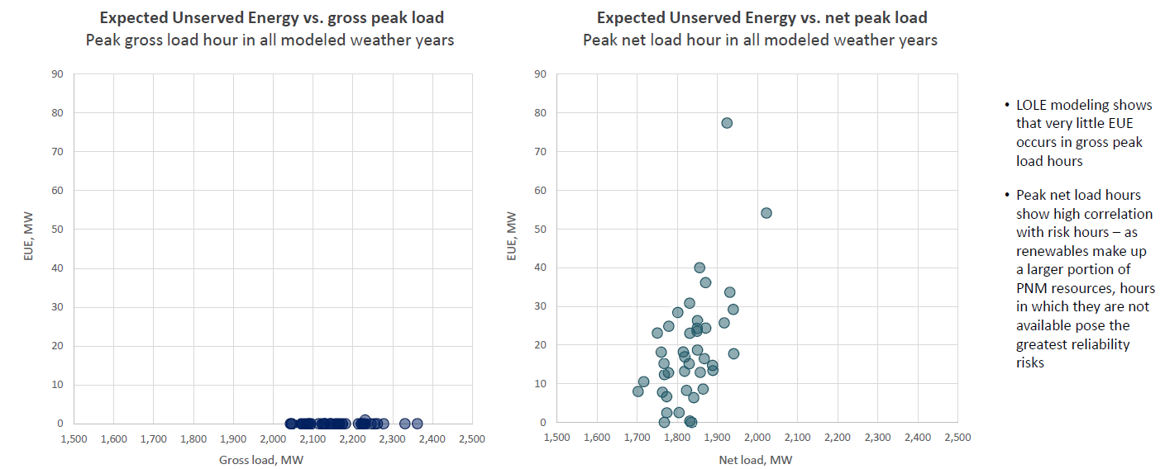
What DRIVES RESOURCE PLANNING?

Slide 10
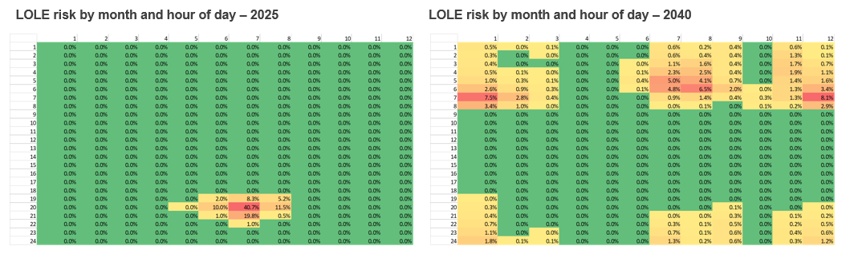
What DRIVES RESOURCE PLANNING?

Slide 11
Allocation in a carbon free Future
Existing production allocation methods
3S1W gross load
Four hours of the year allocate production revenue requirements
Production allocation considerations going forward
2024 and beyond
Based on system risk (LOLE)
Based on net load
Others

Slide 12
Allocation in a carbon free Future
Considerations for production allocation
Align costs with customer classes that benefit
Gross load vs net load
Gradualism and rate shock
Inter-Class subsidies

Slide 13
Allocation in a carbon free Future
We want your thoughts on using a two-step process
Net renewable generation from all customer class loads
Then allocate fixed costs using residuals loads

Slide 14
Allocation in a carbon free Future
2024 Generation Production Allocation
Customer Class | Top 5 weighted LOLP hours
1-Residential | 48.71%
2-Small Power | 9.10%
3-Gereral Power 3B/D | 16.04%
3-General Power 3C/E | 1.57%
4-Large Power | 7.92%
35-Large Power > 3MW | 1.51%
5-Large Service > 8MW | 0.26%
15 - Public Universities | 0.49%
33 - Station Power | 0.02%
10 - Irrigation Service | 0.33%
11 - Water pumping | 1.90%
6 - Private Lights | 0.01%
20 - Street lights | 0.01%
30 - Manufacturing > 30MW | 6.11%
36 - Special Service* | 6.04%
 | 100.00%
* 36B production allocation is specified in the special services contract

Slide 15
Allocation in a carbon free Future
2024 Generation Production Allocation
Customer Class | Top 5 weighted LOLP hours | Top 10 weighted LOLP hours
1-Residential | 48.71% | 48.95%
2-Small Power | 9.10% | 9.15%
3-Gereral Power 3B/D | 16.04% | 16.10%
3-General Power 3C/E | 1.57% | 1.57%
4-Large Power | 7.92% | 7.97%
35-Large Power > 3MW | 1.51% | 1.52%
5-Large Service > 8MW | 0.26% | 0.26%
15 - Public Universities | 0.49% | 0.49%
33 - Station Power | 0.02% | 0.02%
10 - Irrigation Service | 0.33% | 0.34%
11 - Water pumping | 1.90% | 1.96%
6 - Private Lights | 0.01% | 0.03%
20 - Street lights | 0.01% | 0.05%
30 - Manufacturing > 30MW | 6.11% | 6.17%
36 - Special Service* | 6.04% | 5.42%
 | 100.00% | 100.00%
* 36B production allocation is specified in the special services contract

Slide 16
Allocation in a carbon free Future
2024 Generation Production Allocation
Customer Class | Top 5 weighted LOLP hours | Top 10 weighted LOLP hours | Top 50 weighted LOLP hours
1-Residential | 48.71% | 48.95% | 49.15%
2-Small Power | 9.10% | 9.15% | 9.22%
3-Gereral Power 3B/D | 16.04% | 16.10% | 16.29%
3-General Power 3C/E | 1.57% | 1.57% | 1.58%
4-Large Power | 7.92% | 7.97% | 8.07%
35-Large Power > 3MW | 1.51% | 1.52% | 1.61%
5-Large Service > 8MW | 0.26% | 0.26% | 0.26%
15 - Public Universities | 0.49% | 0.49% | 0.54%
33 - Station Power | 0.02% | 0.02% | 0.02%
10 - Irrigation Service | 0.33% | 0.34% | 0.34%
11 - Water pumping | 1.90% | 1.96% | 2.01%
6 - Private Lights | 0.01% | 0.03% | 0.04%
20 - Street lights | 0.01% | 0.05% | 0.07%
30 - Manufacturing > 30MW | 6.11% | 6.17% | 6.34%
36 - Special Service* | 6.04% | 5.42% | 4.46%
 | 100.00% | 100.00% | 100.00%
* 36B production allocation is specified in the special services contract

Slide 17
Allocation in a carbon free Future
2024 Generation Production Allocation
Customer Class | Top 5 weighted LOLP hours | Top 10 weighted LOLP hours | Top 50 weighted LOLP hours | Top 100 weighted LOLP hours
1-Residential | 48.71% | 48.95% | 49.15% | 48.92%
2-Small Power | 9.10% | 9.15% | 9.22% | 9.28%
3-Gereral Power 3B/D | 16.04% | 16.10% | 16.29% | 16.33%
3-General Power 3C/E | 1.57% | 1.57% | 1.58% | 1.58%
4-Large Power | 7.92% | 7.97% | 8.07% | 8.09%
35-Large Power > 3MW | 1.51% | 1.52% | 1.61% | 1.63%
5-Large Service > 8MW | 0.26% | 0.26% | 0.26% | 0.26%
15 - Public Universities | 0.49% | 0.49% | 0.54% | 0.54%
33 - Station Power | 0.02% | 0.02% | 0.02% | 0.02%
10 - Irrigation Service | 0.33% | 0.34% | 0.34% | 0.34%
11 - Water pumping | 1.90% | 1.96% | 2.01% | 1.99%
6 - Private Lights | 0.01% | 0.03% | 0.04% | 0.05%
20 - Street lights | 0.01% | 0.05% | 0.07% | 0.09%
30 - Manufacturing > 30MW | 6.11% | 6.17% | 6.34% | 6.36%
36 - Special Service* | 6.04% | 5.42% | 4.46% | 4.51%
 | 100.00% | 100.00% | 100.00% | 100.00%
* 36B production allocation is specified in the special services contract

Slide 18
Allocation in a carbon free Future
2024 Generation Production Allocation
Customer Class | Top 5 weighted LOLP hours | Top 10 weighted LOLP hours | Top 50 weighted LOLP hours | Top 100 weighted LOLP hours | 3S1W
1-Residential | 48.71% | 48.95% | 49.15% | 48.92% | 50.55%
2-Small Power | 9.10% | 9.15% | 9.22% | 9.28% | 10.48%
3-Gereral Power 3B/D | 16.04% | 16.10% | 16.29% | 16.33% | 18.37%
3-General Power 3C/E | 1.57% | 1.57% | 1.58% | 1.58% | 2.23%
4-Large Power | 7.92% | 7.97% | 8.07% | 8.09% | 8.68%
35-Large Power > 3MW | 1.51% | 1.52% | 1.61% | 1.63% | 1.32%
5-Large Service > 8MW | 0.26% | 0.26% | 0.26% | 0.26% | 0.21%
15 - Public Universities | 0.49% | 0.49% | 0.54% | 0.54% | 0.37%
33 - Station Power | 0.02% | 0.02% | 0.02% | 0.02% | 0.02%
10 - Irrigation Service | 0.33% | 0.34% | 0.34% | 0.34% | 0.24%
11 - Water pumping | 1.90% | 1.96% | 2.01% | 1.99% | 1.29%
6 - Private Lights | 0.01% | 0.03% | 0.04% | 0.05% | 0.06%
20 - Street lights | 0.01% | 0.05% | 0.07% | 0.09% | 0.11%
30 - Manufacturing > 30MW | 6.11% | 6.17% | 6.34% | 6.36% | 6.07%
36 - Special Service* | 6.04% | 5.42% | 4.46% | 4.51% | 0.00%
 | 100.00% | 100.00% | 100.00% | 100.00% | 100.00%
* 36B production allocation is specified in the special services contract

Slide 19
Allocation in a carbon free Future
2024 Generation Production Allocation
Customer Class | Net 3S1W | Net 4CP | 3S1W
1-Residential | 50.56% | 49.64% | 50.55%
2-Small Power | 8.91% | 8.61% | 10.48%
3-Gereral Power 3B/D | 16.07% | 16.27% | 18.37%
3-General Power 3C/E | 1.58% | 1.63% | 2.23%
4-Large Power | 7.70% | 7.85% | 8.68%
35-Large Power > 3MW | 1.50% | 1.49% | 1.32%
5-Large Service > 8MW | 0.25% | 0.24% | 0.21%
15 - Public Universities | 0.33% | 0.43% | 0.37%
33 - Station Power | 0.02% | 0.02% | 0.02%
10 - Irrigation Service | 0.22% | 0.29% | 0.24%
11 - Water pumping | 1.40% | 1.55% | 1.29%
6 - Private Lights | 0.08% | 0.01% | 0.06%
20 - Street lights | 0.14% | 0.01% | 0.11%
30 - Manufacturing > 30MW | 5.85% | 5.72% | 6.07%
36 - Special Service * | 5.37% | 6.24% | 0.00%
 | 100.00% | 100.00% | 100.00%
* 36B production allocation is specified in the special services contract

Slide 20
Allocation in a carbon free Future
Stakeholders Next Steps – Allocations
Send us your proposed methodologies
You can calculate allocators, or we can help
Wrap up / Summary
TOD
Allocations
Next Meeting

Slide 21
Appendix

Slide 22
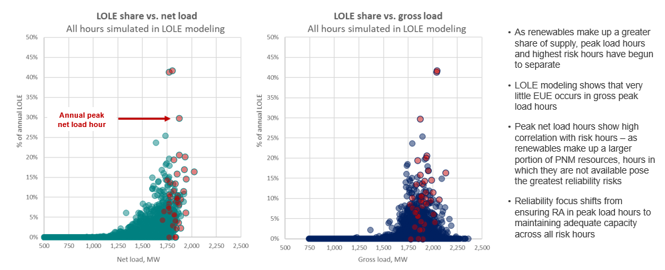
What DRIVES RESOURCE PLANNING?

Slide 23
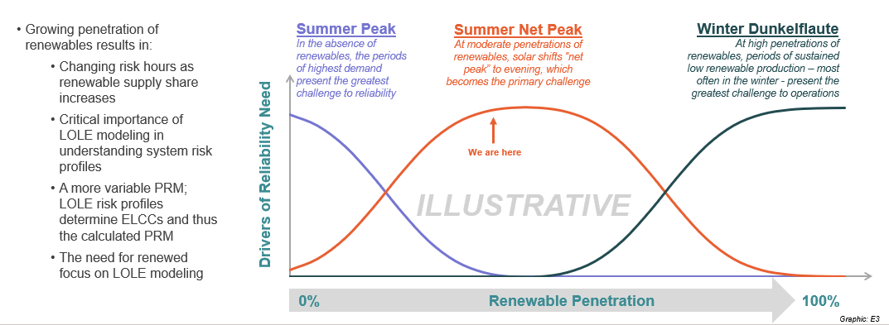
What DRIVES RESOURCE PLANNING?

Slide 24
Allocation in a carbon free Future
2024 Generation Production Allocation
Customer Class | Top 50 weighted LOLP hours | 3S1W
1-Residential | 49.15% | 50.55%
2-Small Power | 9.22% | 10.48%
3-Gereral Power 3B/D | 16.29% | 18.37%
3-General Power 3C/E | 1.58% | 2.23%
4-Large Power | 8.07% | 8.68%
35-Large Power > 3MW | 1.61% | 1.32%
5-Large Service > 8MW | 0.26% | 0.21%
15 - Public Universities | 0.54% | 0.37%
33 - Station Power | 0.02% | 0.02%
10 - Irrigation Service | 0.34% | 0.24%
11 - Water pumping | 2.01% | 1.29%
6 - Private Lights | 0.04% | 0.06%
20 - Street lights | 0.07% | 0.11%
30 - Manufacturing > 30MW | 6.34% | 6.07%
36 - Special Service | 4.46% | 0.00%
 | 100.00% | 100.00%

Slide 25
Allocation in a carbon free Future
Carbon free portfolios require a fresh look at cost allocation
The goal is to maintain alignment between cost causation and cost allocation
Customers who benefit
Customers who cause expenses

Slide 26
Allocation in a carbon free Future
2040 Generation Production Allocation
Customer Class | Top 5 weighted LOLP hours | Top 10 weighted LOLP hours | Top 50 weighted LOLP hours | Top 100 weighted LOLP hours
1-Residential | 38.78% | 38.01% | 38.58% | 38.54%
2-Small Power | 8.19% | 8.10% | 7.75% | 7.68%
3-Gereral Power 3B/D | 14.93% | 15.18% | 14.62% | 14.60%
3-General Power 3C/E | 1.97% | 1.92% | 1.66% | 1.63%
4-Large Power | 7.58% | 7.69% | 7.74% | 7.78%
35-Large Power > 3MW | 1.53% | 1.59% | 1.67% | 1.70%
5-Large Service > 8MW | 0.25% | 0.25% | 0.25% | 0.26%
15 - Public Universities | 0.18% | 0.22% | 0.34% | 0.37%
33 - Station Power | 0.03% | 0.03% | 0.03% | 0.03%
10 - Irrigation Service | 0.09% | 0.13% | 0.17% | 0.19%
11 - Water pumping | 1.36% | 1.54% | 1.71% | 1.79%
6 - Private Lights | 0.21% | 0.22% | 0.26% | 0.25%
20 - Street lights | 0.39% | 0.41% | 0.47% | 0.45%
30 - Manufacturing > 30MW | 6.58% | 6.64% | 7.00% | 7.04%
36 - Special Service * | 17.93% | 18.06% | 17.76% | 17.69%
 | 100.00% | 100.00% | 100.00% | 100.00%

Slide 27
Allocation in a carbon free Future
Comparison of Generation Production Allocation
Customer Class | 2024 Top 50 LOLP | 2040 Top 50 LOLP | 2024 - 2040 Change
1-Residential | 49.15% | 38.58% | -10.57%
2-Small Power | 9.22% | 7.75% | -1.47%
3-Gereral Power 3B/D | 16.29% | 14.62% | -1.67%
3-General Power 3C/E | 1.58% | 1.66% | 0.08%
4-Large Power | 8.07% | 7.74% | -0.33%
35-Large Power > 3MW | 1.61% | 1.67% | 0.07%
5-Large Service > 8MW | 0.26% | 0.25% | -0.01%
15 - Public Universities | 0.54% | 0.34% | -0.20%
33 - Station Power | 0.02% | 0.03% | 0.01%
10 - Irrigation Service | 0.34% | 0.17% | -0.17%
11 - Water pumping | 2.01% | 1.71% | -0.31%
6 - Private Lights | 0.04% | 0.26% | 0.22%
20 - Street lights | 0.07% | 0.47% | 0.40%
30 - Manufacturing > 30MW | 6.34% | 7.00% | 0.66%
36 - Special Service | 4.46% | 17.76% | 13.30%
 | 100.00% | 100.00% | 0.00%

