Slide 1
Pricing Advisory Committee (PRAC)
March 11, 2025 Meeting

Slide 2
Meeting Agenda
Brief introductions
PRAC website https://www.pnm.com/prac
Production allocators subcommittee in process
Transmission allocators
        Is it appropriate to use the same allocation method for generation production and transmission going forward?
        Discussion on PNM’s Transmission Allocation proposal
        Future PRAC meetings (Schedule)

Slide 3
Transmission Allocation BACKGROUND
PNM used a 12CP allocation methodology for transmission allocation prior to the final order in case 15-00261-UT.
The same allocation methodology (3S1W) for generation production and transmission was used in the Unopposed Stipulation for Case No. 24-00089-UT.
EPE (20-00104-UT) uses a 4CP allocation for Transmission costs and AED with 4CP for Generation Production.
SPS (22-00286-UT) uses AED 4CP allocation for Transmission costs and for Generation Production.

Slide 4
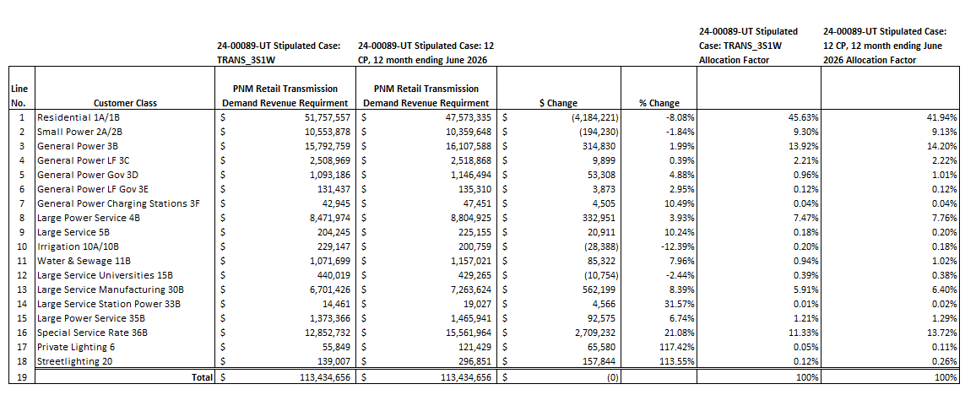
Transmission Allocation BACKGROUND
Unopposed Stipulation for Case No. 24-00089-UT Transmission Allocation
Transmission is 13% of total Revenue Requirement

Slide 5
Proposed Transmission Allocation GOING FORWARD
PNM believes it is appropriate to allow different allocation methodologies for generation and transmission systems.
PNM proposes to use a 12CP transmission allocator that matches the allocation method supported by FERC to split transmission costs into wholesale and retail jurisdictions.
Discussion and Q&A of PNM’s Proposal.

Slide 6
(Blank slide without template)

