Slide 1
Pricing Advisory Committee (PRAC)
April 8, 2025 - Transmission allocators

Slide 2
Pricing Advisory Committee Agenda
April 8, 2025
PRAC website https://www.pnm.com/PRAC
calendar, meeting materials, registration
Brief introductions (PNM)
PNM’s transmission allocator support and recap (PNM)
Open discussion (all)
Next PRAC meetings (PNM/all)

Slide 3
3S1W versus 12CP Transmission Allocation
Examine Historical Data
  System has evolved where less than half of the total transmission is used by PNM retail, since a significant portion of PNM transmission system demand is driven by FERC wholesale transmission customers (i.e., point-to-point and network service customers).
  Historical data shows the 12CP method more accurately reflects the usage pattern and demand on the transmission system throughout the year.
  PNM created heat maps for 8760 hours to dynamically display trends and patterns across months (rows) and hours (columns), with color intensities representing the data values.

Slide 4
Slide Overview
Slide 5 – Transmission Map
Slide 6 – 2016 PNM firm load
Slide 7 – 2016 Path 48 Flows Highest Usage Summer Months
Slide 8 – 2024 PNM firm load
Slide 9 –2024 Path 48 Flows Highest Usage Non-Summer Months
Slide 10 – 2024 Eastern NM Transmission Flows
Slide 11 – 2024 PNM Solar Resource Output

Slide 5
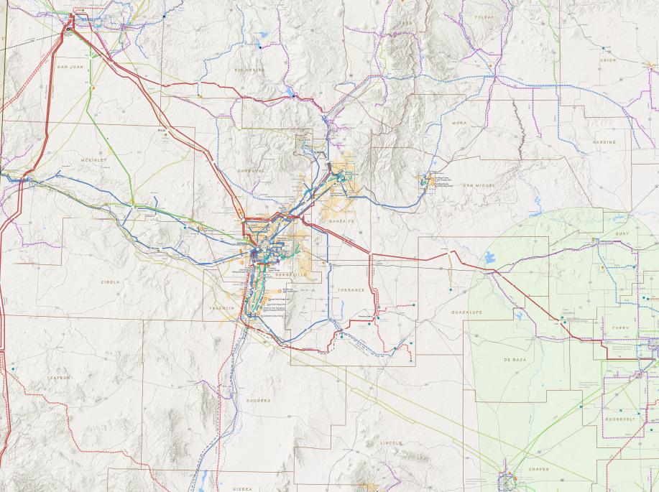
Transmission Map
Negative South to North Flows
The lines shown in red represent the primary backbone transmission lines in New Mexico.
Lower-voltage lines, depicted in green and blue, serve as backups to the backbone lines and are responsible for distributing power to smaller, more remote load areas.
Path 48 transmission cut-set
Positive North to South Flows
Positive West to East Flows
Negative West to East Flows
Eastern NM transmission cut-set

Slide 6
2016 - PNM FIRM LOAD
PNM's peak loads are primarily concentrated in the late afternoon and early evening hours during the summer months and one winter month as well.
Path 48 Max Loading
Path 48 Max Loading

Slide 7
2016 – PATH 48 Flows
Path 48 flows have historically aligned closely with PNM's retail load demands, driven by importing base-load resources from Palo Verde, Four Corners, and San Juan.
Path 48 Max Loading
Path 48 Max Loading

Slide 8
2024 - PNM FIRM LOAD
Currently, PNM's peak loads are primarily concentrated in the late afternoon during the summer months.
Path 48 Max Loading
Path 48 Max Loading

Slide 9
2024 – PATH 48 Flows
Path 48 flows no longer align closely with retail loads and now occur year-round, as observed.
Path 48 Max Loading
To better understand the impacts of Path 48, the average absolute values were analyzed.
Since 2016, Path 48 has experienced a significant decrease in imports and is now seeing more exports than imports. This shift is largely driven by the addition of solar and wind generation in the Albuquerque area and Eastern New Mexico, respectively.
Path 48 Max Loading

Slide 10
2024 – Eastern NM transmission Flows
Path 48 Max Loading
Path 48 Max Loading

Slide 11
2024 – Solar OUTPUT
Path 48 Max Loading
Path 48 Max Loading

Slide 12
SUMMARY
Historically, investments in the bulk transmission system enabled PNM to expand the delivery of power, primarily from base-load generating resources, to load centers. These investments were closely tied to growth in retail demand, which was largely driven by summer load.
In recent years, however, transmission capital investments have shifted focus. Efforts have been directed towards integrating solar renewable resources closer to load centers and the expansion of transmission infrastructure in eastern New Mexico for wind farms. As a result, there has been a significant reduction in Path 48 imports during the summer months, with the bulk transmission system now being increasingly used to export power to the Four Corners and San Juan areas.
Path 48 Max Loading

Slide 13
Open discussion
PRAC comments or concerns
Questions
Initial thoughts on Distribution Allocators
  Need for change?
  Recommended changes?

Slide 14
Next PRAC meetings
Mid April Subcommittee Meeting for Generation Allocators
May 13 Distribution allocators
Summer break
August 12 – December 9 Default TOD/ Net metering
Registration for the remaining 2025 meetings is available on the PRAC webpage

