Slide 1

PNM PRAC Net Metering Workshop
May 12, 2026
The Importance of Bankable Net Metering
Jim DesJardins
Executive Director, Renewable Energy Industries Association of New Mexico

Slide 2
Renewable Energy Industries Association-NM
New Mexico based trade organization representing 60+ diverse companies since 2004. Members and customers located throughout urban and rural New Mexico.
Mission is to support, promote and advance the just and orderly transition to renewable energy in New Mexico through bold advocacy and strong partnerships.
Active in New Mexico regulatory and legislative environments. Also work with state and local governments.
REIA-NM is an affiliate of the Solar Energy Industries Association (SEIA).

Slide 3
PNM Current Net Metering Program
Current Net Metering program was started in 2008.
Approx. 50,000 Customers are currently on the program. Estimate that an additional 10,000 net metering customers are on other NM utilities.
Most systems do not have energy storage due to dis-incentive created by how PNM screens residential solar with AC Coupled energy storage.
Currently 180,000 tons of CO2 are being saved annually by PNM Net metering Customers.
The PNM net metering program helped to start an industry that now employs over 2,000 people. Economic benefits to suppliers, service industry and other businesses.
The PNM “Practices For Distribution Planning” Report for NM PRC on Nov. 28, 2023, states “ By 2040 estimated 23% of PNM Customers will have Solar.” We are not even half way there.

Slide 4
What is the Current Situation?
30% Federal Tax Credit for residential Solar was terminated on 12/31/2025.
High uncertainty due to tariffs and geo-political environment.
Demand for electricity is going up due primarily to data centers and other large loads.
Difficult to build transmission and large projects due to permitting and siting challenges.
Customer sited solar is quick and easy to deploy and does not have NIMBY related issues.
There is no alternative solution to bankable net metering proposed by PNM to incentivize the continued growth of customer sited solar.
We are in the early stages of disruptive industry that we can embrace.

Slide 5
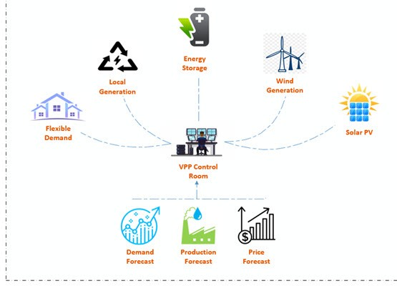
Virtual Power Plants: The next Chapter
Virtual Power Plants (VPPs) are DERS that are networked to enable them to dispatch energy on demand at times when energy is scarce. Makes use of existing assets.
Brattle Group study from May, 2023 shows that VPPs are less expensive than gas peaker plants.
Test on July 29, 2025 on Pacific Gas & Electric, Southern California Edison and San Diego Gas & Electric was conducted by Tesla & Sunrun and results analyzed by the Brattle Group…100,000 Homes participated and 535 Megawatts of energy was dispatched.
States with VPP programs, pilots or enabling legislation include CA,TX, AZ, CO, MA, CT, VT, NY, MD, VA and HI.

Slide 6

Preserve Current Net Metering Program until another program is in the place that compensates PNM customers with solar for their contribution to the grid.
PNM should not use system screening methods that discourage the attachment of energy storage with solar.
Support advancements for interconnection of solar systems such as Meter Collar Adapters.
Support a Virtual Power Plant program and other similar programs that incentivize generation in built environment with the ability to store energy when it is not needed and dispatch energy when it is needed.
Now is not the time to remove incentives for energy generation when demand is going up. Let’s work together to plan the next steps.

Slide 7

Jim DesJardins, Executive Director jimdesjardins1@gmail.com reia-nm.org
(o) 505-503-1000
(c) 505-917-5074
Questions?

