Slide 1
Pricing Advisory Committee (PRAC) – FINAL
May 12, 2026

Slide 2
II. Prac agenda May 12, 2026
Size of solar banks
Recap and update August 2025 slides regarding current state of DG interconnections
Solar banking: April 2025 – March 2026
Banking at other utilities
Issues PNM is considering as a part of eliminating solar banking
Presentation Jim DesJardins, REIA-NM
Presentation by EQ Research on behalf of REIA-NM
Working group – not for reproduction

Slide 3
Distributed generation current state (Aug 2025)
Interconnection SUMMARY
Total Interconnections: 47,038
Residential: 45,820
Commercial: 1,218
% of Customer Base:
9.0%
Interconnections, 2019-2025:
32,624
2019-2025 as % of Total:
69%
Working group – not for reproduction

Slide 4
Distributed generation current state (updated April 2026)
Interconnection SUMMARY
Total Interconnections: 48,650
Residential: 47,430
Commercial: 1,212
Community Solar: 6
% of Customer Base:
9.3%
Interconnections, 2019-Apr2026:
35,648
2019-2026 as % of Total:
73%
Interconnections 2022-Apr2026
21,023
Working group – not for reproduction

Slide 5
Distributed generation
Capacity summary, comparison
Reporting through July 2025
Total Capacity [MWac]:
324.71
Total Capacity (MWdc]:
390.52
Reporting through April 2026
Total Capacity [MWac]:
343.00
Total Capacity [MWdc]:
443.22
Community Solar Capacity [MWac]:
29.90
Working group – not for reproduction

Slide 6
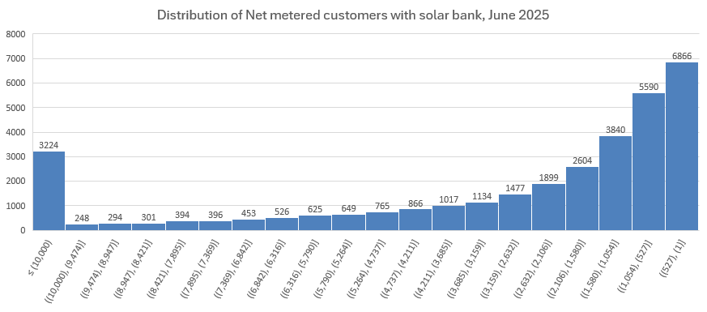
Distributed generation
Solar bank Balance
Working group – not for reproduction

Slide 7
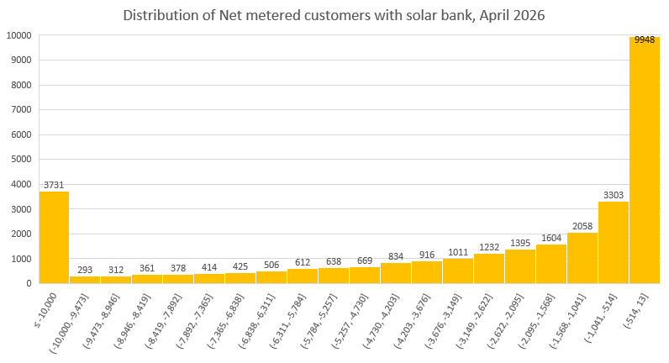
Distributed generation
Solar bank Balance, April 2026
Working group – not for reproduction

Slide 8
Distributed generation
excess solar bank quarterly reporting
Working group – not for reproduction

Slide 9
Distributed generation
Rate 12 payout, excess solar generation (May 2024-April 2025)
Rate 12
 | Non-TOU/TOD Hours
5/1/2024 | $0.0175602
6/1/2024 | $0.0271828
7/1/2024 | $0.0625424
8/1/2024 | $0.0449656
9/1/2024 | $0.0358135
10/1/2024 | $0.0460603
11/1/2024 | $0.0532982
12/1/2024 | $0.0441286
1/1/2025 | $0.1348575
2/1/2025 | $0.0678898
3/1/2025 | $0.0183563
4/1/2025 | $0.0146815
Working group – not for reproduction

Slide 10
II. Net metering
Solar Banks
Annual solar bank data
Monthly solar bank data: April 2025-March 2026
Solar banking at other utilities
Working group – not for reproduction

Slide 11
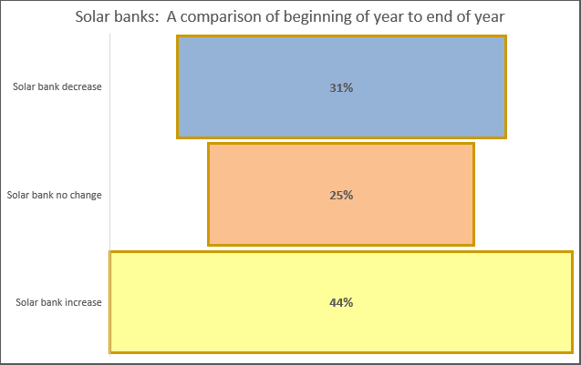
II. Solar banks: April 2025-March 2026
An annual look
Working group – not for reproduction

Slide 12
II. Solar banks: April 2025-March 2026
Change in solar banks by month, total kwh
Solar Bank Month | Solar Bank delta (kWh)
May 2025 | 12,703,479
June 2025 | 9,043,752
July 2025 | (1,599,783)
August 2025 | (2,917,374)
September 2025 | (248,070)
October 2025 | 4,360,018
November 2025 | 3,415,989
December 2025 | (2,160,849)
January 2026 | (4,541,618)
February 2026 | 200,921
March 2026 | 7,415,666
Annual solar bank change:
25,672,131 kWh
Working group – not for reproduction

Slide 13
II. Solar banks: April 2025-March 2026
Rider 12 avoided cost payout by month
Solar Bank Month | Positive solar bank growth (# premises) | Rate 12 $/kWh, Secondary Voltage KGCS | Customer Rate 12 payments
May 2025 | 32,373 | $0.0142642 | $215,373
June 2025 | 27,230 | $0.0263952 | $332,647
July 2025 | 14,754 | $0.0422974 | $251,277
August 2025 | 11,238 | $0.0310628 | $162,257
September 2025 | 11,952 | $0.0303988 | $164,200
October 2025 | 20,369 | $0.0288138 | $197,881
November 2025 | 23,553 | $0.0528694 | $370,438
December 2025 | 13,617 | $0.0320802 | $155,664
January 2026 | 8,517 | $0.0756319 | $305,889
February 2026 | 15,173 | $0.0359092 | $201,956
March 2026 | 27,823 | $0.0003085 | $3,317
Working group – not for reproduction
Notes:
By solar bank growth, I mean in a particular month, the DG system generated excess solar energy. If the excess solar energy was paid out at Rate 12 for the month, that is what would have been paid to customers.

Slide 14
Solar banks: April 2025-March 2026
Solar bank increase/decrease
Working group – not for reproduction

Slide 15
II. Net metering
Solar Banks at other utilities
Interstate Power & Light (IA)
110% of energy consumption, up to max 1MW
Banking is allowed from month to month. Generation that exceeds 100%/1MW, excess is credited at the avoided cost.
Excess generation forfeited at end of annual period.
Mississippi Power
Net billing instead of net metering. Excess generation is billed on either legacy PURPA rate (CSPP) or RENM rate created in 2016.
CSPP rate pays avoided costs for generation < 100kW
RENM rate pays avoided costs plus 2.5 cents per kWh “value of distributed generation” subsidy/adder up to 2MW renewable generation. Additional 2 cents per kWh adder for low income customers.
No netting Excess kWh against future kWh consumption, carryover, or banking.
Full-cost customer charge is $1.60 per day.
Idaho Power
Legacy net metered customers receive a kWh credit for excess generation
Non-legacy customers take service on Real Time Net Billing and get an avoided cost based financial credit for each kWh exported. Both kWh and financial credits are applied to customers’ bills and excess credits are carried forward.
Evergy (MO and KS)
Excess generation paid monthly at avoided cost.
Before 2014 (?) kWh banking month to month was allowed, but this was changed.
Working group – not for reproduction

Slide 16
II. Net metering
Solar Banks at other utilities, ctd…
Arizona Public Service
Eliminated solar banking around 2015/16 after a cost and value of solar proceeding.
Compensate DG customers for exported energy based on avoided cost rate called Resource Comparison Proxy (RCP)
Legacy customers were grandfathered for a period of time. As terms expire, they are moved to the RCP rate rider. Avoided costs uses past 5 years of rolling grid scale solar as a basis.
Tucson Electric Power
No solar banking.
Residential and Small General Service customers are now under net billing. An administrated price compensates exports.
Medium General Service and larger customers still have original net metering. Excess solar generation was banked for usage in future months and cashed out at MCCCG once a year.
Net metered customers were grandfathered in 2018.
Working group – not for reproduction

Slide 17
II. Net metering
Proposal: eliminate solar banking
Issues under consideration
Tranches for grandfathering based on interconnection date
Avoided cost rate averaged over a period of time
Move to TOD in stages
Size Limit
Working group – not for reproduction

Slide 18
Next meeting
June 2026 (registration link on PNM.com/prac)
Rate design topic
Possibility for stakeholder presentations on any of the topics that have been considered in past two years of PRAC meetings:
  Allocation methodologies
  TOD pilot modifications
  Low income rate
  Net metering
  Other
Working group – not for reproduction

Slide 19
Appendix: pnm Load & Total pnm renewable generation
March 26, 2026 – April 1, 2026
Working group – not for reproduction

Slide 20
Appendix: Rate 12, March 2026 – February 2027
Rate 12 by voltage
Effective Date | EGBS | EGBS | EGBC | EGBP | EGBP | EGRS | EGRS | EGTS | EGTS | EGTS | EGTP | EGTP | EGTP
 | Secondary Voltage | Secondary Voltage | Secondary Voltage | Primary Voltage | Primary Voltage | Time-of-Day Secondary Voltage | Time-of-Day Secondary Voltage | Time-of-Day Secondary Voltage | Time-of-Day Secondary Voltage | Time-of-Day Secondary Voltage | Time-of-Day Primary Voltage | Time-of-Day Primary Voltage | Time-of-Day Primary Voltage
 | KPCS | KOCS | KGCS | KPCS | KOCS | KPCS | KOCS | KPCS | KOCS | KMCS | KPCS | KOCS | KMCS
3/1/2026 | ($0.0192129) | $0.0198825 | $0.0003085 | ($0.0188721) | $0.0195297 | $0.0130312 | ($0.0022897) | $0.0130312 | $0.0095773 | ($0.0291631) | $0.0128001 | $0.0094073 | ($0.0286457)
4/1/2026 | ($0.0001132) | $0.0304820 | $0.0151844 | ($0.0001112) | $0.0299412 | $0.0346915 | $0.0108053 | $0.0346915 | $0.0181520 | ($0.0036657) | $0.0340760 | $0.0178300 | ($0.0036006)
5/1/2026 | $0.0138334 | $0.0280183 | $0.0209258 | $0.0135879 | $0.0275212 | $0.0258796 | $0.0199158 | $0.0258796 | $0.0246425 | $0.0091869 | $0.0254205 | $0.0242053 | $0.0090240
6/1/2026 | $0.0402425 | $0.0536807 | $0.0469616 | $0.0395285 | $0.0527284 | $0.0729292 | $0.0444716 | $0.0628008 | $0.0468446 | $0.0384258 | $0.0616866 | $0.0460135 | $0.0377440
7/1/2026 | $0.0335000 | $0.0347508 | $0.0341254 | $0.0329057 | $0.0341343 | $0.0418691 | $0.0333716 | $0.0416696 | $0.0325031 | $0.0335065 | $0.0409304 | $0.0319265 | $0.0329120
8/1/2026 | $0.0385564 | $0.0467446 | $0.0426505 | $0.0378723 | $0.0459153 | $0.0532539 | $0.0416696 | $0.0539236 | $0.0430252 | $0.0354955 | $0.0529669 | $0.0422619 | $0.0348658
9/1/2026 | $0.0334072 | $0.0364318 | $0.0349195 | $0.0328145 | $0.0357854 | $0.0455211 | $0.0326706 | $0.0455211 | $0.0335917 | $0.0306969 | $0.0447135 | $0.0329958 | $0.0301523
10/1/2026 | $0.0168686 | $0.0385380 | $0.0277033 | $0.0165693 | $0.0378543 | $0.0505884 | $0.0224918 | $0.0505884 | $0.0267590 | $0.0142667 | $0.0496909 | $0.0262843 | $0.0140136
11/1/2026 | $0.0274704 | $0.0390233 | $0.0332549 | $0.0269831 | $0.0383309 | $0.0392568 | $0.0321277 | $0.0392568 | $0.0369569 | $0.0198146 | $0.0385603 | $0.0363012 | $0.0194631
12/1/2026 | $0.0197491 | $0.0312368 | $0.0254930 | $0.0193988 | $0.0306826 | $0.0363579 | $0.0231496 | $0.0363579 | $0.0260965 | $0.0169877 | $0.0357129 | $0.0256335 | $0.0166863
1/1/2027 | $0.0271891 | $0.0545310 | $0.0408600 | $0.0267067 | $0.0535635 | $0.0537251 | $0.0380852 | $0.0537251 | $0.0465636 | $0.0203575 | $0.0527719 | $0.0457375 | $0.0199963
2/1/2027 | ($0.0035658) | $0.0328760 | $0.0146551 | ($0.0035025) | $0.0322928 | $0.0352348 | $0.0101813 | $0.0352348 | $0.0236285 | ($0.0176097) | $0.0346097 | $0.0232093 | ($0.0172972)
Working group – not for reproduction
Notes:
This is the current Rate 12 avoided costs on file at the Commission. KPCS = kWh off-peak, KOCS = kWh on-peak, KMCS = kWh super off-peak, KGCS = gross kWh

