Slide 1
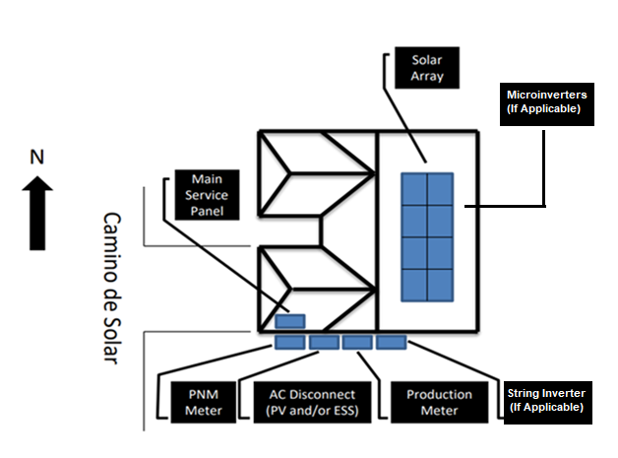
SITE MAP
REQUIRED FEATURES
Site Address (must match application).
Info Box that contains the Quantity, Manufacturer, and Model Number for the Modules and Inverters.
If Energy Storage is applicable the info box must include its Quantity, Manufacturer, Model Number and Mode of operation.
Location and name of closest street.
Compass Rose.
Please keep all required items on a single page.
All equipment labelled with arrow callouts as its installed (not in a legend).
Fully illustrate the solar array distinguishing each panel. Label string inverters and microinverters.
If you are installing a production meter, (see Variance info box) make sure to follow the metering requirements or a Variance will be required.
PV Disconnect(s) must be outside, accessible to the utility, in line of sight, and within 5’ of the Utility Meter or a Variance will be required.
ESS Disconnect(s) (if applicable) must be outside, accessible to the utility, in line of sight, and within 10’ or a Variance will be required.
If you are submitting an Expansion, please see the additional requirements on the Site Map Required Features.
Info Box
Module(s): Quantity, Manufacturer, Model Number Inverter(s): Quantity, Manufacturer, Model Number *Calculations not required.
(If Applicable) Storage: Quantity, Manufacturer, Model Number Mode of Operation: i.e., Backup
505 Camino de Solar Albuquerque, NM 87111
Variance Info Box (If installing a Production Meter)
☐ Must be within 5' of the Utility Meter
☐ Must be on the same plane and in line of sight
☐ No visible obstructions between the Production Meter and the Utility Meter i.e., a Fence
Production meter (if applicable) and
Utility meter are within 5 ft
Note: PNM may request additional information if
determined it is needed during the screening process

Slide 2
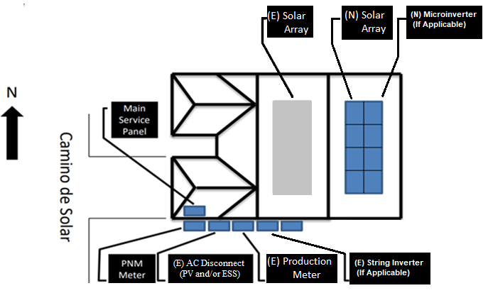
Info Box
Existing (E) Module(s): Quantity, Manufacturer, Model Number Inverter(s): Quantity, Manufacturer, Model Number New (N) Module(s) Quantity, Manufacturer, Model Number Inverter(s): Quantity, Manufacturer, Model Number *Calculations not required.
If Applicable (N) Storage: Quantity, Manufacturer, Model Number Mode of Operation: i.e., Backup
SITE MAP
EXPANSION
REQUIRED FEATURES
(These are in Addition to the Required Features on new applications)
See Info Box which must distinguish between Existing (E) and New (N) systems. Must contain both new and existing quantity of Modules and Inverters as well as their manufacturer & model number.
If Energy Storage is applicable the info box must include its Quantity, Manufacturer, Model Number, Mode of operation, and labeled as (N) New or (E) Existing.
All equipment clearly labelled as Existing (E) or New (N) on the arrow callouts.
Fully illustrate the new solar array distinguishing each panel. Differentiate between String Inverters and Microinverters.
If you are replacing your production meter, (see Variance info box) make sure to follow the metering requirements or a Variance will be required. Expansions have the same variance requirements.
If V2G functionality is desired, EV charger must be depicted in diagrams and application.
505 Camino de Solar Albuquerque, NM 87111
Production meter (if applicable) and
Utility meter are within 5 ft
Note: PNM may request additional information if
determined it is needed during the screening process

