Slide 1
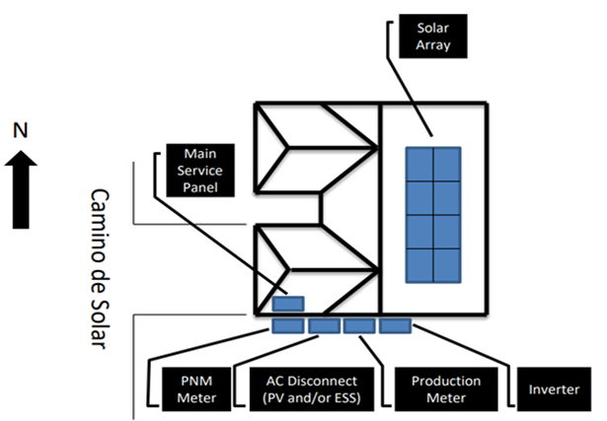
SITE MAP
REQUIRED FEATURES
Site Address (must match application).
See Info Box which must contain the quantity of Modules and Inverters as well as their make & model number. If you are installing Energy Storage; the Info Box must include its make & model number, and mode of operation.
Location and name of closest street.
Compass Rose.
Please keep all required items on a single page.
All equipment labelled with arrow callouts (not in a legend).
Fully illustrate the solar array distinguishing each panel.
If you are installing a production meter, (see Variance info box) make sure all requirements are met or a Variance will be necessary.
PV Disconnect(s) must be outside, accessible to the utility, in line of sight, and within 5’ of the Utility Meter or a Variance will be required.
ESS Disconnect(s) (if applicable) must be outside, accessible to the utility, in line of sight, and within 10’ or a Variance will be required.
If you are submitting an Expansion, please see the additional requirements on the Site Map Required Features.
Info Box
Module(s): Quantity, Manufacturer, Model Number Inverter(s): Quantity, Manufacturer, Model Number *Calculations not required.
(If Applicable) Storage: Quantity, Manufacturer, Model Number Mode of Operation: i.e., Backup
505 Camino de Solar Albuquerque, NM 87111
Variance Info Box (If installing a Production Meter)
☐ Must be within 5' of the Utility Meter
☐ Must be on the same plane and in line of sight
☐ No visible obstructions between the Production Meter and the Utility Meter i.e., a Fence
Production meter (if applicable) and
Utility meter are within 5 ft
Note: PNM may request additional information if
determined it is needed during the screening process

Slide 2
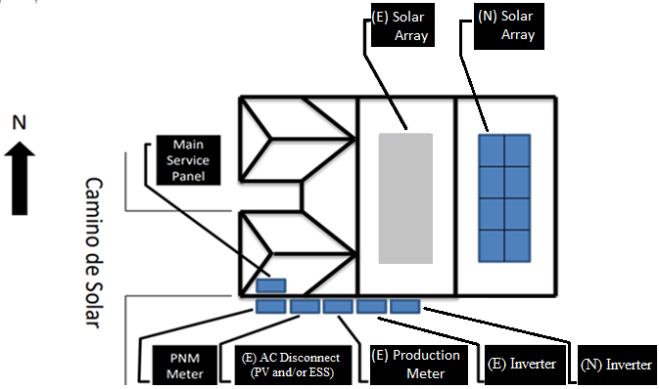
Info Box
Existing (E) Module(s): Quantity, Manufacturer, Model Number Inverter(s): Quantity, Manufacturer, Model Number New (N) Module(s) Quantity, Manufacturer, Model Number Inverter(s): Quantity, Manufacturer, Model Number *Calculations not required.
(If Applicable) Storage: Quantity, Manufacturer, Model Number Mode of Operation: i.e., Backup
SITE MAP
EXPANSION
EXPANSION REQUIRED FEATURES
(These are in Addition to the Required Features on new applications)
See Info Box which must distinguish between Existing (E) and New (N) systems. Must contain both new and existing quantity of Modules and Inverters as well as their make & model number. If you are installing Energy Storage; the Info Box must include its make & model number, and mode of operation.
All equipment clearly labelled as Existing (E) or New (N) on the arrow callouts.
Fully illustrate the new solar array distinguishing each panel.
If you are replacing your production meter, (see Variance info box) make sure all requirements are met or a Variance will be necessary. Expansions have the same variance requirements.
If V2G functionality is desired, EV charger must be depicted in diagrams and application.
505 Camino de Solar Albuquerque, NM 87111
Note: PNM may request additional information if
determined it is needed during the screening process
Production meter (if applicable) and
Utility meter are within 5 ft

