Slide 1
Money-savings Programs for Your Business: How PNM Can Help You
Presented by Jason Norris of the PNM Business Development Department
March 20, 2024

Slide 2
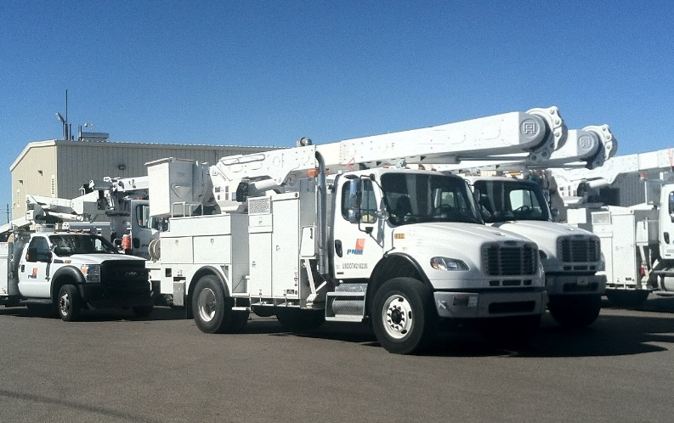
Who We are
Public Service Company
Of New Mexico
Our core mission is to provide reliable, low-cost, safe and environmentally responsible energy to our customers
Founded in 1917
First New Mexico business on the NYSE
Annual revenues $1.4B
Employs 1,500 New Mexicans
Gives over $4M from shareholders to local non-profits annually

Slide 3
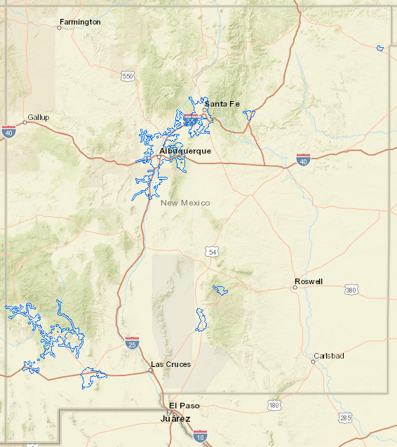
Serving new Mexicans for over 100 years
530,000 customers in 40 communities
Over 15,000 miles of transmission and distribution lines
Currently the PNM generation portfolio is 61% carbon free
PNM is committed to becoming a carbon emissions free utility and is already well on their way to achieving that goal

Slide 4
Overview
Goal
To learn about money-saving opportunities for customers, available through the money savings programs offered by PNM.
There will be several key takeaways from the presentation:
Find out which rebates you may qualify for
Understand how the Strategic Energy Management (SEM) Program can help you
Learn about Peak Saver and other incentives

Slide 5
Presenters
Jason Norris, Senior Account Manager
Jason has spent the last 25 years working with PNM customers. He now works with our Power Quality segment which includes Hospitals and Data Centers. Jason’s role is to be an advisor, a problem solver, and a thought partner. His goal is to cultivate meaningful relationships that lead to positive customer outcomes.

Slide 6
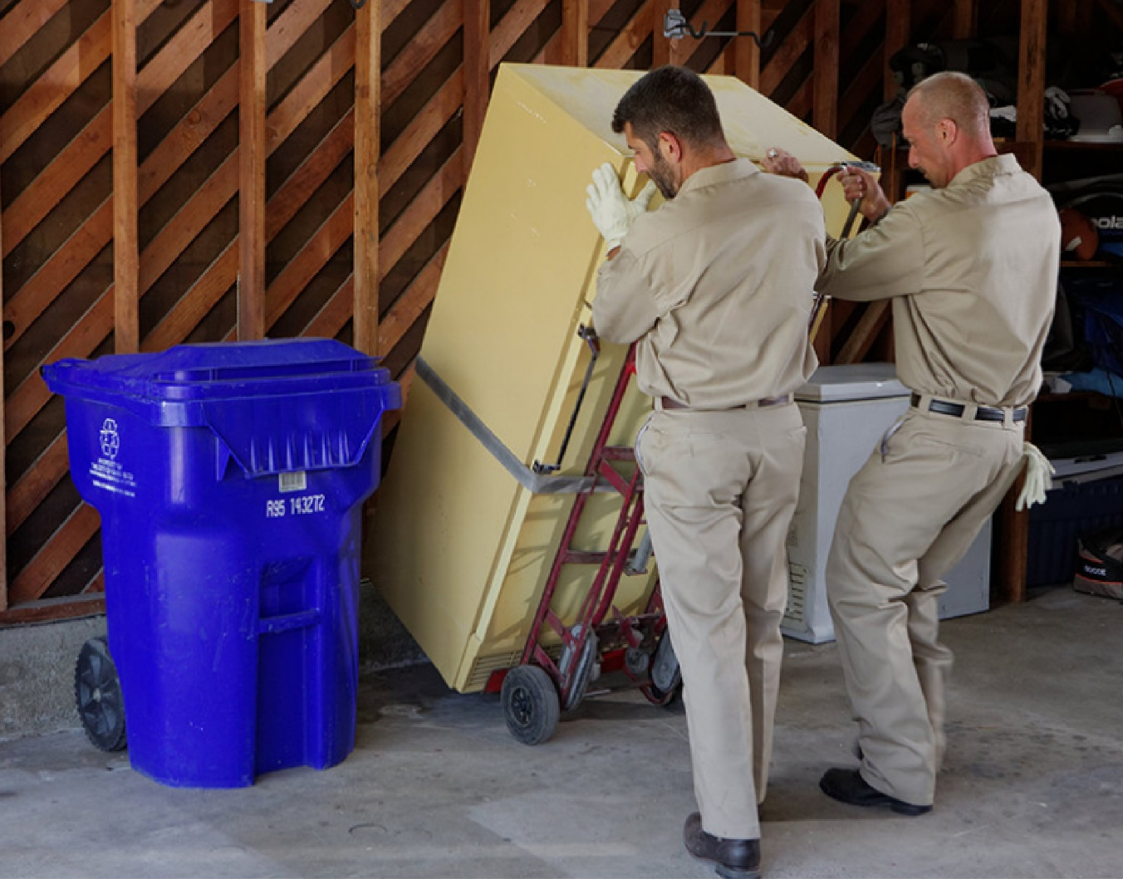
RETROFIT REBATES
Improve your existing facility with prescriptive or custom energy-efficient improvements.
PNM customers receive rebates for installing energy-efficient equipment such as lighting, heating, ventilation, and air conditioning (HVAC), refrigeration, and food service equipment that help you reduce your energy bill and save you money in the long run.

Slide 7
New construction rebates
PNM business customers can apply for incentives for implementing more efficient designs and for conducting enhanced building commissioning in new construction.

Slide 8
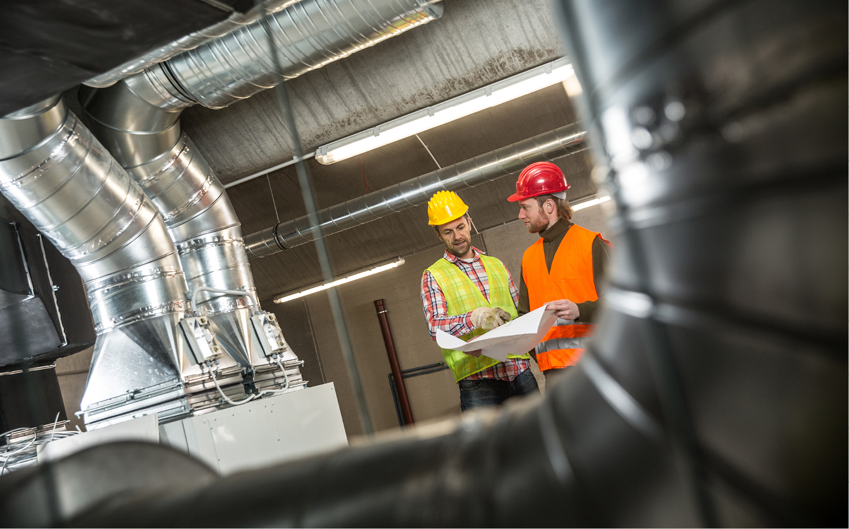
BUILDING TUNE-UP PROGRAM
Optimize your facility's performance by improving the efficiency of your existing operations through the retro commissioning program.
If you manage an older facility, it may be time for a tune-up.
Rebates are available to help offset the costs of the upgrades, helping you to save money.

Slide 9
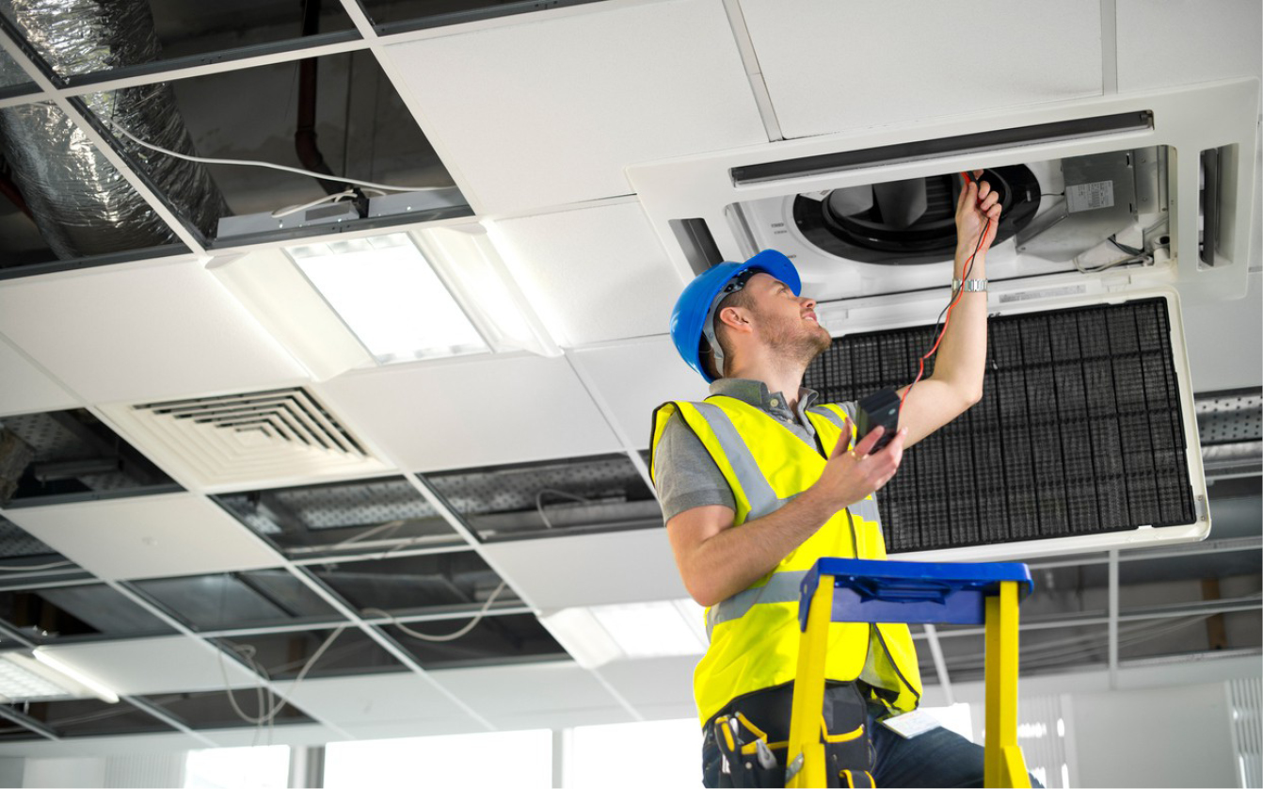
BUILDING operator certification program
Certify your team through the Building Operator Certification Program.
Tuition reimbursement for qualified building operators and facility managers to complete a national training program
This program improves skills and knowledge of energy-efficient building maintenance.

Slide 10
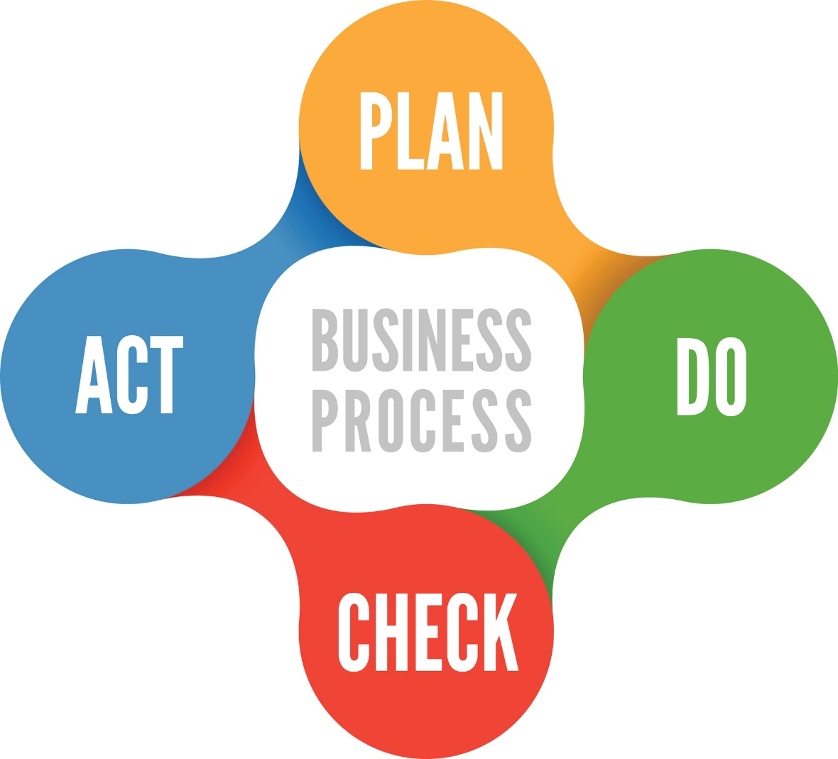
Strategic energy management
Strategic Energy Management (SEM) uses Continuous Improvement approaches like those found in Lean or Six Sigma.
They identify and remove waste from your energy streams and Management System methods like those found in Environmental, Health, and Safety programs to help your organization plan, manage, and control energy performance on a sustained basis.

Slide 11
Strategic energy management
HOSPITAL CASE STUDY
A five-hospital energy-savings initiative
Annual savings of 2.96 million kWh
62,800 annual therms saved
O&M improvements reduce energy costs by $180,000 annually (65.7%)
“
One of the hospital Sustainability Program Managers said, “Strategic Energy Management provided the structure, methodology and discipline needed to achieve buy-in across our culture”.
“

Slide 12
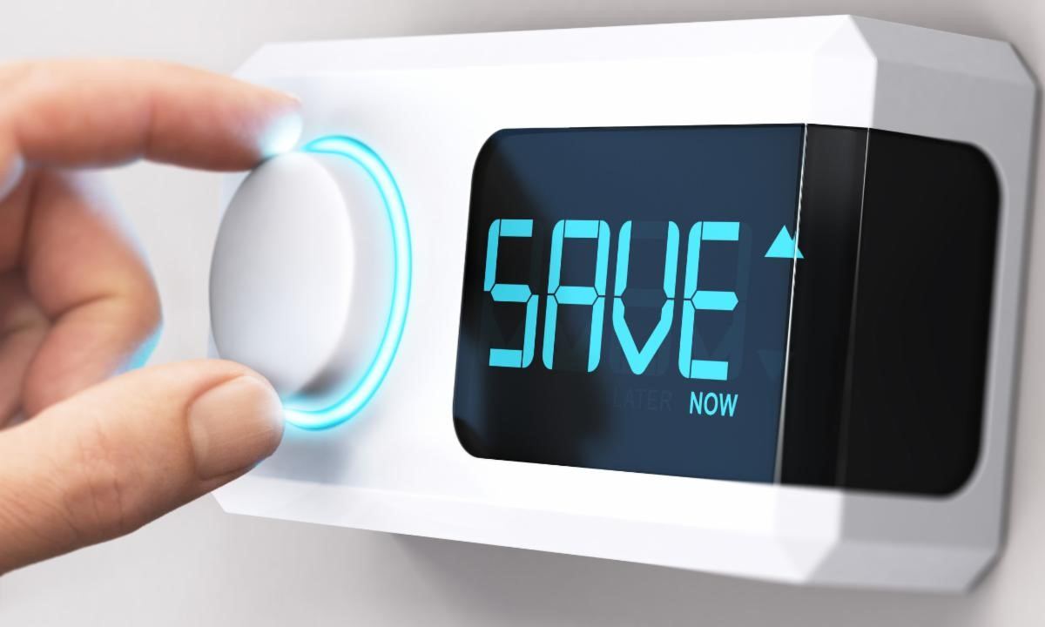
Peak saver
Large commercial and industrial business customers can help reduce the demand for electricity during the hottest summer days.
You can earn an annual incentive based on the reduction of power demand during your participation in the program.

Slide 13
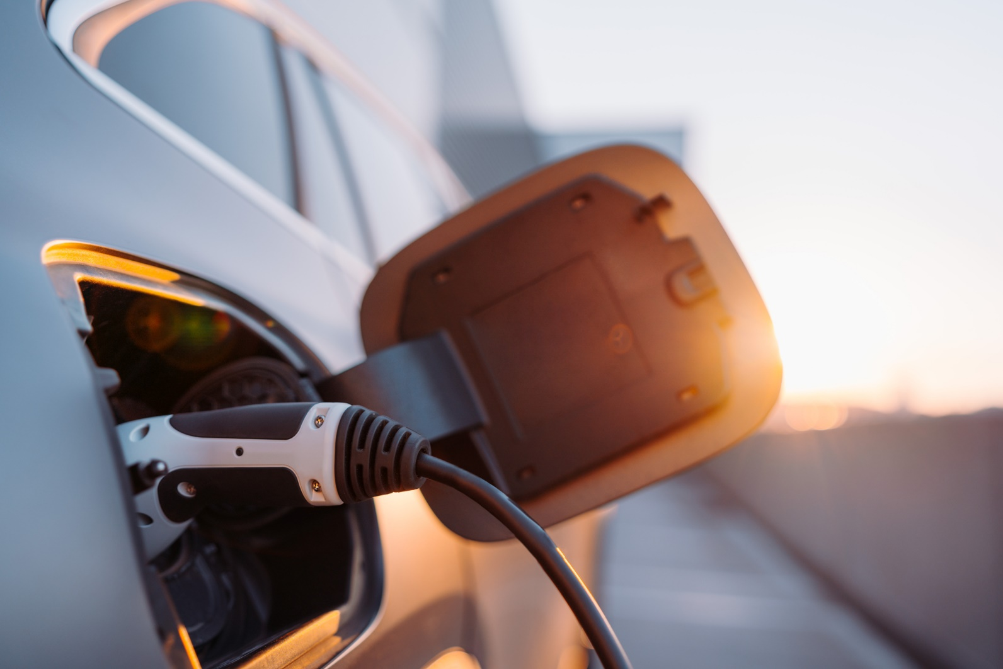
Transportation electrification
Commercial Rebates:
$2,500 rebate per port for a Level 2 charger
$25,000 rebate for a DC Fast Charger
Residential Rebate:
$500 rebate

Slide 14
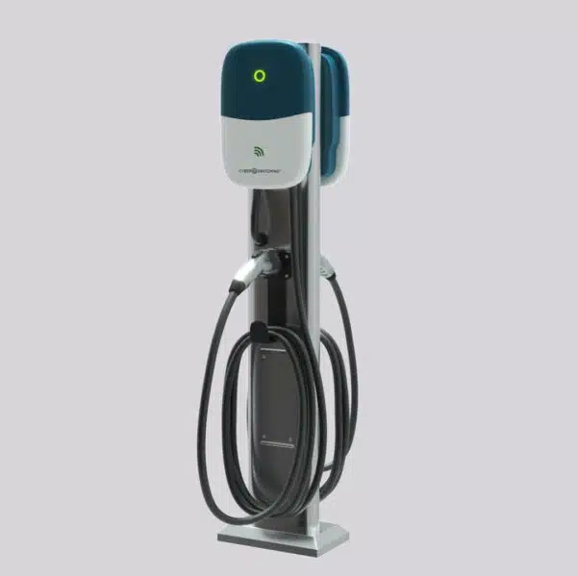
Level 2 chargers
Level 2 Charger;
Give customers a reason to stop and shop. Level 2 chargers typically use 208 to 240 volts and can add between 12 to 25 miles per charging hour to your customer’s battery.

Slide 15
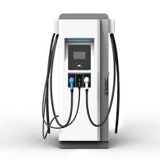
DC fast chargers
DC Fast Charger:
Direct Current Fast chargers typically use 480 volts and are often called Level 3 chargers. They are the fastest way to charge a compatible EV. Typically, 80% of the battery can be charged in just 30 to 60 minutes, helping your customers quickly recharge
For more information on transportation electrification or to find a program authorized contractor, go to:
https://ev.pnm.com/

Slide 16
pnm sky blue
Joining PNM Sky Blue® makes it easy and affordable to support clean, renewable wind and solar energy without making the commitment of putting solar panels on your roof or wind turbines in your backyard. The program is completely voluntary, and it has no contract or long-term commitment.

Slide 17
pnm sky blue cont’d
Participants in the program will receive a small renewable energy credit on their monthly bills for every kilowatt hour (kWh) they subscribe to as part of PNM Sky Blue.
This means that for every $1.70 you spend on PNM Sky Blue®, you will receive a credit back of about $0.70 cents, or put another way, $.007 per kWh. This is money back in your pocket for supporting renewable energy in New Mexico.

Slide 18
Rebates awarded (2010 – 2023)
PROGRAM TYPE | NO. OF PROJECTS | REBATES AWARDED | kWh SAVED
Retrofit | 43 | $737,243.12 | 6,393,596
New Construction | 31 | $764,405.46 | 7,779,673
A/C Tune-up | 1 | $1,575.00 | 4,116
Retro Commission | 17 | $158,392.00 | 1,678,111
BOC | 9 | $13,200.00 | 323,405
TOTALS | 101 | $1,674,816 | 16,178,901

Slide 19
Clean energy resources
18 solar centers around New Mexico power 60,000 homes.
Enough wind power to support the energy needs of 73,000 homes.
Wind, solar and geothermal power saves 400 million gallons of water every year.
The total reduced air emission is the equivalent of taking over 200,000 cars off New Mexico roads.
PNM must be 100% carbon-free by 2045.

Slide 20
For more information
Go to pnm.com/bizrebates to find out more about these energy savings programs and rebates.

Slide 21
Questions

