Slide 1
Detective E. Ibarra Organized crime unit

Slide 2
Disclaimer
Personal training and experience
Cases pertaining to OCU investigations
Personal experience with victims/reporting parties
Personal experience with the District Attorney’s Office
Contact with Offenders
(not PP expert, I created this presentation)

Slide 3
Case Assigned for Investigation
Crime Occurs
Report to Police
1. Calls for Service (911 or 242 COPS)
2. Online/Telephone Reporting Unit
Officer responds, report
Case Number Generated
Online Temporary Number
Case forwarded to the OCU
Case Assigned to Detective for Follow up

Slide 4
Investigation Goal
Ultimate Resolution - Arrest
Get the Case to District Attorney
Prosecution of the Offender
Stop Criminal Activity
Recover Losses

Slide 5
Transparency
Case Load
Detective Availability (2)
Case Priority
Solvability
Workable Leads, Supporting evidence
Arrest Warrant Approval
Case Submitted to DA’s Intake
Case priority for DA’s Office (violent)
Will the case be Reviewed, When
Conviction Probability

Slide 6
Investigation
Elements for a Criminal Charges
Offender(s) Identity
Positively Identifiable for Court Purposes
Evidence of the crime
Video
Documentation
Victim/Witness

Slide 7
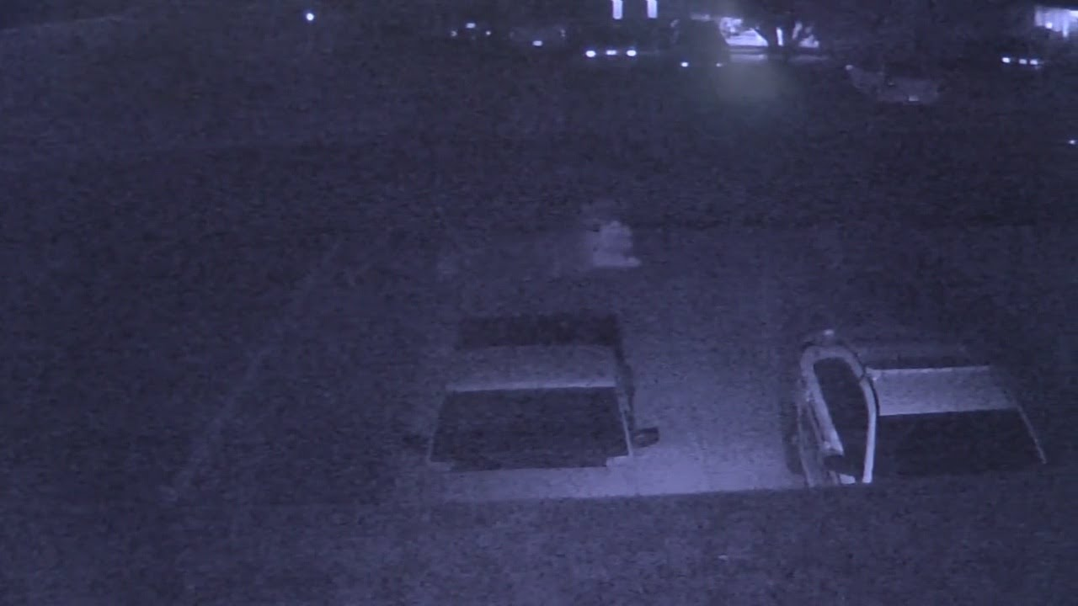

Slide 8
Key Documentation for Successful Prosecution
Clear video
What ever exists
What was taken
Type of Wire
Linear feet
Weight
Damage Totals
Serial Numbers/Owner markings
Time Line
Accurate Dates and Times
Locations
Reliable Witness
Report All Incidents

Slide 9
Recycling Yard Mandates
Regulation Licensing Department
Take a picture of the driver’s license
Take a picture of the silence plate
Not Mandated, but some take a picture of the seller
Not Mandated, Condition of the Wire (New, Clean)
Banned Items
Bad Actors

Slide 10
Case Reference
Offender Mr. Chavez
2018 City Light Poles’ Copper Stripped (over 30k lbs)
Citelum, Sup. Sean Popp
Dates, Times, 5704 L.ft of # 8 = 2,566.8 lbs were taken, the next day 2,560 lbs were sold. Multiple entries. Damage totals. Owner markings
Regulation Licensing Dept. Metal Database
Records of Mr. Chavez’ Sales
Name, Pictures of silence plates, wire, condition, pattern, Vehicle descriptions.
Surveillance
Probable Cause for Search Warrants
Arrest Warrants

Slide 11
Need Your Assistance
Report
Good Witness
Have Evidence Ready
Help gather as much as possible
Video in readable format
Documents
Be Available to Answer Additional Questions
Direct Contact Information/phone numbers
For follow up
For District Attorney (DA will call once)
Share Information CICA (Construction Industry Crime Alliance)
Show up to Court

