Slide 1
2022 PNM Copper Theft Awareness Seminar
Welcome!

Slide 2
Armando Najera
PNM Distribution Standards
Copper Theft Awareness

Slide 3
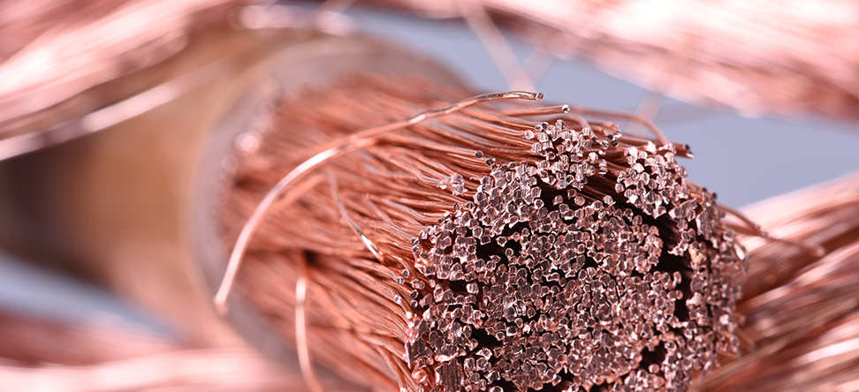
Copper theft prevention – What you need to know to protect your business
PNM Energy solutions webinar series
Prepared by: A. Nájera

Slide 4
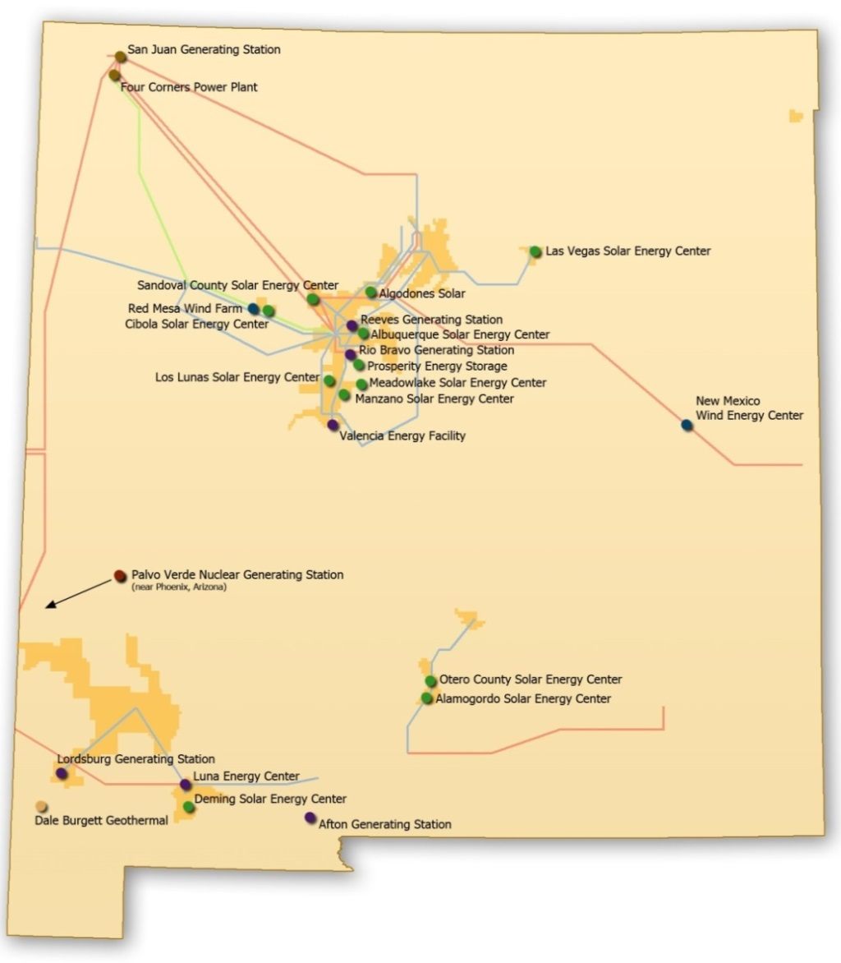
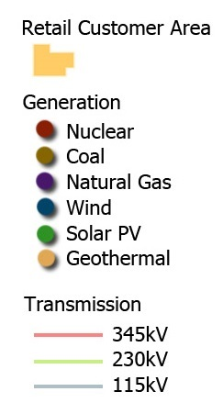
PNM Proudly Serving NEW Mexicans for over 100 years
  530,000 customers in 40 communities
  15,158 miles of transmission and distribution lines
  2,701 MW generation capacity
Prepared by: A. Nájera

Slide 5
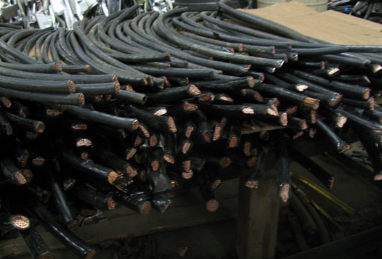
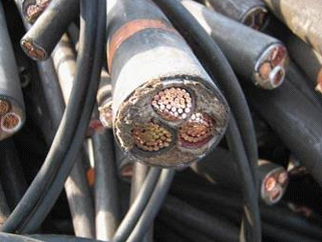
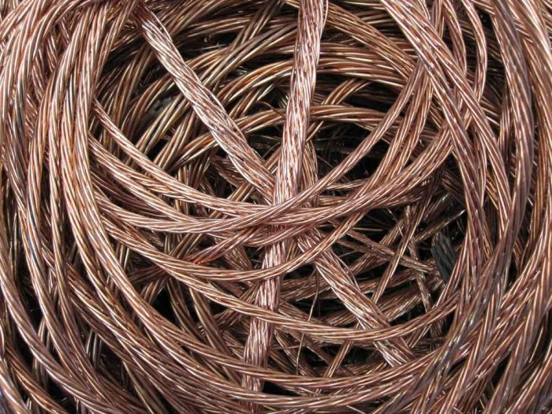
Copper theft affects us all
A look at Copper Theft in NM
55% of all copper theft happens on commercial properties, Still leaving 45% to residential. Making security on both equally as important
The average home contains about 400 pounds of copper.
In recent past, 96% of all metal theft was pure copper
Breaking down as follows: 35% copper pipe, 24% copper wiring, 20% A/C wiring, 8% copper tubing, 6% copper line, 4% copper roofing, 3% copper coil
The U.S. Department of Energy estimates that utility companies lose $1 billion of wire each year to scrap metal theft
Prepared by: A. Nájera
Notes:
TEMPLATE

Slide 6

What you’ll learn……
A basic understanding of the electrical system supplying power to your property,
A basic understanding of the underground layout of wires leading to and from the transformer,
Identify “weak” areas in your property needing to be updated to prevent copper theft,
Learn to look what the thieves are looking for as they pick their target,
Learn what works and what doesn’t work,
Working with PNM towards a common goal
Source: PBS.org
Prepared by: A. Nájera
Notes:
TEMPLATE

Slide 7
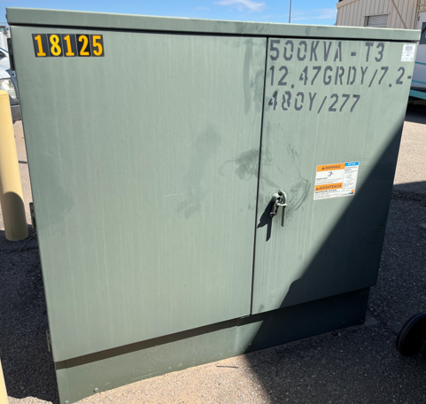
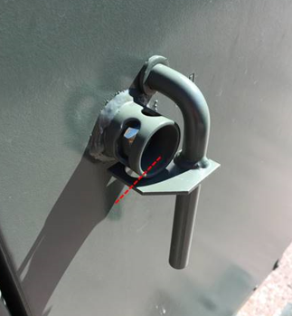
Common PNM electrical equipment
Identifying a transformer (typically where barricades are installed)
kVA listing,
T3, T1, T4 listing,
Black and yellow Station Number
Standard transformer door handle
Tall and rectangular
Prepared by: A. Nájera
Notes:
TEMPLATE

Slide 8
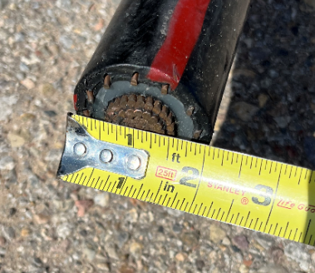
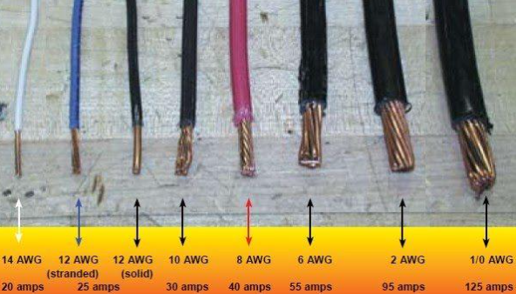
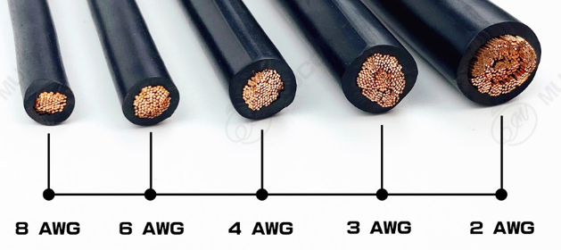
Why copper?
According to the National Insurance Crime Bureau (NICB), copper theft has accounted for a staggering 96 percent of all reported metal thefts in the past three years)
Take for example our 750 kcMil, 15kV Cu,
62 strands of conductor plus 12 strands of concentric neutral = 74 total strands of Cu
Copper is at $3.59 /lbs. or $32.4 ft
$32.4/ft X 100’ x 3 = $9,721 materials only
Prepared by: A. Nájera
Notes:
TEMPLATE

Slide 9
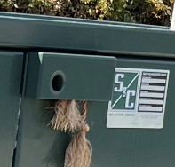
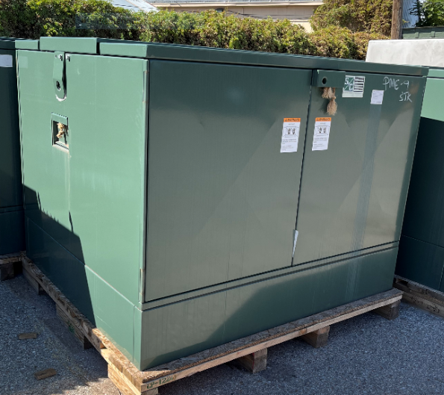
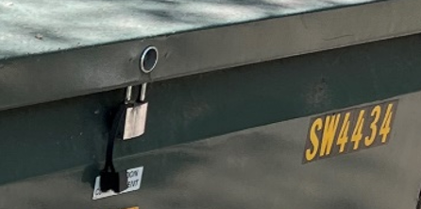
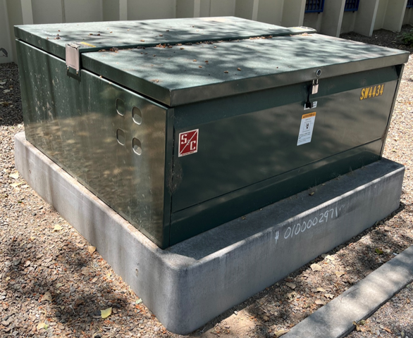
Common PNM electrical equipment
NOT needing barricading
Pad-Mounted Gears
PME’s (deadfront SW)
PMH’s (livefront SW)
Short and square
422 Vista Switchgear
Short and square
Prepared by: A. Nájera
Notes:
TEMPLATE

Slide 10
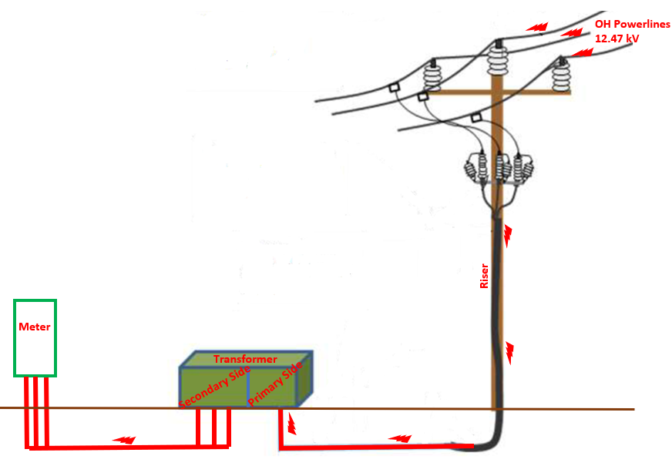
Overhead Configuration, Typical Layout
One of many configurations
Primary Voltage, 12,470 Volts Phase to Phase, 7,200 Volts Phase to ground,
Primary voltage is reduced, end use voltage of 120/240 volts,
A transformer reduces the voltage, for commercial and residential use
Customer’s Responsibility
PNM Responsibility
Prepared by: A. Nájera
Notes:
TEMPLATE

Slide 11
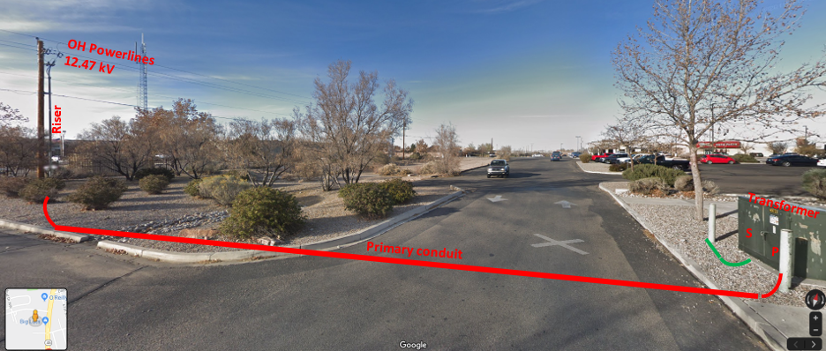
A Real-life example
Primary Voltage, 12,470 Volts Phase to Phase, 7,200 Volts Phase to ground,
Primary voltage is reduced, end use voltage of 120/240 volts,
A transformer reduces the voltage, for commercial and residential use
Prepared by: A. Nájera
Notes:
TEMPLATE

Slide 12
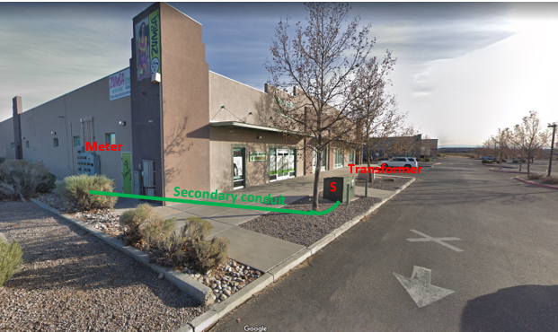
A real-life example (Customer side)
Prepared by: A. Nájera
Notes:
TEMPLATE

Slide 13
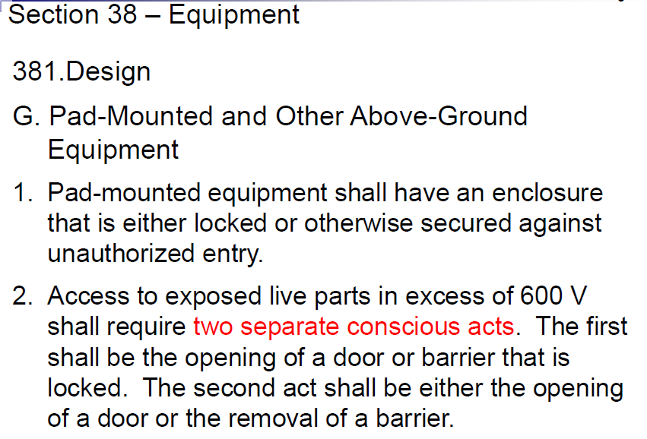
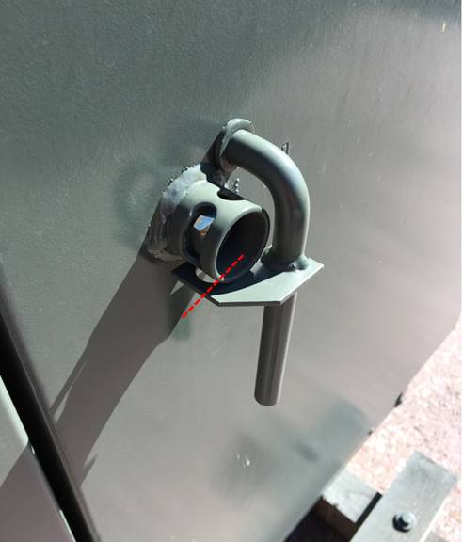
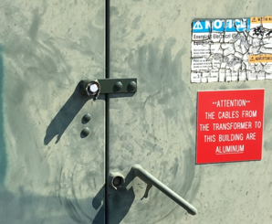
NESC Section 38, Rule 381G 2, Pad-Mounted and Other Above-Ground Equipment
* penta-head bolts and door latch
Note the door latch system of the transformer
Retrofit door latch system for the transformer by PNM
Prepared by: A. Nájera
Notes:
TEMPLATE

Slide 14
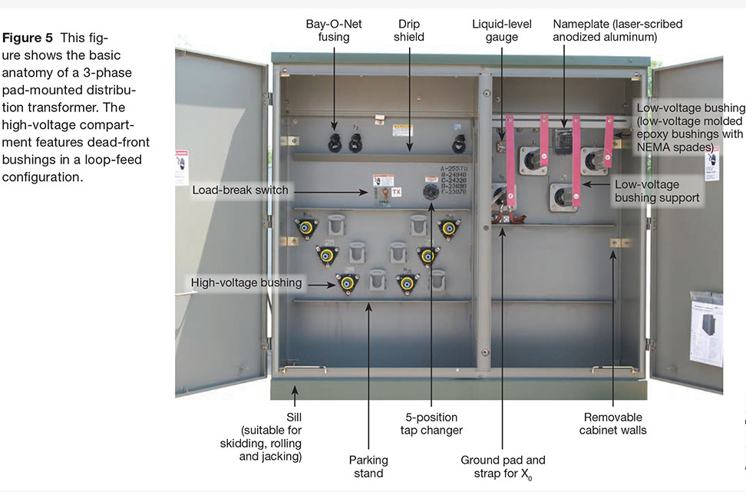
Components of a transformer
A quick look inside a transformer…
PNM Side
Customer Side
Secondary Side
Prepared by: A. Nájera
Notes:
TEMPLATE

Slide 15
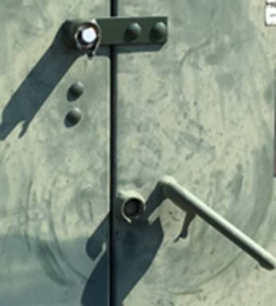
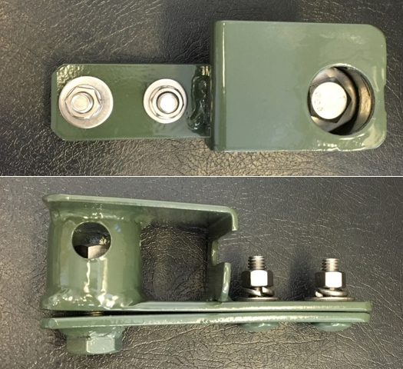
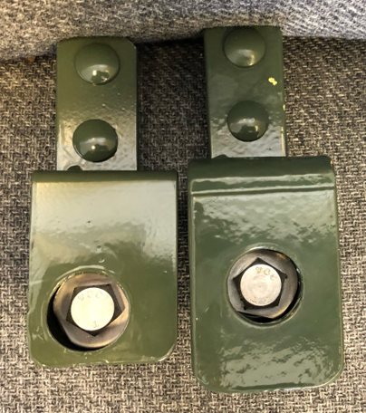
PNM modifying penta-head retrofit lock
Retrofit lock redesign, door latch system of transformer
Existing transformer handle w/ pentahead as delivered by manufacturer
Original retrofit lock system
¾” steel instead of 10 gauge steel or 304 stainless steel
Thicker edges
Wider steel plate
New and improved design
Prepared by: A. Nájera
Notes:
TEMPLATE

Slide 16
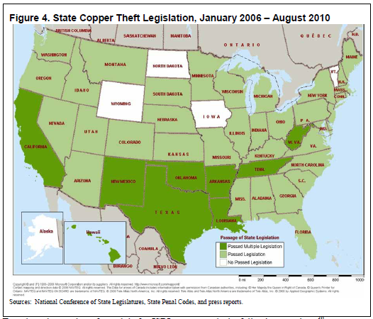
PNM working with state legislation
PNM also actively works with Crime Stoppers
Requiring photo identification for every retail transaction and recording the license plate
Keeping good records so information can be provided on materials
Keeping a list of suspicious materials
When paying cash for a transaction, requiring the seller’s signature on a receipt
Training employees on how to identify suspicious materials.
The latest was House Bill (HB) 69 from the 2022 Legislative Session
Prepared by: A. Nájera
Notes:
TEMPLATE

Slide 17
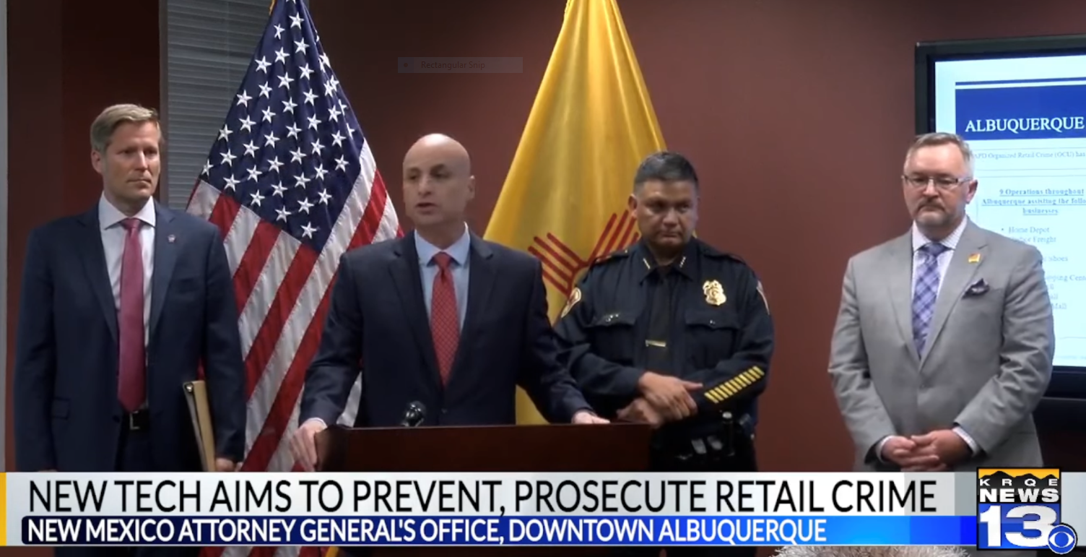
Working together
New Mexico Organized Retail Crime Association
The Software is described as “an online interface used by retailers and law enforcement to track criminal activity and gather data in real time”.
New Mexico Chamber of Commerce raised this type of theft with the Attorney General’s office
Register and find out more information about the New Mexico Organized Retail Crime Association (NMORCA) at www.nmchamber.org/nmorca.
Individuals are asked to register on the website,
Applications are reviewed and verified,
They are then granted access to the online Auror.co platform. On the platform they can share data, security video, pictures, crime descriptions etc. The platform uses AI to start building patterns and links suspects and provides all of that information to law enforcement around the state.
-President & CEO of NMCC, Rob Black
Prepared by: A. Nájera
Notes:
TEMPLATE

Slide 18
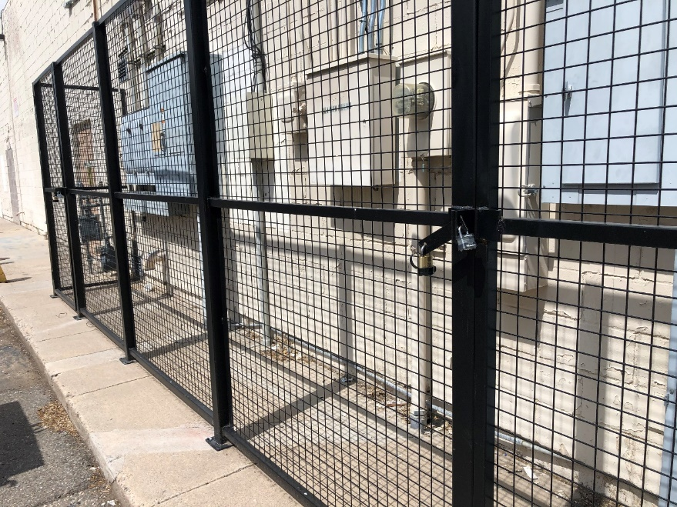
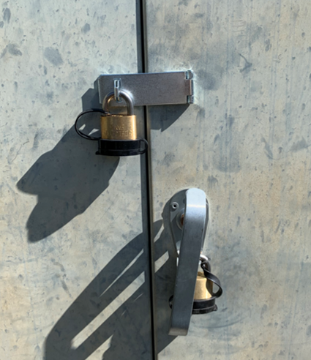
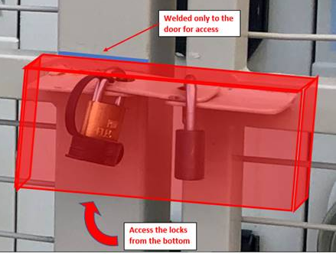
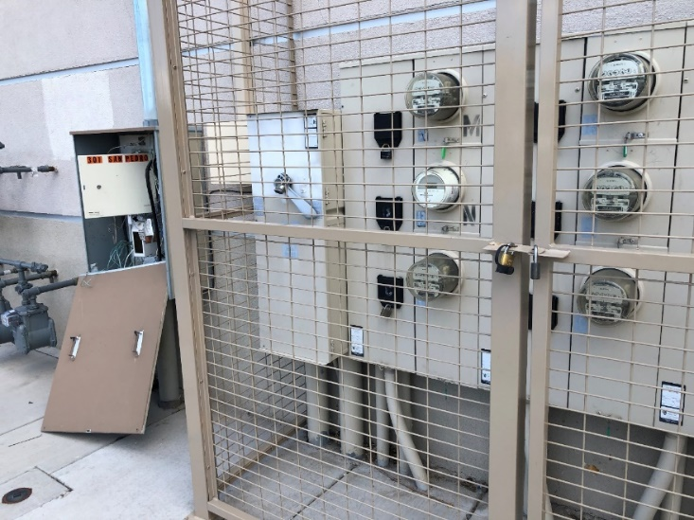

Protecting and securing the meter
Thieves typically break into CT can first to see the conductors and because it’s easier than the transformer
* PNM Meter Dept will install CT can lock and hasp when copper theft occurs.
* Installing a cage around the meter is great, but locks need be protected.
* Please acquire approval from PNM prior to building enclosures.
* Protective cover suggested to protect both locks from being cut
Prepared by: A. Nájera
Notes:
TEMPLATE

Slide 19
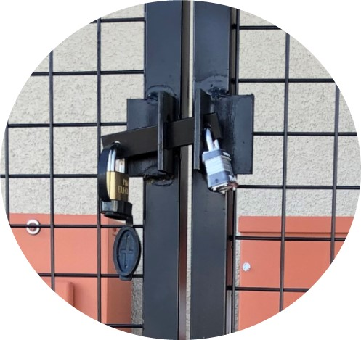
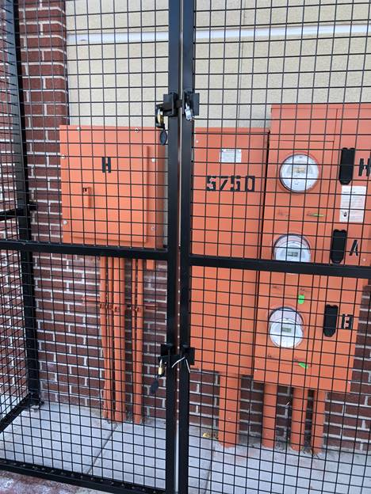
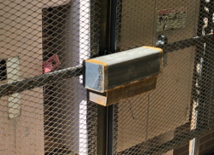
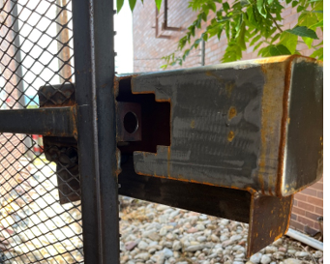
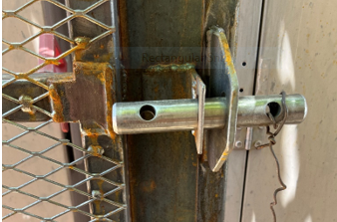
Possible failure modes identified
Sharing of Lessons learned
Prepared by: A. Nájera
Notes:
TEMPLATE

Slide 20
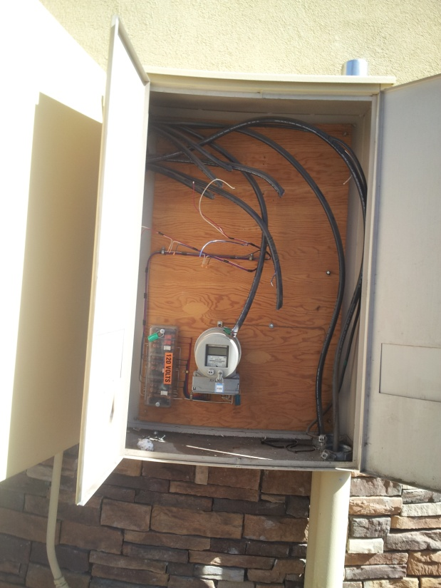
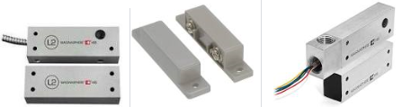
Protecting and securing the meter
Thieves typically break into CT can first to see the conductors and because it’s easier than the transformer
* PNM does not permit high security magnetic contacts to be placed inside the CT can. They can be epoxied on the outer shell though.
* NEC 725.136 Separation from Electric Light, Power, Class 1, Non–Power-Limited Fire Alarm Circuit Conductors, and Medium-Power Network-Powered Broadband Communications Cables.
* The rules for separating the conductors of these power supplies from various other types of conductors are in NEC 725.136;
* Separation from Other Systems, NEC 725.55 Not allowed to house Class 2 or Class 3 circuit conductors in any enclosure, raceway or cable with conductors of power or Class 1 conductors
Within the enclosure
Prepared by: A. Nájera
Notes:
TEMPLATE

Slide 21
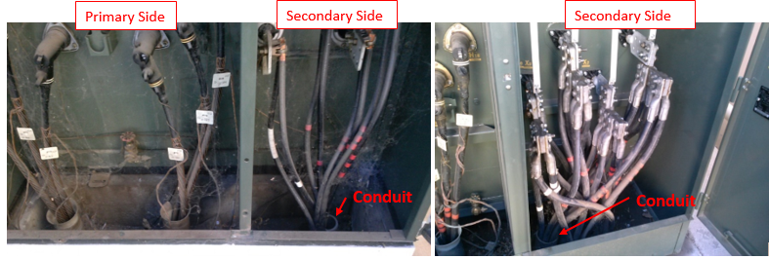
A closer look inside a transformer…
Field examples of the inside of a transformer
PNM Side
Customer Side
A larger volume of aluminum is necessary to conduct the same electricity as copper, so typically you must upsize your conductor two sizes to accommodate the same circuit ampacity
Prepared by: A. Nájera
Notes:
TEMPLATE

Slide 22
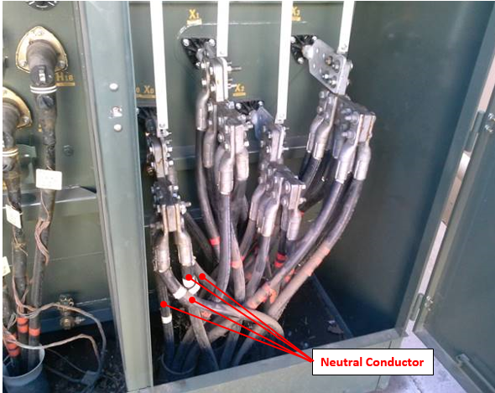
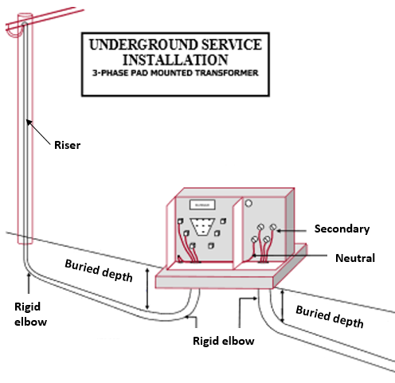
Copper theft modus operandi
Field examples of the inside of a transformer
This is a single conduit, 4 wire 3ф power representation shown; with the fourth conductor (shown in white tape and connected to the HoXo lug) being the fourth wire. The neutral wire is designed to carry residual, unbalanced, or net current back and is the cable that is being stolen.
Prepared by: A. Nájera
Notes:
TEMPLATE

Slide 23
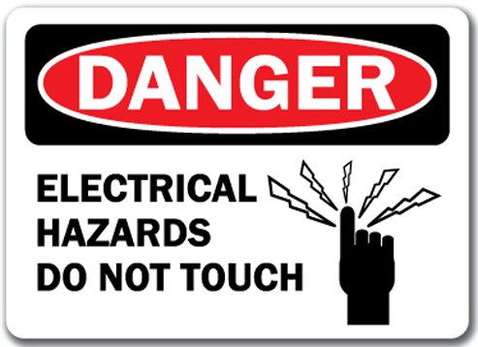
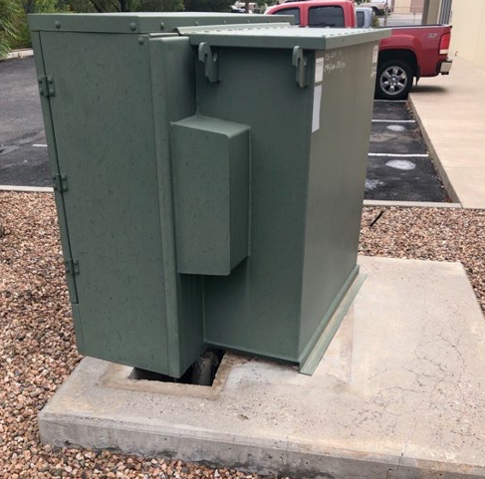
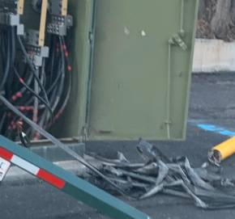
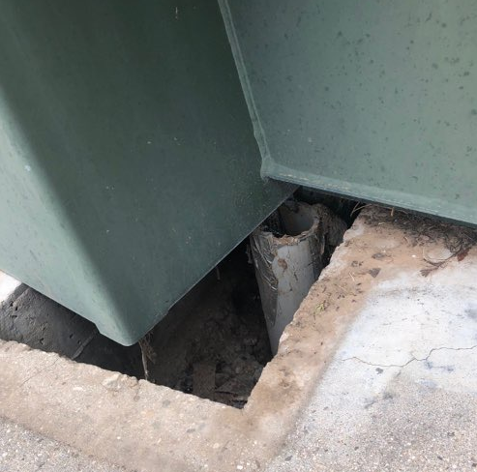
How do you know if you’re a victim of copper theft
Signs to look for
First and foremost, NEVER ever touch a transformer that has been tampered with, it may be energized!
Lights in your business are flickering,
The more you turn on, the more power fluctuations,
Opened electrical panel doors
Seeing debris outside the transformer like stripped jacket cover from conductors or cut copper pieces.
Prepared by: A. Nájera
Notes:
TEMPLATE

Slide 24
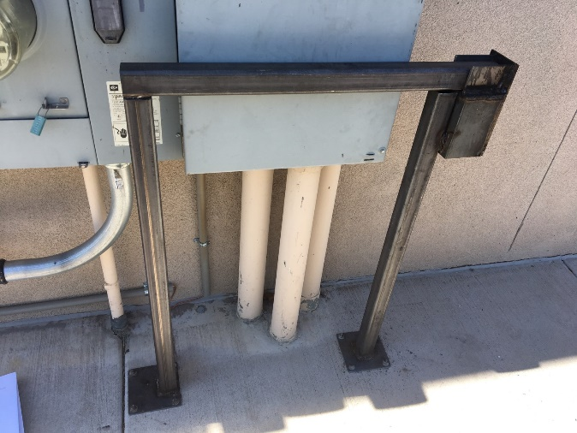
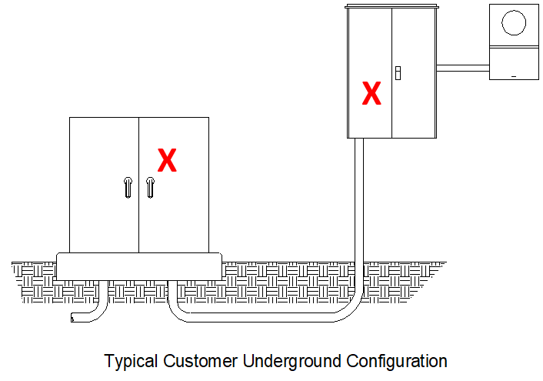
Things to look for, know your risk level
Risk factors increasing chances for becoming a victim of copper theft
Has your site been hit by copper theft before?
Is the property in a less trafficked area, after hours?
Type of building, dentist office, shopping centers,
Is my property well lit, cameras in place?
The longer the secondary conduit distance, the more desirable,
The more conduits, the more likely it’ll be hit (tells the thief there are more than one),
Damaged or compromised transformer / meter box, the more likely it’ll be hit
Prepared by: A. Nájera
Notes:
TEMPLATE

Slide 25
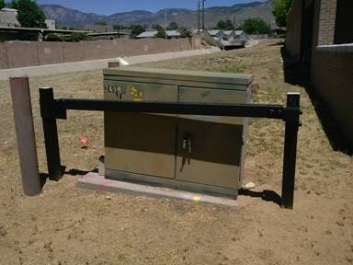
Lessons learned from barricade installation. What’s wrong with this picture?
One of the first barricade to be built Public Library on Juan Tabo NE
This is an example of one of the first barricades to be installed
Barricade Process
Prepared by: A. Nájera
Notes:
TEMPLATE

Slide 26
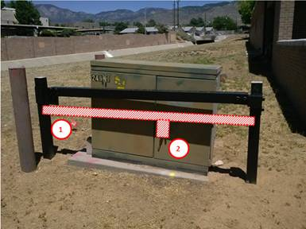
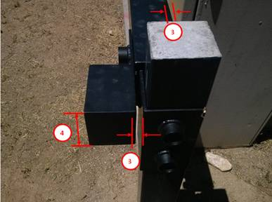

Possible failure modes identified
Sharing of Lessons learned
The barricade should be as close to the center as possible. There have been cases where the doors have been pulled open from the bottom when the barricade is so high up.
There should be a three-sided protection box around the lock to prevent any further cutting of the locks.
Large gaps are a weak point in the design. The closer you can get to the cabinet doors the better and there should not be a gap from the lock insert since in the past there have been cases where thieves cut this very small piece of metal to open the barricade.
Lastly but not least, the depth of the key box is too shallow, again there has been a case where bolt cutters could still fit, open, and able to cut the lock off.
Prepared by: A. Nájera
Notes:
TEMPLATE

Slide 27



Possible failure modes identified
Sharing of Lessons learned
Prepared by: A. Nájera
Notes:
TEMPLATE

Slide 28





Possible failure modes identified
Sharing of Lessons learned
Prepared by: A. Nájera
Notes:
TEMPLATE

Slide 29



Possible failure modes identified – Legacy barricades
Sharing of Lessons learned
Prepared by: A. Nájera
Notes:
TEMPLATE

Slide 30




Possible failure modes identified – Legacy barricades
Getting more daring
Prepared by: A. Nájera
Notes:
TEMPLATE

Slide 31



Padmount transformers
Barricading more than before
Prepared by: A. Nájera
Notes:
TEMPLATE

Slide 32

Lessons learned illustrated
Note: The “Copper replaced with Aluminum” label does not deter
Barricade should be as close to the transformer as possible
Prepared by: A. Nájera
Notes:
TEMPLATE

Slide 33

If you are a victim of copper theft
What needs to happen when a customer has been hit with copper theft
Contact PNM at our main number for Customer Service 246-5700 so that we can then send a trouble truck and make it safe.
The customer then needs to hire an electrician to do the work. That electrician will need to provide a) a copy of liability insurance, b)their EE98J license (journeyman license), and c) a completed “Access to PNM Equipment Form” which can be found at, https://www.pnm.com/energy-and-copper-theft
The customer needs to email all these documents to our general email account: metropermits@pnm.com
Lastly, the customer should follow up with call to ensure that we did indeed receive the information but also to discuss specifics of scheduling needs.
Additionally, I can send you supporting information if you need it.
Prepared by: A. Nájera
Notes:
TEMPLATE

Slide 34




What we don’t want to see.
Violation of NESC code, NEC code, OSHA, and PNM’s Safety Rules
Barricade can’t be removed. PNM Needs to have access
PNM Needs to have access
No welding, cutting, or drilling is permitted
PNM Needs to have access
Prepared by: A. Nájera
Notes:
TEMPLATE

Slide 35





What we don’t want to see.
Unauthorized locks installed on equipment,
Violation of NESC code, NEC code, OSHA, and PNM’s Safety Rules
Non-PNM lock installed, not permitted
No welding, cutting, or drilling is permitted
Prepared by: A. Nájera
Notes:
TEMPLATE

Slide 36


Unfortunately more examples of What we don’t want to see.
Check with us before securing the transformer
Transformer doors need to open past the 90˚ mark so that the door latch can lock, making it safe for linemen to work on the transformer
PNM Needs to have access
Prepared by: A. Nájera
Notes:
TEMPLATE

Slide 37




Thank you for your time
Questions ??
Prepared by: A. Nájera
Notes:
TEMPLATE

Slide 38


Thank you for
attending!
PNM Business Customers
Phone: (888) 245-3659
Hours: Weekdays, 7:30 a.m. to 6 p.m.
Prepared by: A. Nájera
Notes:
TEMPLATE

Slide 39
Jared Roybal
Project Manager Supervisor, Construction & Maintenance
PNM’s Copper Theft Process

Slide 40
How to Report
If you are a business owner and have been a victim of copper theft, there are steps you should take:
Do not touch the transformer, meter, or any wires. Even if there isn’t any arcing or sparking, the wires may still be energized and pose a serious safety hazard.
Contact PNM Customer Service at 1-888-342-5766 and report it.

Slide 41
New Service Delivery (NSD) process
IF YOU NEED THE TRANSFORMER
DE-ENERGIZED
https://www.pnm.com/esg
This will take “Access to PNM Equipment”
Contractor will complete Equipment Access Form
Service Coordinators
Upon submitting access to PNM equipment, you will receive a confirmation # starting with EA-#####. A service coordinator will review documentation (cert of liability insurance,EE98/EE98J Form, photocopy front side of driver’s license)
Communication
Your contractor will be contacted via email and by phone to schedule
New Service Delivery
If you have any questions call
505-241-3425
M-F, 7:30AM – 3:30PM

Slide 42
Nsd process
Equipment access form
PNM considers safety while working on the PNM system to be paramount.
Access into this equipment will be strictly controlled by PNM and shall be opened by authorized PNM personnel only.
Examples of equipment access include: open/close requests, copper theft, and transformer de-energization.
A qualified contractor must make arrangements to gain access into PNM equipment for the purpose of installing conduit or pulling secondary cable. Whenever possible, the equipment will be de-energized prior to access. If the equipment cannot be de-energized, the contractor must make arrangements for an authorized PNM employee to be present as long as the equipment is open. Any unauthorized access into PNM equipment will be considered trespass and will be prosecuted to the fullest extent of the law.

Slide 43
Nsd process
Certification of liability insurance
As a contractor you should have liability insurance in case an accident occurs.
Driver’s License
A photocopy of the contractor's license is needed to prove they are who they say they are, so we can make sure they have their electrical license.
EE98 / EE98J
Your EE98 is your electrical contractor license, and your EE98J is your electrical journeyman license. It is important that whoever is working on our equipment have their license due to safety concerns.

Slide 44
Dispatch / New Service Delivery
Re-connection
Waiver Dispatch
Statement of Fact form can be sent to zz-ElectricDispatch@pnmresources.com after work hours (4:00pm-7am) Monday through Friday and on weekends.
Waiver NSD
Download the Statement of Fact form. This form can be sent to metropermits@pnm.com during regular business hours (7:30am-3:30pm) Monday through Friday. This form must be submitted with a copy of the installer's Driver's License and New Mexico Electrical Journeyman's license
Communication
https://www.pnm.com/esg
New Service Delivery, Service Coordinators
505.241.3425
If inquiring about municipality permit also call # above

Slide 45
Break
We’ll see you in 10 minutes!

