Slide 1
Bill Karr
Acme Iron & Metal

Slide 2
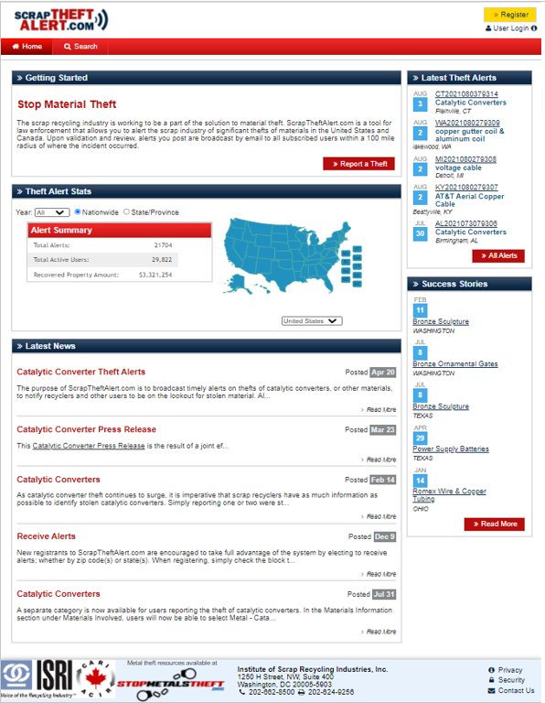
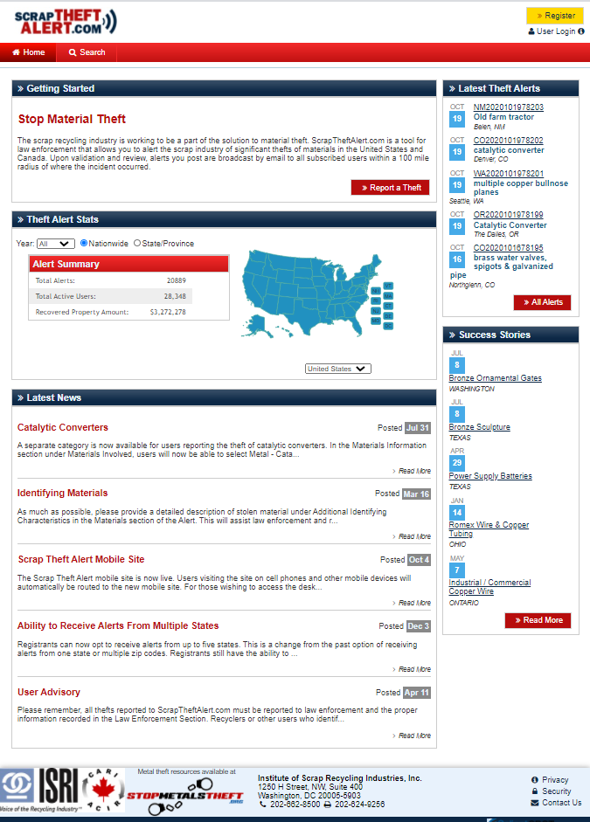
A Proven Tool for Law Enforcement and Industry
FREE and Available to Corporate Security and Other Victims of Materials Theft
Registration Not Required to View Home Page Content

Slide 3
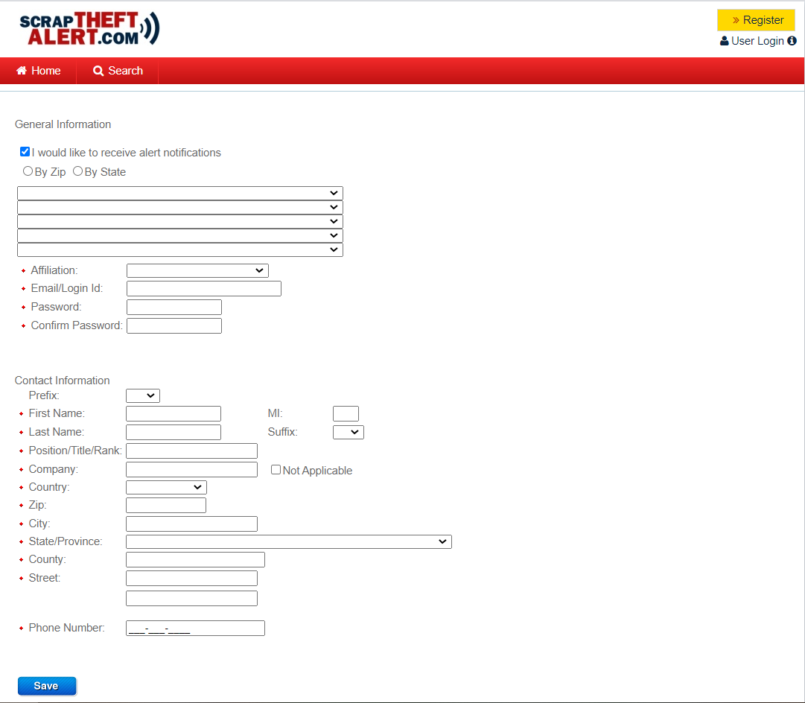
To take full advantage of the site, be sure to check the block to receive alert notifications. You will only receive alerts from the zip code(s) or state(s) you select.
Once registered or after making any changes, be sure to hit the Save button.

Slide 4
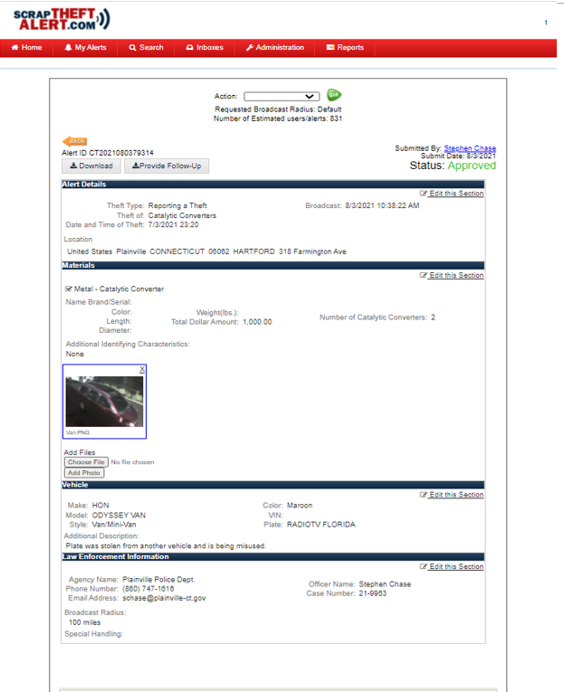
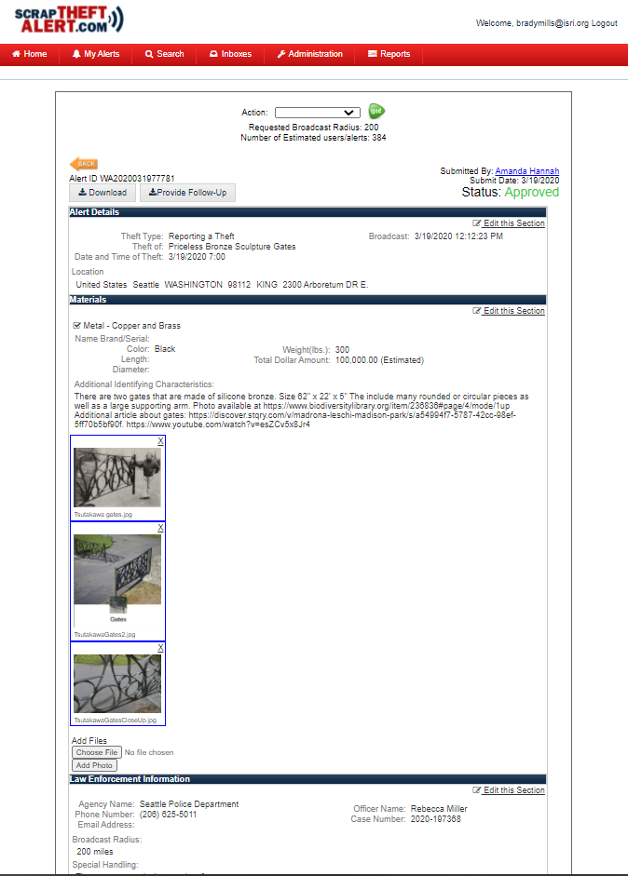
Alert Information
Location, Date & Time
Description of Stolen Item(s)
Upload Photos
Suspect Vehicle Information
Contact Information

Slide 5
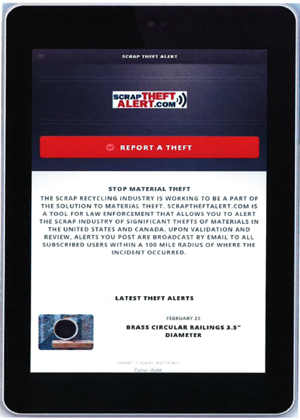
Mobile Site
Users visiting ScrapTheftAlert.com on mobile devices will automatically be routed to the new mobile site. Mobile users can switch over to the desktop site at any time by tapping the View Desktop Site option located on the footer.

Slide 6
ScrapTheftAlert.com
Service Provider on:
Regional Information Sharing Systems (RISS)
April 19, 2017
Law Enforcement Enterprise Portal (LEEP)
July 26, 2017

Slide 7
ISRI Staff Contact:
Brady Mills
Director of Law Enforcement Outreach
Scrap Theft Alert Administrator
202-662-8526
bmills@isri.org

