Slide 1
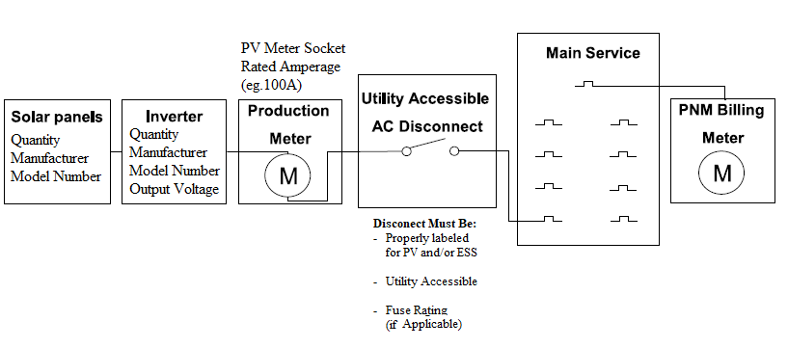
One Line Diagram:
Back-Fed Breaker
REQUIRED FEATURES
Site Address (must match application)
STC Calculation box which contains the number of Modules and Inverters. If Energy Storage is applicable, the info box must include its output and mode of
operation
All equipment labelled with callouts, not in a legend, in correct order, and disconnect between inverter and interconnection point
If you are submitting an Expansion, please clearly label the equipment as New or Existing. Please also make this distinction in the Info box
Equipment Quantity, Manufacturer, and model number
Inverter output Voltage
Production Meter Socket rated amperage (i.e 100A or 200A if system greater than 10kW AC) Note: neutrals cannot be bonded
All ESS must have UL9540 listing
Info Box
Module(s): Quantity, Manufacturer, Model Number Inverter(s): Quantity, Manufacturer, Model Number *Calculations not required.
(If Applicable) Storage: Quantity, Manufacturer, Model Number CEC Certified Mode of Operation: i.e., Backup
505 Camino de Solar Albuquerque, NM 87111
Components and connections shown are for illustrative purposes only
1. This illustrative sketch is not intended to specify utility interconnection or safety requirements.
2. PNM may request additional information if determined it is needed during the screening process.
3. This illustrative sketch is not intended to provide electrical design or code compliance directives.
4. Some components and connections shown may be internal to the inverter. The manufacturer and model number of the inverter must be shown on the drawing.
5. All switches, fuses, and mechanical interlock mechanisms which are part of the operating scheme to isolate the customers generating equipment from the utility during emergency
or maintenance conditions must be shown on the single-line diagram.
6. The narrative description accompanying the single line interconnection diagram must contain sufficient detail to determine if the components in, and the operation of, the
interconnection and protection systems meet the utility’s interconnection and safety standards.
Helpful Features
Voltage at point of Interconnection must match inverter output
If including a Generator or EV charger an NSD application must be submitted

Slide 2
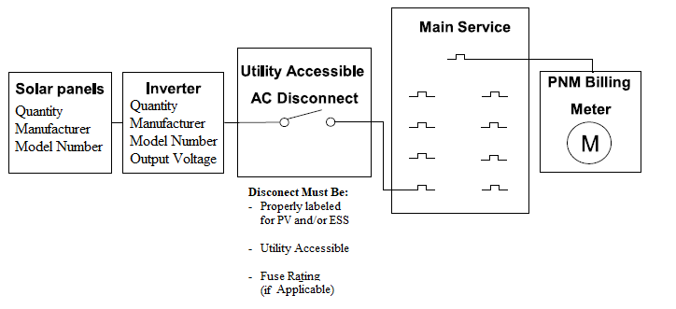
One Line Diagram:
Back-Fed Breaker
For systems at or under 10kW AC
REQUIRED FEATURES
Site Address (must match application)
STC Calculation box which contains the number of Modules and Inverters. If Energy Storage is applicable, the info box must include its output and mode of
operation
All equipment labelled with callouts, not in a legend, in correct order, and disconnect between inverter and interconnection point
If you are submitting an Expansion, please clearly label the equipment as New or Existing. Please also make this distinction in the Info box
Equipment Quantity, Manufacturer, and model number
Inverter output Voltage
All ESS must have UL9540 listing
Info Box
Module(s): Quantity, Manufacturer, Model Number Inverter(s): Quantity, Manufacturer, Model Number *Calculations not required.
(If Applicable) Storage: Quantity, Manufacturer, Model Number CEC Certified Mode of Operation: i.e., Backup
505 Camino de Solar Albuquerque, NM 87111
Helpful Features
Voltage at point of Interconnection must match inverter output
If including a Generator or EV charger an NSD application must be submitted
Components and connections shown are for illustrative purposes only
1. This illustrative sketch is not intended to specify utility interconnection or safety requirements.
2. PNM may request additional information if determined it is needed during the screening process.
3. This illustrative sketch is not intended to provide electrical design or code compliance directives.
4. Some components and connections shown may be internal to the inverter. The manufacturer and model number of the inverter must be shown on the drawing.
5. All switches, fuses, and mechanical interlock mechanisms which are part of the operating scheme to isolate the customers generating equipment from the utility during emergency
or maintenance conditions must be shown on the single-line diagram.
6. The narrative description accompanying the single line interconnection diagram must contain sufficient detail to determine if the components in, and the operation of, the
interconnection and protection systems meet the utility’s interconnection and safety standards.

Slide 3
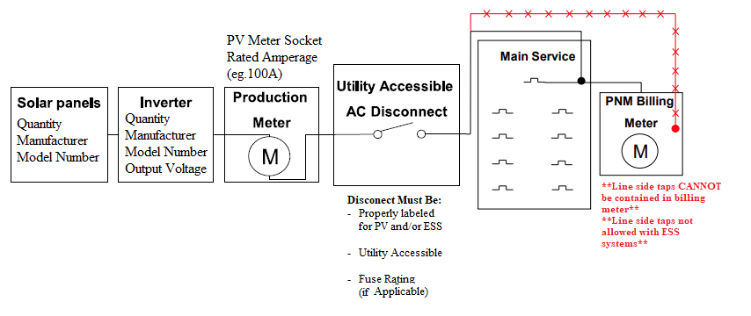
One Line Diagram:
Line Side Tap
REQUIRED FEATURES
Site Address (must match application)
STC Calculation box which contains the number of Modules and Inverters. If Energy Storage is applicable, the info box must include its output and mode of
operation
All equipment labelled with callouts, not in a legend, in correct order, and disconnect between inverter and interconnection point.
If you are submitting an Expansion, please clearly label the equipment as New or Existing. Please also make this distinction in the Info box
Equipment Quantity, Manufacturer, and model number
Inverter output Voltage
Production Meter Socket rated amperage (i.e 100A or 200A if system greater than 10kW AC) Note: neutrals cannot be bonded
Info Box
Module(s): Quantity, Manufacturer, Model Number Inverter(s): Quantity, Manufacturer, Model Number *Calculations not required. *Line side taps not allowed with ESS systems
505 Camino de Solar Albuquerque, NM 87111
Components and connections shown are for illustrative purposes only
1. This illustrative sketch is not intended to specify utility interconnection or safety requirements.
2. PNM may request additional information if determined it is needed during the screening process.
3. This illustrative sketch is not intended to provide electrical design or code compliance directives.
4. Some components and connections shown may be internal to the inverter. The manufacturer and model number of the inverter must be shown on the drawing.
5. All switches, fuses, and mechanical interlock mechanisms which are part of the operating scheme to isolate the customers generating equipment from the utility during emergency
or maintenance conditions must be shown on the single-line diagram.
6. The narrative description accompanying the single line interconnection diagram must contain sufficient detail to determine if the components in, and the operation of, the
interconnection and protection systems meet the utility’s interconnection and safety standards.
Helpful Features
Voltage at point of Interconnection must match inverter output
If including a Generator or EV charger an NSD application must be submitted

Slide 4
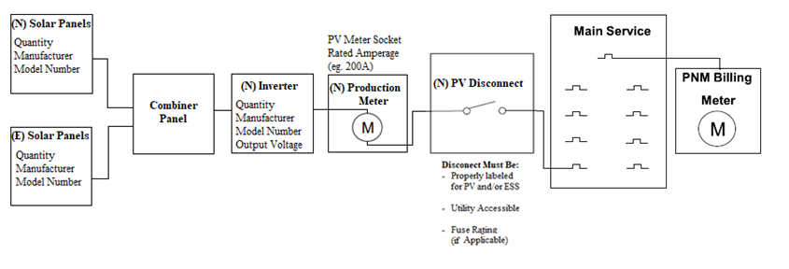
One Line Diagram:
An Expansion example
REQUIRED FEATURES
Site Address (must match application)
STC Calculation box which contains the number of Modules and Inverters. If Energy Storage is applicable, the info box must include its output and mode of
operation
All equipment labelled with callouts, not in a legend, in correct order, and disconnect between inverter and interconnection point
If you are submitting an Expansion, please clearly label the equipment as New or Existing. Please also make this distinction in the Info box
Equipment Quantity, Manufacturer, and model number
Inverter output Voltage
Production Meter Socket rated amperage (i.e 100A or 200A if system greater than 10kW AC) Note: neutrals cannot be bonded
All ESS must have UL9540 listing
Info Box
Existing (E) Module(s): Quantity, Manufacturer, Model Number Inverter(s): Quantity, Manufacturer, Model Number New (N) Module(s) Quantity, Manufacturer, Model Number Inverter(s): Quantity, Manufacturer, Model Number *Calculations not required. *Line side taps not allowed with ESS systems
(If Applicable) Storage: Quantity, Manufacturer, Model Number Mode of Operation: i.e., Backup
505 Camino de Solar Albuquerque, NM 87111
Helpful Features
Voltage at point of Interconnection must match inverter output
If including a Generator or EV charger an NSD application must be submitted

Slide 5
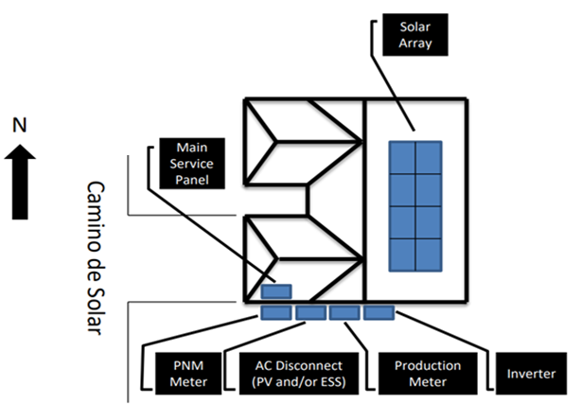
SITE MAP
REQUIRED FEATURES
Site Address (must match application).
See Info Box which must contain the quantity of Modules and Inverters as well as their make & model number. If you are installing Energy Storage; the Info Box must include its make & model number, and mode of operation.
Location and name of closest street.
Compass Rose.
Please keep all required items on a single page.
All equipment labelled with arrow callouts (not in a legend).
Fully illustrate the solar array distinguishing each panel.
If you are installing a production meter, (see Variance info box) make sure all requirements are met or a Variance will be necessary.
PV Disconnect(s) must be outside, accessible to the utility, in line of sight, and within 5’ of the Utility Meter or a Variance will be required.
ESS Disconnect(s) (if applicable) must be outside, accessible to the utility, in line of sight, and within 10’ or a Variance will be required.
If you are submitting an Expansion, please see the additional requirements on the Site Map Required Features.
Info Box
Module(s): Quantity, Manufacturer, Model Number Inverter(s): Quantity, Manufacturer, Model Number *Calculations not required.
(If Applicable) Storage: Quantity, Manufacturer, Model Number Mode of Operation: i.e., Backup
505 Camino de Solar
Albuquerque, NM 87111
Variance Info Box (If installing a Production Meter)
☐ Must be within 5' of the Utility Meter
☐ Must be on the same plane and in line of sight
☐ No visible obstructions between the Production Meter and the Utility Meter i.e., a Fence
Production meter (if applicable) and
Utility meter are within 5 ft
Note: PNM may request additional information if
determined it is needed during the screening process

Slide 6
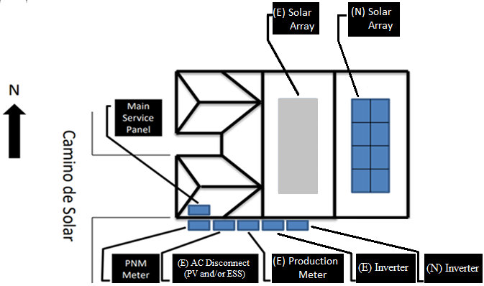
Info Box
Existing (E) Module(s): Quantity, Manufacturer, Model Number Inverter(s): Quantity, Manufacturer, Model Number New (N) Module(s) Quantity, Manufacturer, Model Number Inverter(s): Quantity, Manufacturer, Model Number *Calculations not required.
(If Applicable) Storage: Quantity, Manufacturer, Model Number Mode of Operation: i.e., Backup
SITE MAP
EXPANSION
EXPANSION REQUIRED FEATURES
(These are in Addition to the Required Features on new applications)
See Info Box which must distinguish between Existing (E) and New (N) systems. Must contain both new and existing quantity of Modules and Inverters as well as their make & model number. If you are installing Energy Storage; the Info Box must include its make & model number, and mode of operation.
All equipment clearly labelled as Existing (E) or New (N) on the arrow callouts.
Fully illustrate the new solar array distinguishing each panel.
If you are replacing your production meter, (see Variance info box) make sure all requirements are met or a Variance will be necessary. Expansions have the same variance requirements.
505 Camino de Solar
Albuquerque, NM 87111
Note: PNM may request additional information if
determined it is needed during the screening process
Production meter (if applicable) and
Utility meter are within 5 ft

Slide 7
Future Information
• For 3-phase systems Three Line Diagram is required
• A Three-line diagram may be requested be reviewers as deemed necessary.
• For Large (>10 kWac) and/or 3-phase systems:
• Please include reference to PNM Meter Standard
• Production meter Socket must be rated at least 200A
• For Battery Backup or Energy Storage Systems, please refer
to PNM Interconnection and Safety Standards
• Service upgrade may be required for line side tap
• All diagrams are evaluated to ensure compliance with PNM metering and Interconnection and Safety Standards. This evaluation does not imply NEC compliance.
• For Interconnection and Safety Standards, please visit
• https://www.pnm.com/interconnecting-small-facilities
• https://www.pnm.com/interconnecting-large-facilities

